Slide 1

2022 Multilevel Intervention Training Institute
January 27, 2022

Slide 2

Introduction and Welcome
Erica S. Breslau, Ph.D. National Cancer Institute

Slide 3

Overview and Importance of Theory in Multilevel Research
Sarah Birken, Ph.D.
Wake Forest School of Medicine

Slide 4
Overview and importance of theory in multilevel research
Sarah A. Birken, PhD
Associate Professor (Incoming)
Department of Implementation Science
Wake Forest School of Medicine
Notes:
Thanks so much for having me today. I’m currently at UNC-CH but will be transitioning to Wake Forest’s SOM’s Dept of IS in a couple of short months!

Slide 5

Roadmap
Theory overview Theory for multilevel research Case example Conclusions & resources
Theory overview
What is theory?
Why is theory important?
How do I select theory?
How do I apply theory?
Theory for multilevel research
Case example
Conclusions and resources
Notes:
I imagine that there’s some variation in participants’ familiarity and comfort with theory, so I’m going ot start with an overview of theory – not related to MLR, but just in general – why it’s so important, not as an ivory tower exercise but as a really powerful, practical tool for research and for practice. I’m not going to spend a ton of time on the overview, but I want to make sure that we’re all starting from the same place. Then I’ll talk specifically about the importance in MLR. I’m going to spend most of my time walking you through an example of some multilevel work that my PhD student Soo Hwang is currently working on. Then I’ll end with some closing thoughts and hopefully helpful resources.

Slide 6
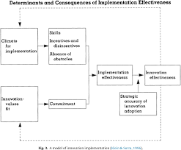
What is theory?
Theory overview Theory for multilevel research Case example Conclusions & resources
“…A set of analytical principles or statements designed to structure our observation, understanding and explanation of the world...” (Wacker, 1998)
Proposes causal relationships among included constructs
In a nutshell, theory answers why or how.
Notes:
I’d like to start by distinguishing theory from models and frameworks. Models and frameworks identify WHAT influences an outcome. Theory explains how or why constructs influence the outcome or each other. [read first two points] That doesn’t’ make models or frameworks bad, or inferior to theories, but it’s an important distinction for reasons I’ll get to in a moment.

Slide 7

What is theory NOT?
Theory overview Theory for multilevel research Case example Conclusions & resources
An idea
A hypothesis
Evidence (e.g., citations)
Notes:
Theories are not off-hand ideas, as often used colloquially, and hypotheses aren’t theories – they should be driven by theory, as in, “Klein and Sorra’s theory of implementation proposes that implementation climate influences implementation success, so we hypothesize that financial incentives increased vaccinations.”

Slide 8
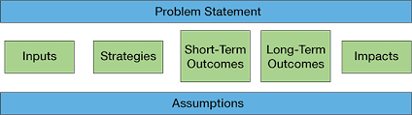
What is theory NOT?, cont’d.
Theory overview Theory for multilevel research Case example Conclusions & resources
A framework is “a structure, overview, outline, system or plan consisting of various descriptive categories, e.g. concepts, constructs or variables…that are presumed to account for a phenomenon” (Nilsen, 2015, p2).
Conceptual
Theoretical
A model is a representation of a phenomenon.
Notes:
Again, theories aren’t better than frameworks or models, but they’re different. Frameworks identify what influences an outcome; models represent what we think is happening. In contrast, a theory explains why or how we think things are happening. That’s important for selecting strategies; understanding how, why, mechanisms. Understanding mechanisms is critical because it can help us to uncover the core functions of an intervention –i.e., how it achieves its outcome. This allows us to adapt the intervention without compromising its effectiveness by ensuring that core functions – i.e., the mechanisms by which it achieves outcomes – are undisturbed.

Slide 9

Why is theory important?
Theory overview Theory for multilevel research Case example Conclusions & resources
Theory gives meaning and explanation to relevant events, supports new insights and problem-solving
Theory helps guide every part of the research process. It helps shape the questions you ask, where you look for answers and the implications you draw from your results (Lipsky).
Notes:
Last point is important. This is where I’m trying to convince you that theory is not an ivory tower exercise; it’s a practical tool to help you ask questions, point you in the direction of answers, and helps you to put your results into relief with respect to what’s already known about the topic.

Slide 10
What can theories, models, and frameworks (TMFs) do?
Theory overview Theory for multilevel research Case example Conclusions & resources
Identify key constructs
Inform data collection
Guide (implementation) planning
Enhance conceptual clarity
Specify processes
Frame evaluation
Inform data analysis
Guide strategy selection
Specify outcomes
Clarify terminology
Convey study’s larger context
Hypothesize relationships
And more!
Birken et al. (2017)
Notes:
Here’s a list of some of the things that theories, models and frameworks can do. I’ll highlight just a couple of things here: identify key constructs – gives you a lens (give example of differential diagnosis); inform data collection (interviews; what variables to include in the pull); analysis (coding); convey study’s larger context: extrapolating to other settings and populaitons (to some extent, there are things that we can generalize about).

Slide 11

How do I choose a TMF?
Theory overview Theory for multilevel research Case example Conclusions & resources
Familiarity
Uniqueness
Approval
Disciplinary origins
Birken et al. (2018)
Notes:
I’ve done some work to develop a tool to help people choose a theory. Unfortunately, the tool doesn’t help to identify a theory; it only helps people choose from among candidate theories and evaluate their relevance for a project. But here are some things that it encourages you to consider:

Slide 12

How do I choose a TMF?
Theory overview Theory for multilevel research Case example Conclusions & resources
Usability
Inclusion of change strategies/techniques
Process guidance
Inclusion of a diagrammatic representation
Simplicity/parsimony
Description of a change process
Accessibility
Birken et al. (2018)

Slide 13

How do I choose a TMF?
Theory overview Theory for multilevel research Case example Conclusions & resources
Testability
Degree of specificity
Specificity of a causal relationship among constructs
Falsifiability
Explanatory power/testability
Fecundity
Logical consistency/plausibility
Empirical support
Birken et al. (2018)

Slide 14

How do I choose a TMF?
Theory overview Theory for multilevel research Case example Conclusions & resources
Applicability
Outcome of interest
Associated research method
Analytic level
Application to a specific setting
Generalizability
Birken et al. (2018)

Slide 15
How do I apply a TMF?
Theory overview Theory for multilevel research Case example Conclusions & resources
Selecting and specifying key variables
Selecting the study design
Deciding the sampling strategy
Developing study materials
Collecting and analyzing data
Reporting findings
Atkins et al. (2017)
Notes:
And once you’ve selected a theory, you should use it this way [read slide]. Atkins’s TDF paper; Note CFIR paper and RE-AIM effort; will go through point by point in the case example

Slide 16
TMFs in multilevel research

Slide 17
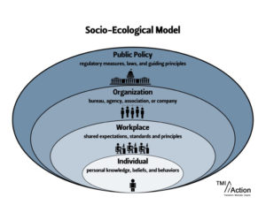
Theory overview Theory for multilevel research Case example Conclusions & resources
Notes:
You’ve seen lots of versions of this

Slide 18
The problem
Theory overview Theory for multilevel research Case example Conclusions & resources
TMFs often only target one level.
TMFs that address multiple levels often don’t do so well, and they often don’t explain interactions among levels.
Notes:
[First point] And when they do target multiple levels, they’re generally frameworks and models that don’t explain how, for example, individual perspectives on the extent to which intervention use is rewarded, supported and expected in an organization contribute to a collective-level implementation climate

Slide 19
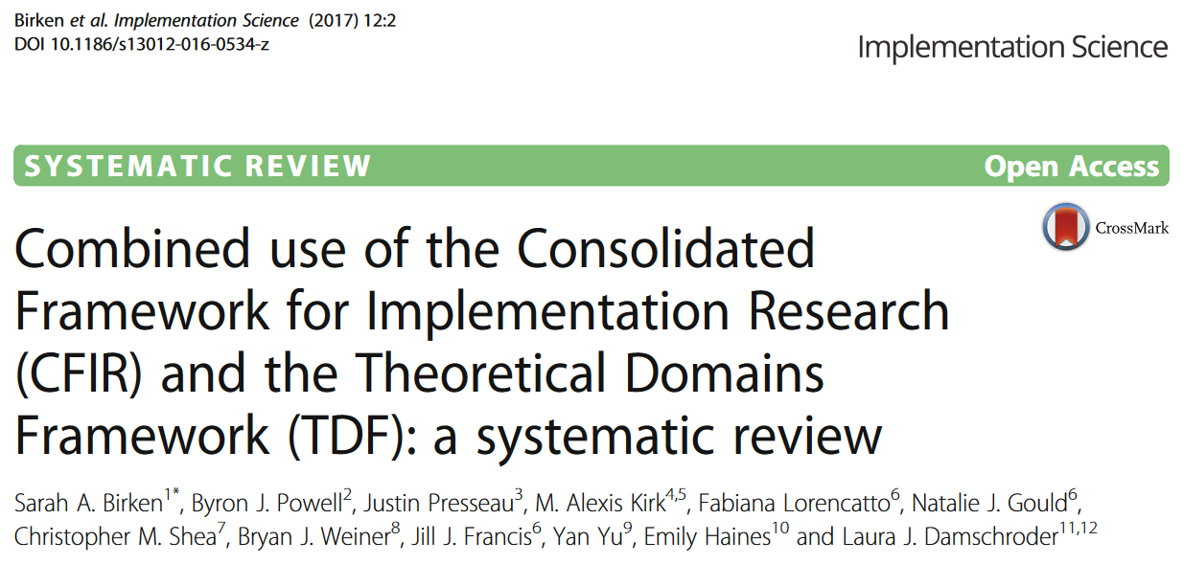
The solution(?)
Theory overview Theory for multilevel research Case example Conclusions & resources
Notes:
My colleagues and I have attempted to do some work to promote the combined use of frameworks to address multiple levels. The big caveat is that, to the extent that we’re relying on conceptual frameworks – as opposed to theories, our ability to leverage results for developing strategies is limited

Slide 20
Multilevel determinants of guideline-concordant active surveillance follow-up care for low-risk prostate cancer
Theory overview Theory for multilevel research Case example Conclusions & resources
Ariel Sooyhun (Soo) Hwang, MPH, CHES, PhD(c)
Dissertation Chair: Sarah Birken
Members: Jennifer Elston Lafata; Cleo Samuel; Ray Tan; Justin Trogdon

Slide 21
Background
Theory overview Theory for multilevel research Case example Conclusions & resources
Prostate cancer is the most frequently diagnosed cancer among men in the U.S.
For low-risk localized prostate cancer, the American Society of Clinical Oncology endorses active surveillance (AS).
AS follow-up care is often guideline-discordant.
Determinants of AS follow-up care lie at multiple levels.
Notes:
Racial disparities
Providers have an approach to care or beliefs about a particular way being optimal
But also there are dynamics within cancer programs and outside cancer programs that likely influence AS care, like whether the cancer program has an academic affiliation

Slide 22
Aims
Theory overview Theory for multilevel research Case example Conclusions & resources
Aim 1. Explore determinants of urologists’ active surveillance follow-up protocol prescriptions.
Aim 2. Identify determinants of guideline-concordant AS follow-up care among patients with low-risk localized prostate cancer.
Notes:
Aim 1: provider and org
So you can see that we have pt-level dets; provider-level dets; and collective-level dets of guideline-concordant AS FU care
Soo has a tricky task of conceptualizing multilevel determinants of AS fu care. That meant that she needed to conceptualize patients’ use of care; provider behavior, and organizational detemrinants of AS follow up care.

Slide 23
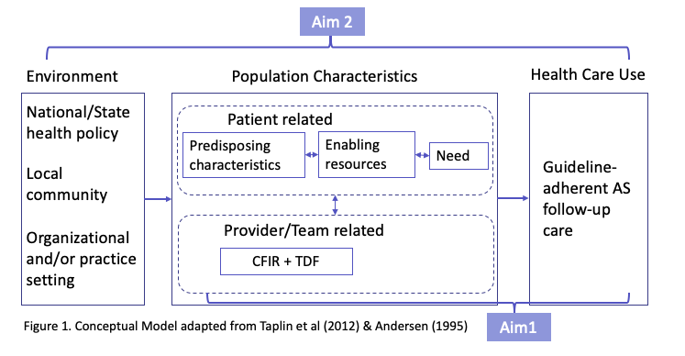
Conceptual framework
Theory overview Theory for multilevel research Case example Conclusions & resources
Notes:
I want to begin by orienting you to the way that Soo is conceptualizing pt-level determinants: Andersen’s. Starting on right – healthcare use of AS follow-up care is influenced by (looking at the top-middle patient-related factors: predisposing, enabling, need). Zapka and taplin broadens our view to think about environmental factors (on the far left) in addition to patient and provider factors; and then, focusing on the provider and team, and org/practice setting, CFIR identifies collective-level determinants of provider AS FU Rx, and TDF identifies individual-level determinants. CFIR (5 domains); TDF (33 psych theories). Now I’m going to show you how Soo is weaving these throughout her work. They’re all tools that inform data collection, analysis, and interpretation

Slide 24
Conceptual framework
Theory overview Theory for multilevel research Case example Conclusions & resources
Notes:
I want to begin by orienting you to the way that Soo is conceptualizing pt-level determinants: Andersen’s. Starting on right – healthcare use of AS follow-up care is influenced by (looking at the top-middle patient-related factors: predisposing, enabling, need). Zapka and taplin broadens our view to think about environmental factors (on the far left) in addition to patient and provider factors; and then, focusing on the provider and team, and org/practice setting, CFIR identifies collective-level determinants of provider AS FU Rx, and TDF identifies individual-level determinants. CFIR (5 domains); TDF (33 psych theories). Now I’m going to show you how Soo is weaving these throughout her work. They’re all tools that inform data collection, analysis, and interpretation

Slide 25
Selecting and specifying key variables
Theory overview Theory for multilevel research Case example Conclusions & resources
AS follow-up (outcome)
Determinants
Individual patient (Andersen’s Behavioral Model)
Individual provider (TDF)
Team (TDF/CFIR)
Organizational (CFIR)
Policy (CFIR)
Notes:
CT imaging is a multilevel intervention, as it turns out

Slide 26
Selecting the study design
Theory overview Theory for multilevel research Case example Conclusions & resources
Aim 1. Explore determinants of urologists’ active surveillance follow-up protocol prescriptions. Guided by the consolidated framework for implementation research (CFIR) and the theoretical domains framework (TDF), which allows for the identification of determinants at multiple levels, I will conduct semi-structured interviews with urologists from multiple institutions to examine determinants of urologists’ AS follow-up care protocol prescriptions.
Aim 2. Identify determinants of guideline-discordant AS follow-up care among patients with low-risk localized prostate cancer. I will use data from Surveillance, Epidemiology and End Results (SEER)-Medicare at NCI. Using the NCCN follow-up guideline as a standard, I will examine the association between patient factors (race/ethnicity, type of institution, and comorbidities) and guideline concordance. I will triangulate findings from the quantitative study with qualitative data from semi-structured patient interviews with patients who received active surveillance for low-risk prostate cancer.
Descriptive
Quasi experiment
Mixed method
Notes:
Of note, looking at association implies relationships among variables, so implicit or explicit bias underlying race-ethnicity to explain why disparities arise

Slide 27
Deciding the sampling strategy
Theory overview Theory for multilevel research Case example Conclusions & resources
“Recruitment of patients will be based on several criteria: 1) male age above 55, 2) diagnosed with prostate cancer, 3) who had undergone active surveillance. To the extent possible, I will purposively recruit patients that are diverse in terms of age, race/ethnicity (non-Hispanic white, non-Hispanic black, Hispanic) and the number of years since initial diagnosis of prostate cancer.”
Andersen’s Behavioral Model
Need
Predisposing characteristics
Enabling resources
“I will start with the purposive sampling method by selecting the initial group of urologists to maximize variation with respect to cancer program location (areas with larger diverse population), size and type (e.g., academic; community; accreditation by organizations such as Commission on Cancer) given that these organizational characteristics may be associated with different level of resources, perceived needs, and peer pressure”
CFIR+TDF

Slide 28

Developing study materials
Theory overview Theory for multilevel research Case example Conclusions & resources
“The interviews will be guided by the CFIR +TDF to identify multilevel determinants of urologists’ prescription of AS follow-up care protocols per the conceptual model described above. The interview guide will be developed based on the process of mapping the interview questions to specific domains of CFIR and TDF.”
“The interviews will focus on examining patients’ perceived barriers and facilitators to receiving AS follow-up care. Informed by the conceptual model (Figure 1), the interviews will be based on assessing the barriers and facilitators at multiple levels. Questions regarding the enabling resources will include access to health insurance, access to urologists, family support. Questions on need will address health status, comorbidities, and how they perceive prostate cancer.”

Slide 29
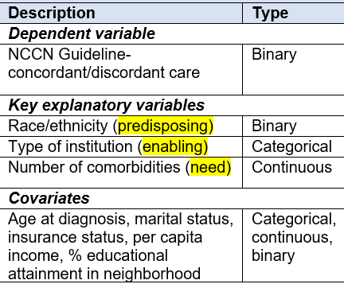
Collecting and analyzing data
Theory overview Theory for multilevel research Case example Conclusions & resources
“Using MaxQDA software, I will use a template analysis approach, using a priori codes based on CFIR+TDF … and Andersen’s Behavioral Model… and identifying additional codes inductively.”

Slide 30
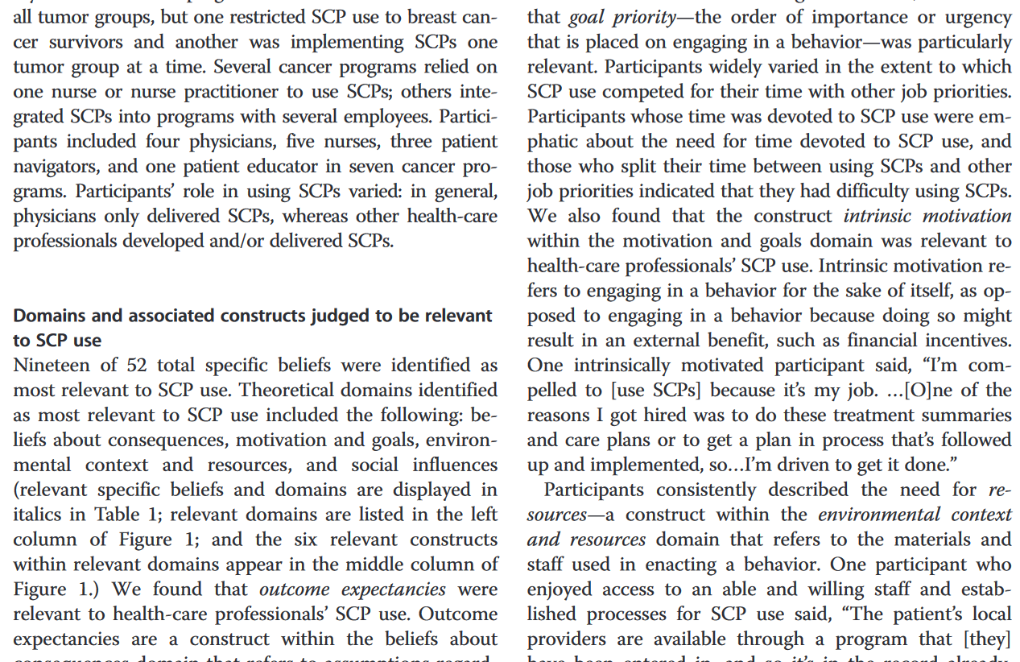
Reporting findings
Theory overview Theory for multilevel research Case example Conclusions & resources
TBD, but…
Notes:
Results can be presented based on theoretical constructs

Slide 31
Conclusions
Theory overview Theory for multilevel research Case example Conclusions & resources
Using TMFs is always important – particularly so for multilevel interventions.
Methods exist for high-quality TMF selection and application.
TMF(s) should be integral to your multilevel research, conceptually and practically.

Slide 32
Resources
Theory overview Theory for multilevel research Case example Conclusions & resources
Atkins L, Francis J, Islam R. et al. A guide to using the Theoretical Domains Framework of behaviour change to investigate implementation problems. Implementation Sci 12, 77 (2017). https://doi.org/10.1186/s13012-017-0605-9
Birken SA, Powell BJ, Shea CM, Haines ER, Kirk MA, Leeman J, Rohweder C, Damschroder L, Presseau J. Criteria for selecting implementation science theories and frameworks: Results from an international survey. Implementation Science. 2017. 12:124. doi: 10.1186/s13012-017-0656-y
Birken SA, Rohweder CL, Powell B J, Shea CM, Scott J, Leeman J, Grewe M E, Kirk MA, Damschroder L, Aldridge WA, Haines ER, Straus S, Presseau J. T-CaST: an implementation theory comparison and selection tool. Implementation Sci 13(1):143 (2018).
Harrison MI, Shortell SM. Multi‐level analysis of the learning health system: Integrating contributions from research on organizations and implementation. Learning Health Systems e10226 (2020). https://doi.org/10.1002/lrh2.10226
Nilsen P. Making sense of implementation theories, models and frameworks. Implementation Sci 10, 53 (2015). https://doi.org/10.1186/s13012-015-0242-0
Wacker JG. A definition of theory: research guidelines for different theory-building research methods in operations management. J Oper Manag. 16:361–85 (1998).

Slide 33

Using Organizational Theory to Design Multilevel Interventions
Bryan J. Weiner, Ph.D.
University of Washington

Slide 34
USING ORGANIZATION THEORY TO DESIGN MULTILEVEL INTERVENTIONS*
Bryan J. Weiner, Ph.D. University of Washington
* I will use the terms “interventions” and “strategies” interchangeably.
Notes:
Hello, I’m Bryan Weiner a professor and implementation scientist at the University of Washington. I’d like to talk a little bit about using organization theory to design multilevel interventions.

Slide 35
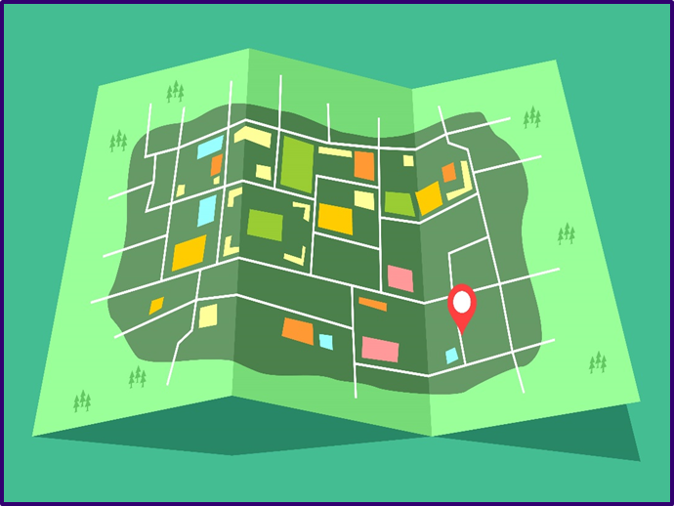
TODAY’S ROADMAP
What do we mean by “level”?
What theories are potentially useful at various levels?
Why do we even need theories for multilevel intervention?
How can interventions at multiple levels be combined?
What is organization theory?
What organization theories are potentially useful for multilevel interventions?
How can we use organization theory in multilevel intervention design?
Notes:
I am going to cover a lot of ground in a short period of time.
Here’s a road map of the topics I plan to cover.
What do we mean by “level”?
What theories are potentially useful at various levels?
Why do we even need theories for multilevel intervention?
How can interventions at multiple levels be combined?
What is organization theory?
What organization theories are potentially useful for multilevel interventions?
How can we use organization theory in multilevel intervention design?

Slide 36
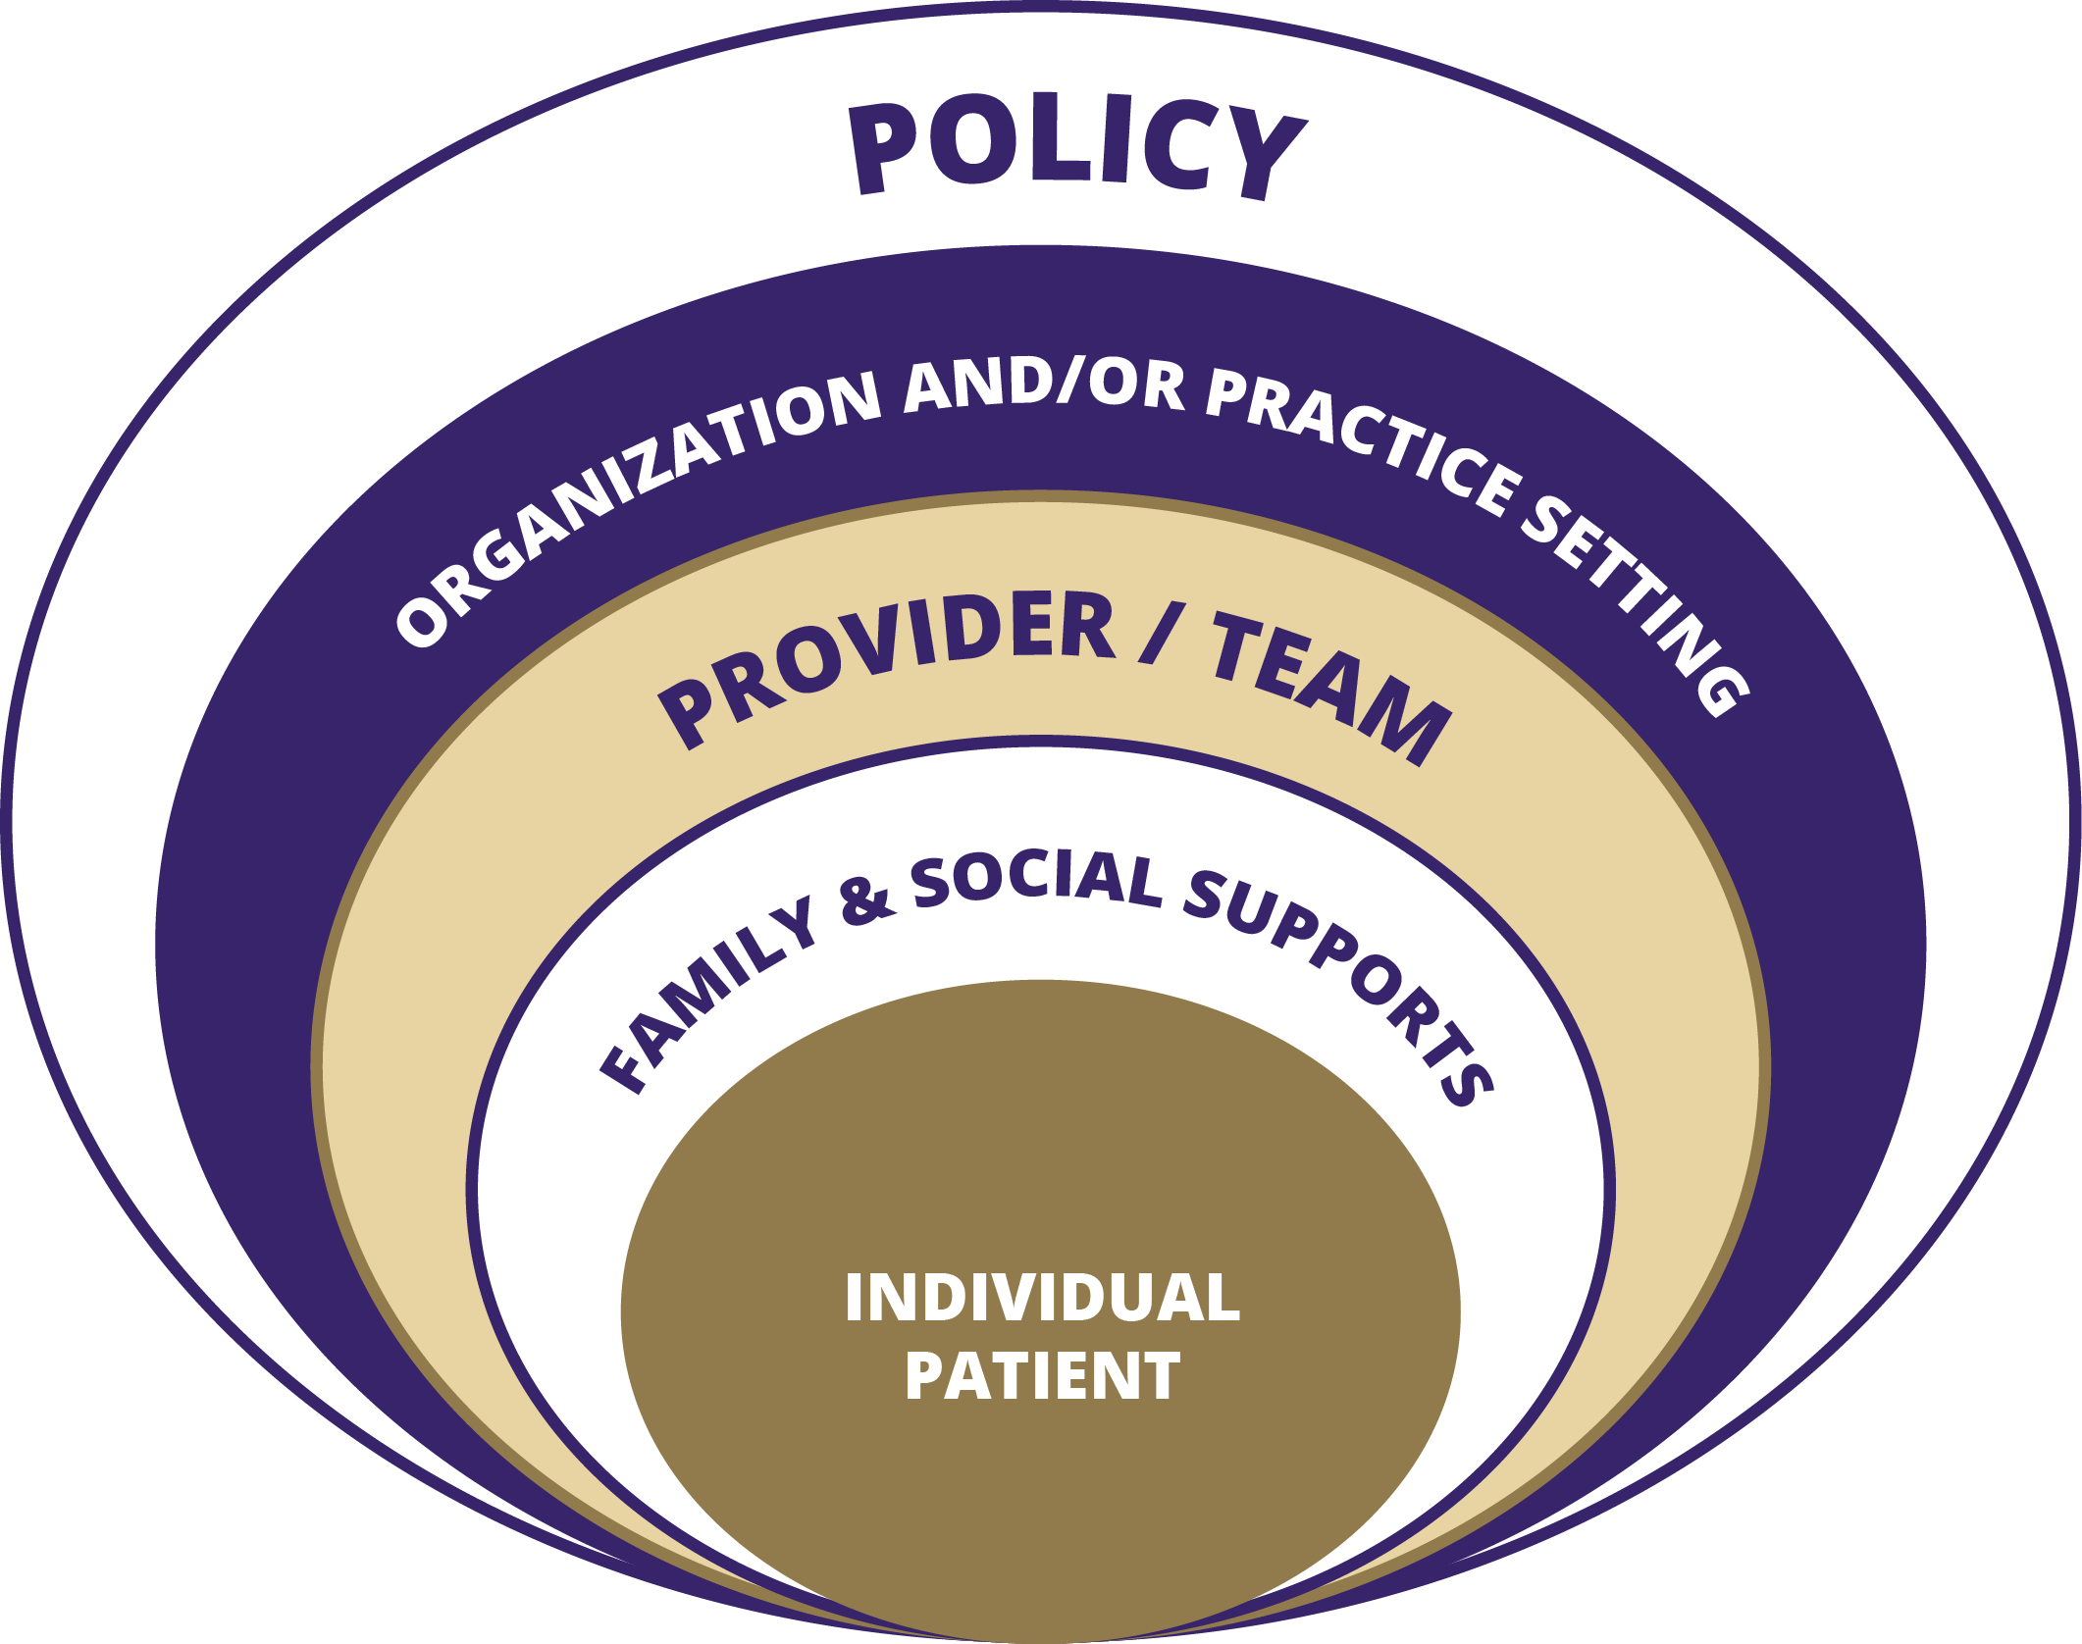
WHAT IS A LEVEL?
Levels as
Social
Units*
* Or levels of social system
Notes:
When we talk about multilevel interventions, we need to recognize that there are different ways of thinking about levels.
The first, and probably, the most intuitive is to define levels in terms of social units that are targeted for intervention.
When you see calls for multilevel interventions in funding opportunity announcements, the levels are usually defined in terms of the social unit.
If the term “social unit” seems to abstract and wonky, you can think instead about the levels of the social system that the intervention targets.
This is a perfectly fine way to think about levels when describing multilevel interventions, but it isn’t (in my view) the optimal way to think about levels when designing multilevel interventions. Why? Because when you’re designing multilevel interventions, you need to think through the causal logic of the multilevel intervention. And that is difficult to do when you think about levels as social units or levels of a social system.

Slide 37
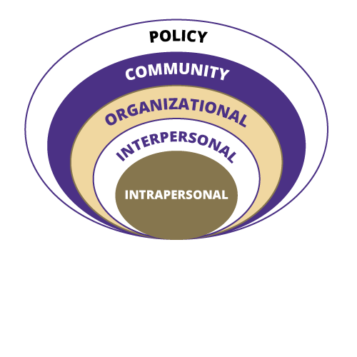
WHAT IS A LEVEL?
Levels as
Determinants
Notes:
An alternative way of thinking about levels is to define levels in terms of the determinants (or causes) targeted by the intervention. This way of thinking about levels helps you think through the causal logic of combining interventions at multiple levels.
These two ways of thinking about levels are different and they can generate differences of opinion about what counts as a multilevel intervention.
Take the example of an intervention that combines provider education and patient education…. Is this a multilevel intervention? When you think about levels in terms of social units, then the answer is yes. When you think about levels in terms of determinants, then the answer is no.
From this second perspective, you have one intervention take takes two different forms. There’s a good chance that educational activities for providers and the educational activities for patients look different. However, despite the different forms they take, they serve the same function, which is to increase awareness and knowledge, which are intra-personal determinants.
Just a reminder: the function of a strategy is defined by its purpose and mechanism. The mechanism tells you how the strategy works, meaning how it changes the determinant that it targets.
So, when thinking about forms/functions or put differently when thinking mechanistically about interventions, thinking about levels in terms of determinants or causes seems more productive for thinking through the causal logic of a multilevel intervention. And it’s that causal logic that’s helpful to think through when designing a multilevel intervention.
As an aside, I would note that early writings in health behavior and health promotion described the levels of the social-ecological model in terms of levels of influence. Levels of influence has the same tone and focus as levels of determinants.

Slide 38
WHAT THEORIES ARE (POTENTIALLY) USEFUL AT DIFFERENT LEVELS?
Level of Influence | Theories
Intrapersonal | Goal setting theory (motivation theories generally) Control theory Self-determination theory
Interpersonal | Communication theory Social influence theory Social cognitive theory
Organizational | Leadership theory Organizational implementation theory Coordination theory
Community | Empowerment theory Social mobilization theory Social network theory (diffusion of innovation)
Policy | Agenda building theory Institutional theory Theories of political behavior
Notes:
Let me switch gears for a moment and talk about theories.
We have lots of theories that we could use to design interventions.
However, most theories focus on a single level of influence.
They might include one or two constructs from a higher or lower level, but they are mostly single-level theories.
We have very few multilevel theories
I will come back around to this point in a few minutes.
But, first I want to make the case that, to design effective multilevel interventions, we need a multilevel theory of the problem and a multilevel theory of the intervention.

Slide 39
WHY DO WE NEED A THEORY OF THE MULTILEVEL INTERVENTION?
Implementation facilitators and barriers operate at multiple levels of analysis
Yet, multi-level implementation interventions often don’t work better than single-level ones
Why?
Selected implementation interventions do not target key determinants of the problem
Interdependence of key determinants of the problem are poorly understood
Notes:
Why do we need a multilevel theory of the problem and a multilevel theory of the intervention? So that we can avoid the kitchen sink approach to designing multilevel intervention or more poetically, we can avoid throwing spaghetti toward to ceiling to see what sticks, if anything. [ADVANCE]
An early systematic review, for example, indicated that multi-level interventions didn’t work any better than single-level ones. The review concluded that simply adding more interventions did not make any difference.
How can this be? If problems have determinants at multiple levels, then interventions that target determinants at multiple levels should work better than those that don’t.
So, what’s going on? Here’s a plausible explanation. [ADVANCE]
First, researchers often select interventions a priori as they write up their grant applications, often without knowing whether those interventions target the key determinants of the problem in the specific settings in which the interventions will be deployed. When we do this, we sometimes we get lucky and our interventions target key determinants. Sometimes we don’t get so lucky.
[ADVANCE]
Second, researchers often combine interventions at different levels without carefully considering how the determinants at different levels interact or combine to produce the problem observed. The key to designing effective multilevel interventions is to select and combine interventions that work together in complementary or synergistic ways.
To do that, you need to understand the interdependence of the determinants of the problem. That is, you need to understand how determinants at multiple levels are inter-related. Put differently, you need a theory of the multilevel problem. If you don’t like that formulation, you could say we need a multilevel theory of the problem.

Slide 40
EXAMPLE:
COORDINATED SURVIVORSHIP CARE
Level of Influence | Possible Barrier/Determinant | Intervention Strategy
Intrapersonal | Patient/provider knowledge, attitudes, beliefs Patient structural barriers (e.g., time, money) Inadequate cues to action | Education, opinion leaders Patient navigation Reminders/audit and feedback
Interpersonal | Poor provider-to-provider communication Poor provider-patient communication Inadequate social/spousal support | Survivorship care plans Communication skills training Social support, peer support
Organizational | Poor care coordination, inefficient processes Inadequate staffing, workload inflexibility Low organizational priority | Quality improvement Task shifting, role revision Management support
Community | Low community awareness, demand Distance from service providers (e.g., rural areas) Inadequate community resources (e.g., gyms) | Social marketing/community awareness campaign Assisted transportation services, community service provision
Macro Policy | Limited incentives to improve care coordination Limited or inadequate insurance coverage | Policy development Advocacy Demonstration programs
Multilevel theory of the problem
Multilevel theory of the intervention
Notes:
Take the example of coordinated survivorship care.
As the middle column shows, there are many possible determinants of the problem operating at different levels of influence.
As the right-hand column shows, there are many possible strategies for intervening at different levels of influence.
How do you avoid a kitchen sink approach? How do you design a multilevel intervention when faced with so many possible determinants and so many possible interventions?
You need a multilevel theory of the problem. Which determinants at which levels individually contribute the most to the problem? How do the determinants at different levels interact or combine to produce the problem?
You also need a multilevel theory of the intervention. Which interventions the address determinants that you just identified? Here you need to understand their mechanisms or functions. How could these interventions work together to address the problem? Here you need to understand how they could interact with each other. What preconditions must be in place for the multilevel intervention to work? What contextual factors might moderate the effectiveness of the multilevel intervention and therefore must be taken into account?
What you want in a multilevel intervention is for the interventions at multiple levels to work together. How you design a multilevel intervention to do that?

Slide 41
THE CAUSAL LOGIC OF
MULTILEVEL INTERVENTION
We explored how interventions at different levels could be combined to produce complementary or synergistic effects
…using a causal modeling framework to develop potential combinations
We concentrated on two forms of causal interdependence: mediation and moderation
…and identified 5 potentially useful strategies for combining interventions at different levels
Notes:
In a paper that I wrote a few years back with some colleagues at UNC Chapel Hill and NCI, [ADVANCE]
we explored how interventions at different levels could be combined to produce complementary or synergistic effects. [ADVANCE]
Using a causal modeling framework, we focused on two causal relations (mediation and moderation)
[ADVANCE]
and described five strategies for increasing complementarity or synergy among interventions operating at different levels.
When I say complementary effects, I mean 2 + 2 = 4 effects. When I say synergistic effects, I mean 2 + 2 = 5 effects. This is what we seek when we combine interventions at multiple levels. We want them to work together, to interact, in ways that produce complementary or synergistic effects on the outcomes of interest.

Slide 42
1. ACCUMULATION STRATEGY
*For expositional purposes, the diagram depicts interventions rather than determinants as causes. To keep the concept simple, a single mediating pathway is presented.
Patient-Centered Medical Home (organizational)
Survivorship Care Plan (Interpersonal)
Coordinated Care
Better Care and Better Outcomes
Provider Education (Intrapersonal))
Legend
Box: intervention and level of influence (in parentheses) Diamond: mediator Oval: outcome
Notes:
For example, strategies at multiple levels could produce additive or cumulative effects on one or more mechanisms.

Slide 43
2. AMPLIFICATION STRATEGY
Patient-Centered Medical Home (Organizational)
Coordinated Care
Better Care and Better Outcomes
Survivorship Care Plan (Interpersonal)
Audit and feedback (Intrapersonal)
Notes:
Alternatively, interventions could amplify or boost the signal of other interventions, perhaps by increases the primary audience’s sensitivity to or receptivity to the other interventions.

Slide 44
3. FACILITATION STRATEGY
Patient- Centered Medical Home (Organizational)
Coordinated Care
Better Care and Better Outcomes
Survivorship Care Plan (Interpersonal)
Health Information Exchange (Community)
Notes:
Another possibility, interventions at one level might facilitate the effect of interventions at other level by clearing the causal pathway between the mechanism and the outcome.

Slide 45
4. CASCADE STRATEGY
Professional Society Motivation
Advocacy (Macro Policy)
Accreditation (Organizational)
Manager* Motivation
Coordinated Care
SCPs (Intrapersonal)
Better Care and Better Outcomes
* Physician Motivation
Notes:
Interventions at different levels might work in a cascading fashion where interventions at lower levels facilitate the flow of the effects of interventions at higher levels. Or vice versa.

Slide 46
5. CONVERGENCE STRATEGY
Patient-Centered Medical Home (Organizational)
Coordinated Care
Physician-Patient Interaction
Survivorship Care Plan (Interpersonal)
Knowledge Motivation
Patient Education (intrapersonal)
Better Care and Better Outcomes
Notes:
Interventions at multiple levels might converge by changing the pattern of interaction between two or more social units.

Slide 47
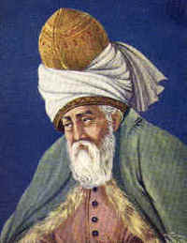
GUIDING WISDOM
You think because you understand 'one' you must also understand 'two', because one and one make two. But you must also understand 'and'.
~ Rumi
Notes:
That was a very quick tour of the five strategies. You can read more about them the 2012 article.
I opened that article with this saying by the Sufi poet, Rumi.
You think because you understand 'one' you must also understand 'two', because one and one make two. But you must also understand 'and'.
I chose this saying because there is something different about multilevel interventions. They are more, or should be more, than just the sum of their parts.

Slide 48
WHAT IS ORGANIZATION THEORY?
Level of Influence | Organization theories
Micro (individual) | Expectancy theory Role theory Decision-making theory
Meso (groups/teams) | Psychological safety theory Relational coordination theory Theories of work team performance
Macro (organization, environment) | Structural contingency theory Resource dependence theory Neo-institutional theory Resource view of the firm Organizational learning theory Organizational readiness for change theory
Notes:
OK. Turning to organization theories.
Organizational theory consists of many approaches to organizational analysis. What do I mean by organizations? Organizations are social units of people that are structured and managed to meet a need, or to pursue collective goals.
Important to recognize that organization theory includes theories at multiple levels.
We have micro-level theories that address the psychology, behavior, and performance of individuals in workplace settings.
We have meso-level theories that address the psychology, behavior, and performance of workgroups or work teams.
We have macro-level theories that address how organizations are structured, how they operate, and how they perform – and how factors in the organization’s environment affect organizational structure, operations, and performance.
Still the case that theories generally focus on determinants at a single level of influence, although they might include some factors at higher or lower levels.
This illustrates the point that I made earlier. They are called “organization theories” because they describe and explain stuff that happens in organizations settings or organizations as social units. But, as you can see, organization theories address determinants at different levels, and only some organization theories focus on organization-level determinants.

Slide 49
CONNECTING THE DOTS
Organizational Interventions
Culture interventions
Leadership interventions
QI, Lean, Six Sigma
Task-shifting
Role expansion
Staffing models
Colocation, relocation
Work redesign
Decentralization
Integration interventions
Queuing strategies
Readiness enhancement
Resource reallocation
Coalition building
Organizational Determinants
Climate/culture
Coordination, communication
Formalization
Centralization
Standardization
Work flow
Division of labor
Power and politics
Leadership
Organizational readiness
Resources + capabilities
Organizational learning
Organization
Theories
Culture, climate theories
Leadership theories
Communication theory
Structural contingency
Resource dependence
Institutional theory
Coordination theory
Org Readiness theory
Implementation theory
Resource view of the firm
Org learning theory
Power, politics theory
Strategic management
Notes:
What are some organizational determinants? [ADVANCE]
Here’s a list. It’s not exhaustive, but it gives you a good sense of the determinants or causes that serve as barriers or facilitators of implementation success.
[ADVANCE]
Here’s a short list of organization theories that speak to these organizational determinants.
[ADVANCE]
And here’s a list of interventions that target those organizational determinants.
The work that needs to be done is to connect the dots.
Sarah Birkin, Jennifer Leeman, Greg Aarons, Mark Erhart, and others (including me) are working to connect organizational determinants with organization theories and organizational interventions.

Slide 50
BUILDING A THEORY OF THE INTERVENTION
MODERATOR
MODERATOR
IMPLEMENTATION
STRATEGY
MECHANISM
BARRIER
PROXIMAL
OUTCOME(S)
DISTAL
IMPLEMENTATION
OUTCOME
PRECONDITION
FOR MECHANISM ACTIVATION
PRECONDITION
FOR PROXIMAL
OUTCOME
Notes:
One tool – causal pathway diagram that might help bring organizational determinants, organizational interventions, and organization theories together.
Note this is for a single implementation strategy but the mechanism, preconditions, and moderators could operate a different levels.
This is a fair simple diagram. The strategy could work through multiple mechanisms that operate at multiple levels. Likewise, you could have multiple preconditions or moderators operating at different levels.
The value of a tool like this is to think through how, why, and under what conditions the intervention might work.
You could also use it to think through how, why, and under what conditions multiple interventions might work synergistically.
And, for organizational interventions, organization theory can be useful in thinking through the mechanisms, preconditions, and moderators.

Slide 51
Take-Aways
Recognize that “level” means different things to different people
We need a multilevel theory of the problem and a multilevel theory of the intervention
Avoiding kitchen-sink approaches means thinking through the interdependence of the determinants and the strategy-mechanism-determinant path
There are many organizational determinants, organizational interventions, and organization theories – but the connections among them have yet to be clarified or elaborated
Notes:
That was a lot of ground covered. So, let me summarize the take-away messages:
Recognize that “level” means different things to different people [ADVANCE]
We need a multilevel theory of the problem and a multilevel theory of the intervention [ADVANCE]
Avoiding kitchen-sink approaches means thinking through the interdependence of the determinants and the strategy-mechanism-determinant path [ADVANCE]
There are many organizational determinants, organizational interventions, and organization theories – but the connections among them have yet to be clarified or elaborated

Slide 52
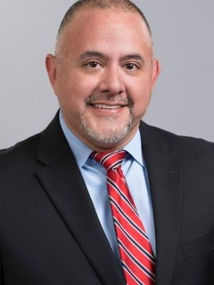
Team Science for Multilevel Intervention Research in Healthcare
Hector P. Rodriguez, M.D. Ph.D.
University of California, Berkeley

Slide 53
Team Science for Multilevel Intervention Research in Health Care
Hector P. Rodriguez
University of California, Berkeley
Email: hrod@berkeley.edu

Slide 54
Impacts of Health Care Team Structures and Processes
on the Effectiveness of Multilevel Interventions
Implementation Outcomes
Adoption
Reach
Fidelity of implementation
Reach
Maintenance
Organizational Structural Capabilities
Cere management capabilities
Health information technology capabilities
Behavioral health integration
Transitional care management
Organizational Readiness
Quality of organizational context (implementation climate)
Leadership
Capacity of internal facilitation
Strength and extent of evidence
Implementation climate
Implementation Strategies
Audit and provide feedback
Centralize technical assistance
Conduct cyclical small tests of change
Learning Collaboratives
Resources Sharing Agreements
Facilitation
Use of champions/opinion leaders
Intervention Tailoring
Financial (dis)incentives
Patient-Level Impacts
Quality of Care
Patients’ Experiences
Costs / Efficiency
Outcomes
Care Team Structure
Team size
“Real Team”- dedication and stability
Role coverage and clarity
Team composition
Transactive memory systems
Team age
Team diversity
Availability of specific expertise
Care Team Functioning
Psychological safety (organizational learning)
Team Participation
Relational Coordination
Communication
Decision-making
Openness to New Ideas
Adaptability
Professional Impacts
Clinician burnout
Employee loyalty
Intent to Quit

Slide 55
Team Science for Multilevel Research
Team Science: Enabling Team Effectiveness as Part of Multilevel Interventions
Real Team: Bounded, interdependent, stable over time, authority for executing work processes
Compelling Direction: clear, challenging, and consequential
Enabling Structure: Team composition, design of the work (skill variety, feedback from the work itself), and norms of conduct
Supportive context: appropriate reward system suited to team task(s), norms of conduct
Hackman, J. R. (2002). Leading Teams: Setting the Stage for Great Performances. Boston, MA: Harvard Business School Press

Slide 56
Team Science for Multilevel Research
Team Process Losses vs. Gains That Occur When “Enabling Conditions” are Insufficient vs. Robust
Effort
Loss: Social loafing by team members
Gain: Development of high shared commitment to the team and its work
Performance Strategy
Loss: Mindless reliance on habitual routines
Gain: Invention of innovative, task-appropriate work procedures
Knowledge and Skill
Loss: Inappropriate weighting of members contributions
Gain: Sharing of knowledge and development of member skills
Hackman, J. R. (2002). Leading Teams: Setting the Stage for Great Performances. Boston, MA: Harvard Business School Press

Slide 57
Team Science for Multilevel Research
Team Coaching
Address Effort – motivational
Minimize the free riding
Build shared commitment to the group and its work
Address Performance strategy - consultative
Minimize thoughtless reliance on habitual routine
Foster the invention of ways of preceding with work
Address knowledge and skills - educational
Minimize suboptimal weighting of members’ contributions
Foster development of members’ knowledge and skills
Hackman, J. R. (2002). Leading Teams: Setting the Stage for Great Performances. Boston, MA: Harvard Business School Press

Slide 58
Team Science for Multilevel Research
Key Team Science Concepts
for Multilevel Research
Team Structure
Team Size (large teams and diffuse accountability)
Team Diversity
Task Redundancy / Work Design
Structured communication (vs. ad hoc)
Transactive memory systems
Multi-team systems
Team Processes/ Functioning
Team Participation (participation of members with low professional status)
Relational / Task Coordination
Psychological Safety (at the team level)

Slide 59
Team Science for Multilevel Research
Implementing Team-based Care for Multilevel Interventions
Randomized trials of team-based approaches consistently demonstrate improved processes of care and patient outcomes, but clinical and organizational context matter!
Implementation of interprofessional teams in routine settings can be a disruptive organizational change
Patients experiences of team-based primary care highlight challenges of implementing teams in ways that are value added to patients’ experiences

Slide 60
Five Major Team Science Gaps that Multilevel Intervention Researchers Can Tackle
Clarifying which enabling conditions of team effectiveness (real team, compelling direction, enabling structure, supportive context, expert coaching) impact the effectiveness/impact of multilevel interventions.
Examine the impact team structures and processes on implementation fidelity vs. adaptability/tailoring for complex multilevel interventions.
Compare the impact of implementing team coaching/facilitation strategies to improve the impact of multilevel interventions on patient outcomes.
Understand how coordination within multiteam systems impacts the effectiveness of multilevel interventions o patient outcomes.
How to use “unobtrusive” administrative or physiologic measures in multilevel research to capture high-frequency data representing team and organizational dynamics (change over time).

Slide 61
Resources
Helfrich, C. D., Simonetti, J. A., Clinton, W. L., Wood, G. B., Taylor, L., Schectman, G., . . . Nelson, K. M. (2017). The Association of Team-Specific Workload and Staffing with Odds of Burnout Among VA Primary Care Team Members. J Gen Intern Med.
Kazi S, Khaleghzadegan S, Dinh JV, et al. Team Physiological Dynamics: A Critical Review. Hum Factors. September 2019:18720819874160. doi:10.1177/0018720819874160
Lemieux-Charles L, McGuire WL. What do we know about health care team effectiveness? A review of the literature. Med Care Res Rev MCRR. 2006;63(3):263-300. doi:10.1177/1077558706287003
Marlow, S. L., Hughes, A. M., Sonesh, S. C., Gregory, M. E., Lacerenza, C. N., Benishek, L. E., . . . Salas, E. (2017). A Systematic Review of Team Training in Health Care: Ten Questions. Jt Comm J Qual Patient Saf, 43(4), 197-204.
Powell BJ, Waltz TJ, Chinman MJ, et al. A refined compilation of implementation strategies: results from the Expert Recommendations for Implementing Change (ERIC) project. Implement Sci IS. 2015;10:21. doi:10.1186/s13012-015-0209-1
Rodriguez HP, Rogers WH, Marshall RE, Safran DG. Multidisciplinary primary care teams: effects on the quality of clinician-patient interactions and organizational features of care. Med Care. 2007;45(1):19-27. doi:10.1097/01.mlr.0000241041.53804.29
Rodriguez, H. P., Meredith, L. S., Hamilton, A. B., Yano, E. M., & Rubenstein, L. V. (2015). Huddle up!: The adoption and use of structured team communication for VA medical home implementation. Health Care Manage Rev, 40(4), 286-299
Taplin SH, Weaver S, Chollette V, et al: Teams and teamwork during a cancer diagnosis: Interdependency within and between teams. 2015. J Oncol Pract 11:231-238
Valentine, M. A., Nembhard, I. M., & Edmondson, A. C. (2015). Measuring teamwork in health care settings: a review of survey instruments. Med Care, 53(4), e16-30.

Slide 62

Conceptual Aspects of Theory: Individual-Level Behavior Theory
Karen Emmons, Ph.D.
Harvard T.H. Chan
School of Public Health

Slide 63




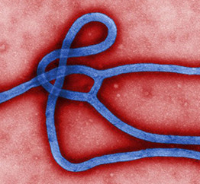


Conceptual Aspects of Theory:
Individual-Level Behavior Theory
Karen M. Emmons, Ph.D.
Multi-Level Training Institute

Slide 64

Introduce 3 key categories of individual behavior theory
Consider what is missing
Explore strategies for thinking about mechanisms of change at individual level
Notes:
Goal- fill in the individual level theory component for MLI approaches: Motivational models, Expect Value, and SCT
Introduce: will spend < 5 minutes on each class of theory– and of course, each theory could be a whole semester long class in itself. So this clearly won’t be a deep dive, but rather a (very) quick survey to highlight some of the key indiv level behavior theories
Why individual level is important: because in the end, MOST Ixs are trying to impact on individuals– those individuals may be pts, or they may be providers, or they may be policy-makers who you want to pass a bill. But in the end, understanding a bit about behavior change, and considering how to integrate the constructs that impact on it, in your interventions will likely be quite helpful.

Slide 65
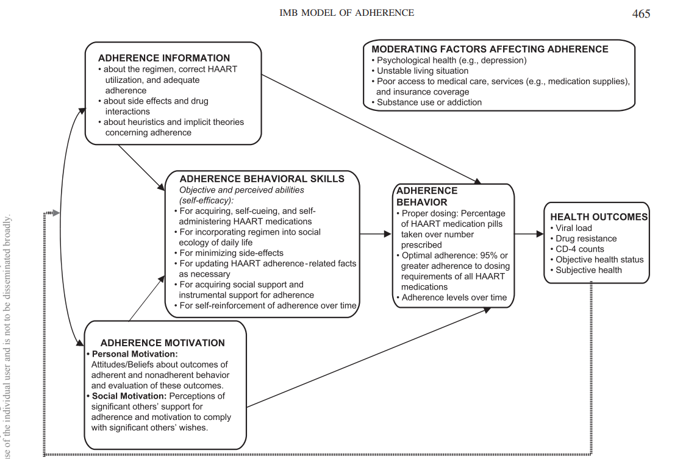
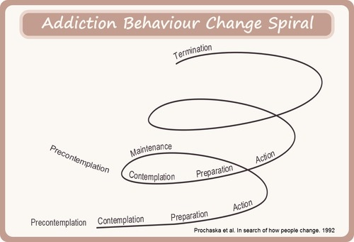
Motivational Models
Transtheoretical Model (TTM)
Information-Motivational Behavioral Skills Model (IMB)
Four main dimensions:
5 stages of change
10 processes of change –cognitive or behavioral events that enable stage progress
2 decisional balance constructs
self-efficacy
Prochaska and DiClemente, 1983
Developed for increasing adherence; 3 main dimensions
Adherence information
Adherence motivation (personal & social)
Adherence skills (objective & perceived)
Fisher, et al, 2006
Notes:
Cognitive and Affective Processes 1) Consciousness Raising (Get the Facts)
2) Dramatic Relief (Pay Attention to Feelings)
3) Environmental Reevaluation (Notice Your Effect on Others)
4) Self-Reevaluation (Create a New Self-Image)
5) Social Liberation (Notice Public Support and Norm Change)
Behavioral Processes
6) Self-Liberation (Make a Commitment)
7) Counter Conditioning (Use Substitutes)
8) Helping Relationships (Get Support)
9) Reinforcement Management (Use Rewards)
10) Stimulus Control (Manage Your Environment)
IMB: Developed specifically in context of adherence to HAART
HAART adherence is great example of the impact of indiv behavioral decisions/outcomes on pop health—transmission of Tx resistant strains of HIV
Specificity addresses concerns of change models needing to connect to complexity of target behavior
Adherence Skills– for getting enabling conditions– e.g. social support, managing side effects of HAART

Slide 66
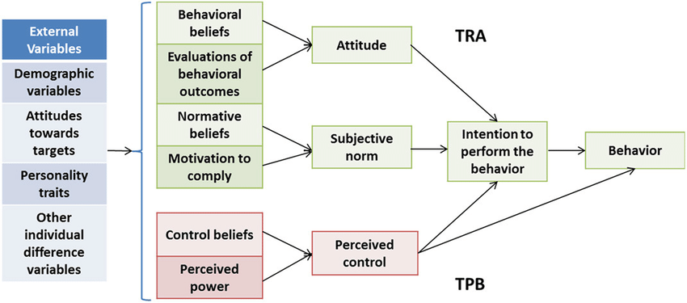
Expectancy Value Theories
Theory of Reasoned Action
Theory of Planned Behavior
assumes that behavior is under volitional control, and is rational
most important determinant of a person’s behavior is a person’s behavioral intention
Fishbein, et al, 1967
Assumes that not all decisions about health (or any actions) are rational
Adds perceived behavioral control to account for factors outside of the individual’s control that may affect intention or behavior
Ajzen, 1991
Notes:
This class of theories posits that behavior is a function of your expectations of the outcome of a particular behavior, and the value that you place on that outcome (e.g. expect that PA improves health, and you value having good health)
Exp-Value theories came out of social scientists at CDC in the 1950’s- around the time that we started to have good and scalable strategies for ED and dx prevention; Found that even when barriers to preventive behavior were reduced (e.g. portable xrays for TB in neighborhoods) participation was not high

Slide 67
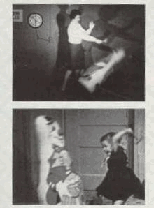
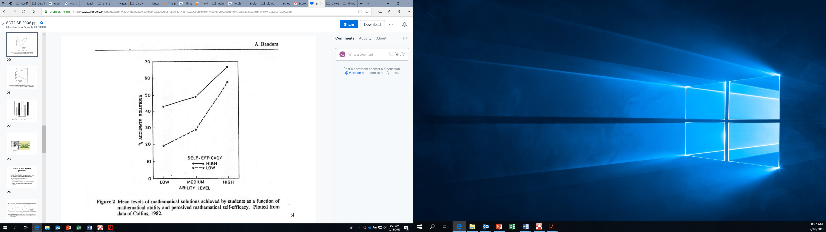
Social Cognitive Theory– Main Concepts
Learning is internal; occurs by observation
Behavior can be self-regulated, is goal-directed
Reinforcement has direct and indirect effects on learning
Cognitions drive behavior; self-efficacy is key
Behavior is influenced by interactions between cognitive, environmental, and behavioral factors
Bandura, 1977
Notes:
SCT – class in itself-- is perhaps most relevant to MLI– it not only recognizes but integrates concepts across level as explanatory mechanisms for indiv level behavior change

Slide 68
SCT Key Constructs
Cognitive influences - abilities for processing information, applying knowledge
Self-efficacy
Collective efficacy
Outcome expectations
Knowledge
Self-Regulation
Emotional Coping
Environmental influences- physical & social factors that affect behavior
7. Observational learning
8. Normative beliefs
9. Social Support
10. Barriers and opportunities
Supporting behavioral factors- abilities and actions taken that are health-enhancing or compromising
11. Behavioral skills
12. Reinforcements/ Incentive Motivation
13. Intentions
Glanz et al, 2015

Slide 69
SCT Key Constructs
Cognitive influences - abilities for processing information, applying knowledge
Self-efficacy
Collective efficacy
Outcome expectations
Knowledge
Self-Regulation
Emotional Coping
Environmental influences- physical & social factors that affect behavior
7. Observational learning
8. Normative beliefs
9. Social Support
10. Barriers and opportunities
Supporting behavioral factors- abilities and actions taken that are health-enhancing or compromising
11. Behavioral skills
12. Reinforcements/ Incentive Motivation
13. Intentions
Glanz et al, 2015
Reciprocal Determinism
Environment
(Physical/Social; external)
Behavior
(Motor/Verbal/Social;
behavioral capabilities)
Person
(Expectations, self-control,
situation; self-efficacy)
Notes:
When you think about the characteristics of MLI, this theory does a pretty good job of helping to identify potential targets AND outcomes at multiple levels.

Slide 70
Project Northland (Perry, Williams, Forster, et al, 1993; Perry, Williams, Veblen-Mortenson, et al., 1996)
Environment
Behavior
Commercial E: Reduce commercial access to alcohol (adult teams)
Commercial and Social E: “Don’t Provide” print media campaign
Social E: Planned alcohol-free prom and homecoming parties (students)
Home E: Parent postcards targeted norms at home re teen alcohol use
- Behavioral capabilities: skills development re assessment of personal and community responsibility for teen alcohol use
Person
Situation: student videos of the community alcohol environment
Expectations: Curriculum on legal outcomes of underage alcohol use
Expectancies: Framed alcohol-free events as fun and cool
Self-control: students taught younger students skills to remain alcohol free
Observational learning: videotaped lawyers arguing cases, followed by mock trial; Peer action teams developed alcohol-free activities; alcohol beverage server training
Self-efficacy: cuts across activities
Notes:
Good example– Project Northland
Ix to reduce underage drinking (indiv behavioral target), by changing the environment, cognitive factors, and behavioral skills of students and their community

Slide 71
What is Missing?
Impulsivity
Habit
Associative learning
Emotional processing
Theories are developed and applied across a broad range of behaviors
When designing an intervention, must understand the nature of the behavior to be changed and mechanisms involved in change
Notes:
Broad range– might not capture all relevant mechanisms for that behavior– selection across theories
Mechs involved in change: internal (psychological and physical) and those that involve changes to the external environment. In

Slide 72
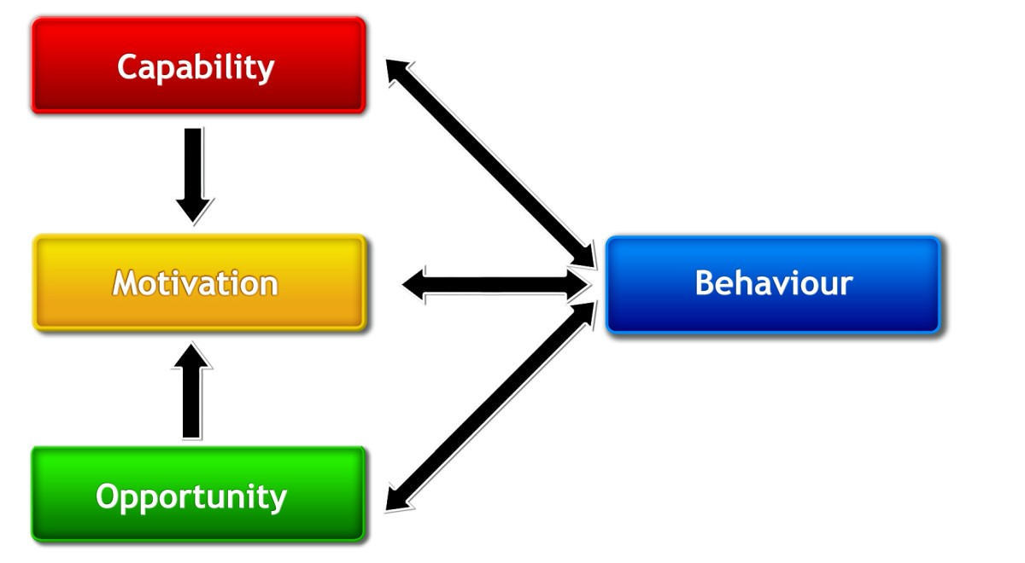
Sources of Behavior: COM-B Framework
Michie, et al., 2011
Notes:
Capability: Physical & psychological
psychological capability being the capacity to engage in the necessary thought processes - comprehension, reasoning et al.)
Motivation:
reflective processes (involving evaluations and plans)
automatic processes (involving emotions and impulses that arise from associative learning and/or innate dispositions)
Opportunity:
physical opportunity afforded by the environment
social opportunity afforded by the cultural milieu that dictates how we think about things (e.g., the words and concepts that make up our language).

Slide 73
Interventions to Target Mechanisms of Behavior Change
Interventions | Definition | Examples
Education | Increasing knowledge or understanding | Providing information to promote healthy eating
Persuasion | Using communication to induce +/- feelings or stimulate action | Using imagery to motivate physical activity
Incentivization | Creating expectation of reward | Using monetary incentives for quitting smoking, preventive action
Coercion | Creating expectation of punishment/cost | Raising health insurance premiums for smokers
Training | Impacting skills | Advanced training to increase safe driving
Restriction | Using rules to reduce oppty to engage in behavior | Restricting tobacco sales to those < age 21
Environmental Restructuring | Changing physical or social context | Practice alerts for providers to screen for tobacco use
Modeling | Providing an example to imitate | Peer models, integration of target behavior in TV/movies
Enablement | Increasing means/reducing barriers to increase capability or opportunity | Behavioral support, medication for smoking cessation, improving cafeteria choice
Michie, et al., 2011
Notes:
Reflective motivation : achieve through increasing knowledge and understanding [EDUCATION]; , eliciting positive (or negative) feelings about behavioural target [PERSUASION]
Automatic motivation : achieve through associative learning that elicit positive (or negative) feelings and impulses and counter-impulses relating to the behavioural target, imitative learning, habit formation [, INCENTIVES, MEDICATION (e.g. Antabuse)
[ SKIP Physical capability: achieve through physical skill development [TRAINING] or enabling interventions [MEDICATION]
Psychological capability: achieve through imparting knowledge or understanding [TRAINING or EDUCATION], training emotional, cognitive and/or behavioural skills]
Physical and social opportunity : achieve through environmental change

Slide 74
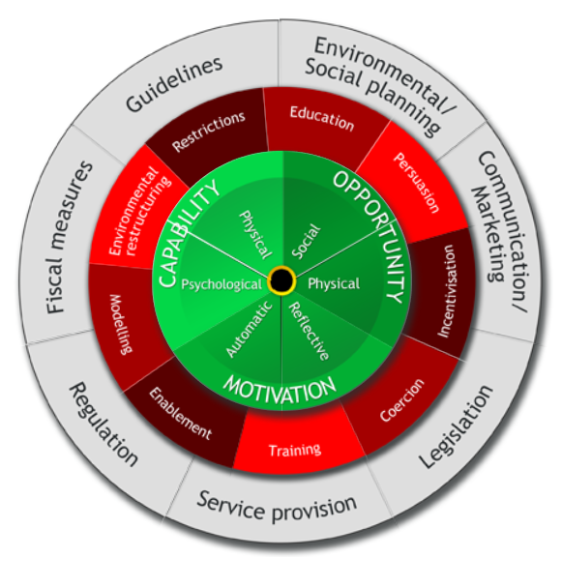
The Behavior Change Wheel

Slide 75
Thank You!

Slide 76
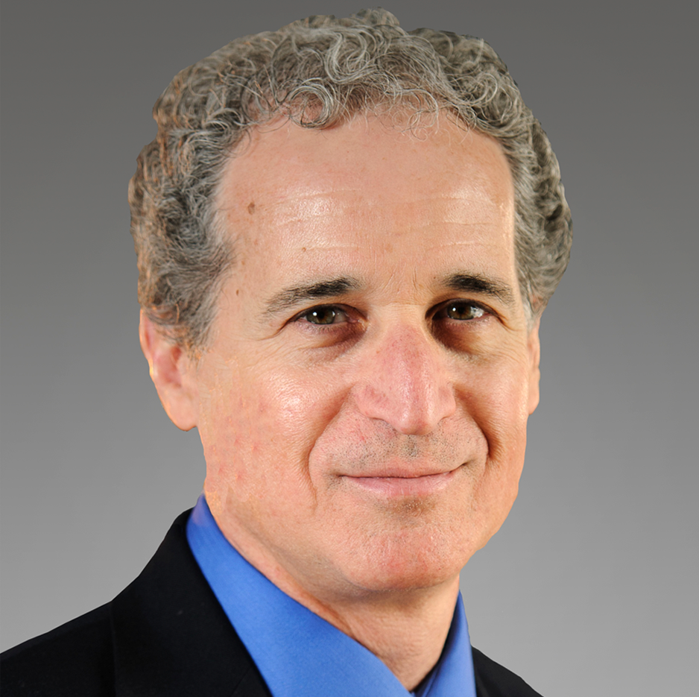
Panel Discussion: What Makes Theory Valuable Yet Practical?
Sarah Birken, Ph.D.
Brian Mittman, Ph.D.
Bryan Weiner, Ph.D.

Slide 77

Module 3 (Live Small Group )
Thursday, February 3, 2022
12:00-2:00pm

