Slide 1

2022 Multilevel Intervention Training Institute
February 10, 2022

Slide 2


Welcome and Introduction to
Module 4
Erica S. Breslau, Ph.D.
National Cancer Institute

Slide 3

Use of Theory: Practical Guidance
Beth Glenn, Ph.D.
University of California Los Angeles

Slide 4

Applying Theory to Multilevel Interventions to Promote the HPV Vaccine
Beth A. Glenn, PhD
Professor of Health Policy and Management,
Fielding School of Public Health
UCLA Kaiser Permanente Center for Health Equity
Jonsson Comprehensive Cancer Center
University of California, Los Angeles
Multilevel Intervention Training Institute
March 2021

Slide 5
The Big Picture:
Factors Influencing HPV Vaccination in Adolescents
Societal Level/Policy
Parent
Community/
Social Norms
Health Care/Public Health System
Health Care Provider
Adolescent

Slide 6
Progression of HPV Vaccine Promotion Research
Observational Study: Assessing HPV Vaccination Rates & Correlates in Adolescents
Intervention to Improve HPV Vaccine Uptake through County-Operated Telephone Hotline
Parent Reminder Intervention in Federally Qualified Health Center (FQHC)
Multilevel Intervention to Improve HPV Vaccination Rates in FQHC (3-level)
Clinic-based Intervention in FQHC (2-level)

Slide 7
Assessing HPV Vaccination in Adolescents
Targeting Mothers through a Telephone Hotline
Parent
Health Care/Public Health System
Adolescent

Slide 8
Observational Study: Setting & Design
Partnership with the Los Angeles County Department of Public Health, Office of Women’s Health (OWH)
  OWH operates a hotline to provide education & appointment assistance for women’s health services to low-income women
  Multilingual: English, Spanish, Korean, Mandarin, Cantonese, Armenian
  Telephone interviews (n = 490) by operators (Jan-Oct 2009)
  Eligibility: Hotline callers ages 18-65 yrs, medical decision-maker for age-eligible adolescent (9-18 years)
CDC/NCI UCLA Cancer Prevention and Control Research Network
(U48 DP000056/SIP 16-04)

Slide 9
Multilevel Health Outcomes Framework
Health Policy Environment Health Care System | Built Environment Economic Environment | Community Capacity & Engagement | Neighborhood Context
Individual (Parent-Level)
Demographics, Living conditions
Health care coverage
Medical/preventive health history
Knowledge, Attitudes, Beliefs
Communication with provider
Barriers & Supports
Cue to action
Barriers/Supports:
Individual, Provider, System, Societal
Provider
Demographics, Specialty
Knowledge, Beliefs, Culture
Communication Style
Barriers & Supports
Practice Related Factors
Adolescent Vaccine
Initiation
(≥ 1 dose)
Parental
Vaccine
Intentions
Adolescent
Vaccine
Completion
(2 or 3 doses)
System
Age/Maturity/Size
Type/Structure/Climate/Resources
Patient & Provider Mix
Readiness for Change
Policies/Practices/Procedures
Previously known as Health Behavior
Framework; Bastani, Glenn et al., 2010

Slide 10
Primary Target: Parent Level
Individual (Parent-Level)
Demographics, Living conditions
Health care coverage
Medical/preventive health history
Knowledge, Attitudes, Beliefs
Communication with provider
Barriers & Supports
Cue to action
Immutable factors:
can identify subgroups of participants to target through your intervention
Mutable factors:
can address these factors through your intervention

Slide 11
Survey Content
IMMUTABLE FACTORS (PARENT AND ADOLESCENT LEVEL)
slldj
Parent-level: age, sex, race/ethnicity, insurance coverage, nativity, marital status,
preferred language, usual source of care
Adolescent level: age, sex, insurance coverage, usual source of care
MUTABLE FACTORS (PARENT LEVEL)
Perceived effectiveness of vaccine, Perceived severity of HPV, Perceived risk of child to acquire HPV
Vaccine beliefs in general and related to HPV (appropriate age)
Perceived barriers (cost, concerns about fertility, future health problems, promiscuity)
Decision-making factors (perceived knowledge, family/social influences, provider
recommendation)

Slide 12
Observation Study: Results
Parent Sample Composition
HPV Vaccination Rates in Adolescents
Adolescent Mean Age = 13.9 yrs
Bastani, Glenn, et al., CEBP, 2011

Slide 13
Factors Associated with HPV Vaccination in
Multivariable Analyses
Immutable Factors
Older age of adolescent
Mutable Factors
Knowledge; HPV vaccine awareness
Believe daughter is too young (reverse scored)

Slide 14
Perceived Barriers of Parents of Unvaccinated Adolescents
Mutable Factors
Need more info to make a decision (66%)
Don’t know where to get vaccine (74%)
Vaccine may cause infertility (17%)
Vaccine may cause health problems (15%)
May encourage daughter to have sex (13%)

Slide 15
Progression of HPV Vaccine Promotion Research
Observational Study: Assessing HPV Vaccination Rates & Correlates in Adolescents
Intervention to Improve HPV Vaccine Uptake through County-Operated Telephone Hotline
Parent Reminder Intervention in Federally Qualified Health Center (FQHC)
Multilevel Intervention to Improve HPV Vaccination Rates in FQHC
Clinic-based Intervention in FQHC

Slide 16
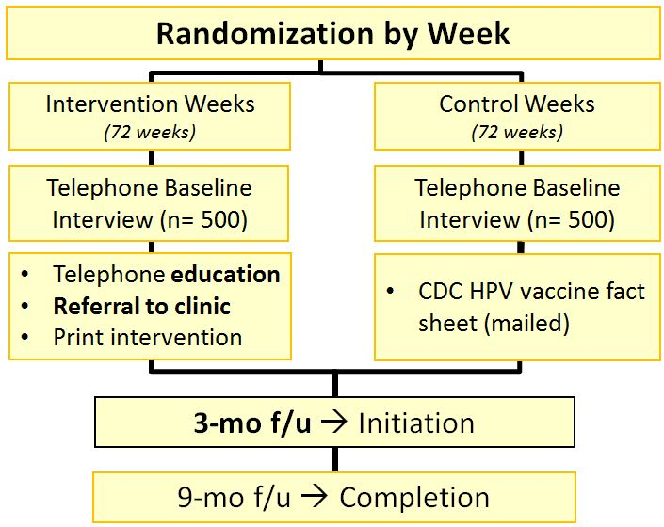
Increasing HPV Vaccine Uptake in a Low Income
Ethnic Minority Population
Multicomponent intervention: Delivered by county staff, targets mothers, provides vaccine education & referral to local VFC clinic
Targeted mothers of adolescents who had not received any HPV vaccine doses
Intervention messages targeted mutable theoretical constructs at parent level and tailored based on immutable factors (e.g., insurance status, race/ethnicity)
Outcome: parent report
Initiation/completion
(NCI R01CA154549; 2012-2018;
Study Team: Bastani, Glenn, Herrmann, Singhal, Crespi, Taylor, Tsui)

Slide 17
Telephone Education Segments
Segment 1
HPV & HPV Vaccine Information
Segment 2
Tailored Messages
Segment
3
Personalized Clinic Referral

Slide 18
Telephone Intervention Scripts Targeting Theoretical Constructs
Segment 1: HPV & HPV Vaccine Information
Constructs Targeted: Knowledge & Awareness of HPV and the Vaccine
The HPV vaccine prevents girls from getting HPV, a common infection that can lead to cervical cancer. The vaccine is recommended by doctors for girls 11‐12 years, but all teens, regardless of age, should get the vaccine. The HPV vaccine is given in three shots over the course of six months.

Slide 19
Telephone Intervention Scripts Targeting Theoretical Constructs
Segment 2: Tailored Messages
Constructs Targeted: Health Beliefs & Barriers
Believe daughter is too young to get vaccine
You think that your child is too young for the HPV vaccine. Actually, doctors recommend the vaccine for girls at 11 and 12 years of age, even though they can get the vaccine up to age 26. The vaccine works best in young girls because they have a stronger immune response than older girls and the vaccine
should be given to girls long before they become sexually active.

Slide 20
Telephone Intervention Scripts Targeting Theoretical Constructs
Segment 3: Personalized Clinic Referral
Constructs Targeted: HPV Parent knowledge, System Factors (via parent)
Referral to vaccine clinic
The HPV vaccine is available for low cost from your usual doctor’s office or clinic or other clinics near your home. If your daughter does not have a usual doctor’s office or clinic, please call one of the clinics in the attached list to ask
about getting an appointment for your daughter to get the HPV vaccine.

Slide 21
Mailed Print Intervention

Slide 22
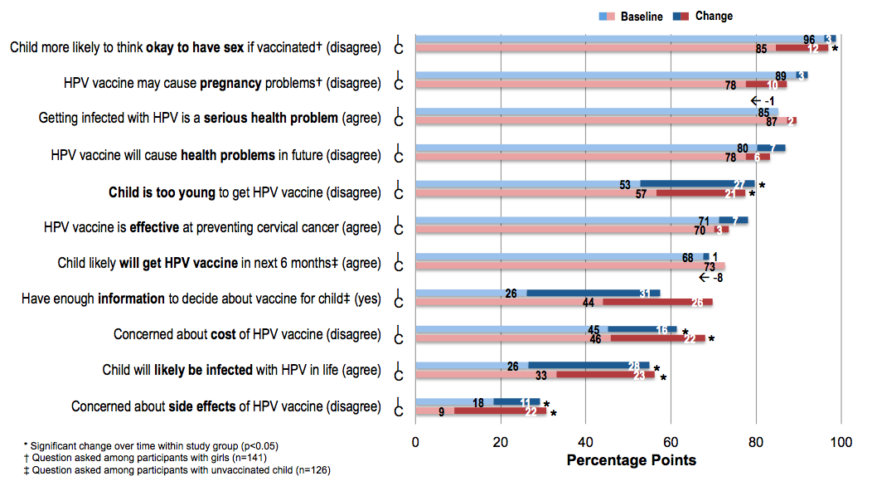
Pre-Post Changes in Theoretical Constructs

Slide 23
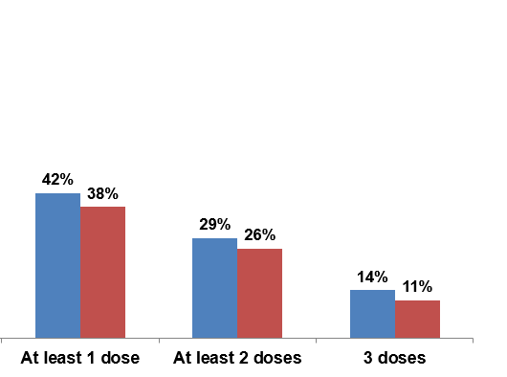
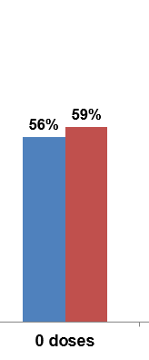
HPV Vaccine Receipt at 9-month Follow-up
HPV Vaccination Rates at 9-Month Follow-up by Study Group (n=211)
Bastani, Glenn et al., 2017

Slide 24
Improving HPV Vaccination in Federally Qualified Health Centers (FQHCs)
Parent
Health Care/Public Health System
Health Care Provider
Adolescent

Slide 25
Progression of HPV Vaccine Promotion Research
Observational Study: Assessing HPV Vaccination Rates & Correlates in Adolescents
Intervention to Improve HPV Vaccine Uptake through County-Operated Telephone Hotline
Parent Reminder Intervention in Federally Qualified Health Center (FQHC)
Multilevel Intervention to Improve HPV Vaccination Rates in FQHC (3-level)
Clinic-based Intervention in FQHC (2-level)

Slide 26
Different Context-Same Theory?
Planning to intervene at parent level, but not clear if same approach would work
Theories/conceptual models aim to identify set of common factors that drive outcomes or behaviors across contexts
Health behavior theories = address knowledge, attitudes and beliefs at the individual level to produce behavior change
May depend on the context

Slide 27
Vaccination in Clinical Settings
Until recently, high level of acceptance of childhood vaccinations
Easy as 1-2-3:*
1) nurse tells parent about needed vaccines + provide Vaccine Info Sheet
2) doctor reiterates importance
3) nurse gives the shot
*Gross oversimplification, but full vaccine discussion not part of process
Interviews with parents of adolescent in FQHC (n = 91)
  Parents not aware of need for HPV vaccine
  Not always sure if provider recommends it
  Want more info
  Parents expressed doubts when providers treated HPV vaccine
  differently (e.g., this one not mandatory, “asked” if want vs.
  recommended)

Slide 28
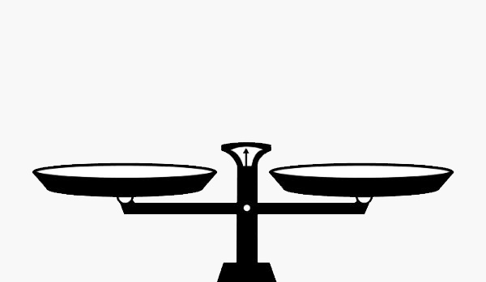
Decision about Providing HPV Vaccine Information
Arguments For
Consistent w/Theory:
knowledge is necessary to create behavior change
Consistent with Prior Research
Local Data: Parents asked for it
Arguments Against
Local Data: Parents notice when providers treat HPV vaccine differently than other vaccines
Emerging evidence (Brewer et al., 2017)
Simple announcement by provider > HPV vaccination rates vs. usual care
Conversation intervention (w/Q & A): no intervention effect

Slide 29
Evaluating the Effect of Parent reminders on HPV Vaccine Receipt Among Adolescents in a Large FQHC
Study setting: Large Federally Qualified Health Center in Los Angeles County
Target Sample: 12 year old adolescents (n=878; >47% female, >85% Hispanic/Latino)
Outcome: next-dose of vaccine
Intervention
Initial reminder
Second reminder @ 1-month if no dose received
No detailed information provided
Randomization by Clinic
Intervention
(3 Clinics)
Control
(3 Clinics)
Letter
Robocall
Text
Baseline Reminder
Usual Care
1-Month Reminder
(NCI R01CA154549; 2016-2018;
Study Team: Bastani, Glenn, Herrmann, Crespi,
Rosen, Johnson, Park)
3-Month Next-dose Completion
3-Month Next-dose Completion

Slide 30



Reminder Types: Letter, Text Message, Robocall
Letter
“Dear <PATIENT_FNAME> <PATIENT_LNAME>,
Our records indicate that you are due for the 1st dose of the HPV vaccine. The HPV vaccine protects boys and girls against many diseases. The vaccine is given in a series of 2 shots that are 6 months apart. It is important to complete the series.
Please call the NEVHC Appointment Center at 818-270-9777 to schedule your appointment.
Northeast Valley Health Corporation.”
Text message
“Hello from Northeast Valley Health Corp. Your child <PATIENT_FNAME> is due for the 1st dose of the HPV vaccination.
Call the Appointment Center at 818-270-9777 to schedule your appt.
Text STOP at any time to stop receiving messages.”
Robocall
Hola! Estamos llamando de Northeast Valley Health Corp. Este mensaje es para XXX.
Nuestro registro indica que le toca la primera dosis de la vacuna de VPH. La vacuna contra el Virus de papiloma humano (VPH) protege a niños y niñas contra muchas enfermedades. La vacuna se administra en una serie de dos vacunas. La segunda vacuna se administra 6 meses después de la primera. Es importante completer la serie.
Llame al centro de citas al 818-270-9777 para programar su cita.

Slide 31
HPV Next-Dose Vaccination at 3-Month Follow-up
11%
13%
11%
7%
The largest effects were observed for mailed reminders,
followed by text message reminders, and lastly robocalls.
Robocalls also least likely to be received

Slide 32
Evaluating the Effect of a Multilevel Clinic-Based Intervention to Increase HPV Vaccine Uptake
Randomization by Clinic
Randomized 8 clinics to study
Matching factors: HPV vaccine initiation rates + size of adolescent population
Multilevel, multicomponent
intervention
Outcome: based on EHR data
Intervention Clinics (N=4 clinics)
Usual Care Clinics (N=4 clinics)
Baseline HPV Rate (n=8,000)
Baseline HPV Rate (n=12,000)
-PCP training
-Nurse/MA training
--System Changes
-Parent prompts
-Usual Care
3-Month Follow-up HPV Rate (Initiation)
3-Month Follow-up HPV Rate (Initiation)
(NCI R01CA154549; 2016-2018; Study Team: Bastani, Glenn, Herrmann, Crespi, Hochman)
12-Month Follow-up HPV Rate (Completion)
12-Month Follow-up HPV Rate (Completion)

Slide 33


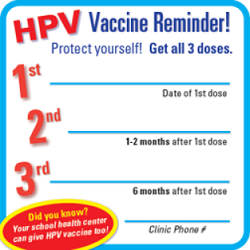
Multilevel Intervention
System Level
System
Age/Maturity/Size
Type/Structure/Climate/Resources
Patient & Provider Mix
Readiness for Change
Policies/Practices/Procedures
Changes to clinic workflow &
policies to reduce missed opportunities
Provider/Staff Level
Provider
Demographics, Specialty
Knowledge, Beliefs, Culture
Communication Style
Barriers & Supports
Practice Related Factors
Current recommendations
Communication techniques
Provider and clinic feedback
Individual (Parent-Level)
Demographics, Living conditions
Health care coverage
Medical/preventive health history
Knowledge, Attitudes, Beliefs,
Communication with provider
Barriers & Supports
Cue to action
Parent Level
Reminder card for 2nd and 3rd dose
Given to parent at time of first dose

Slide 34
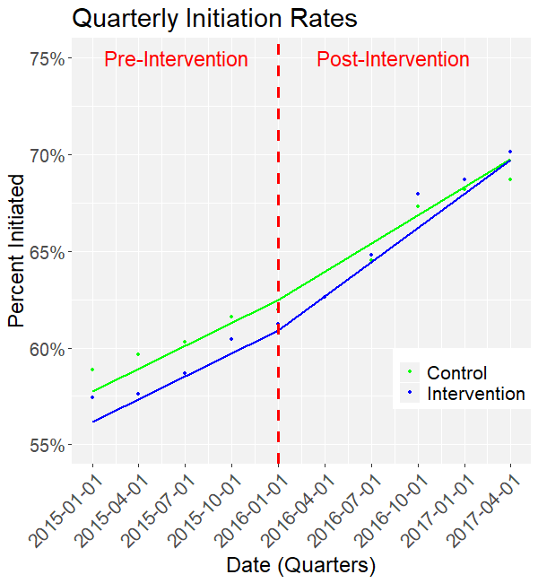
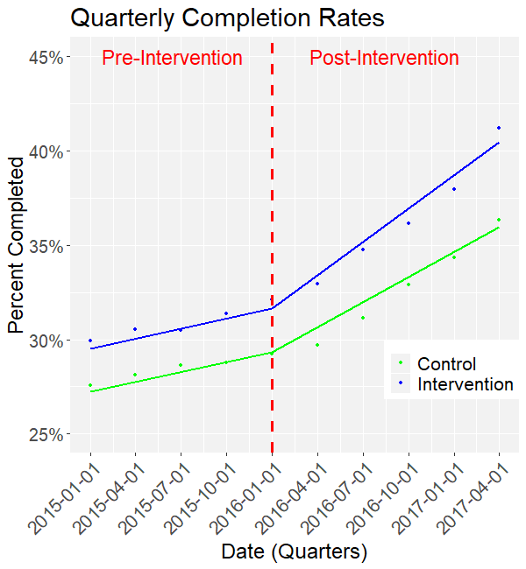
Effect of the Intervention on HPV Vaccine Initiation & Completion
HPV Vaccine Initiation Rates (N~17,000)
HPV Vaccine Completion Rates (N~17,000)
Significant overall effect
and larger effect for males & younger patients
No significant overall effect
Significant effect for males & younger patients

Slide 35
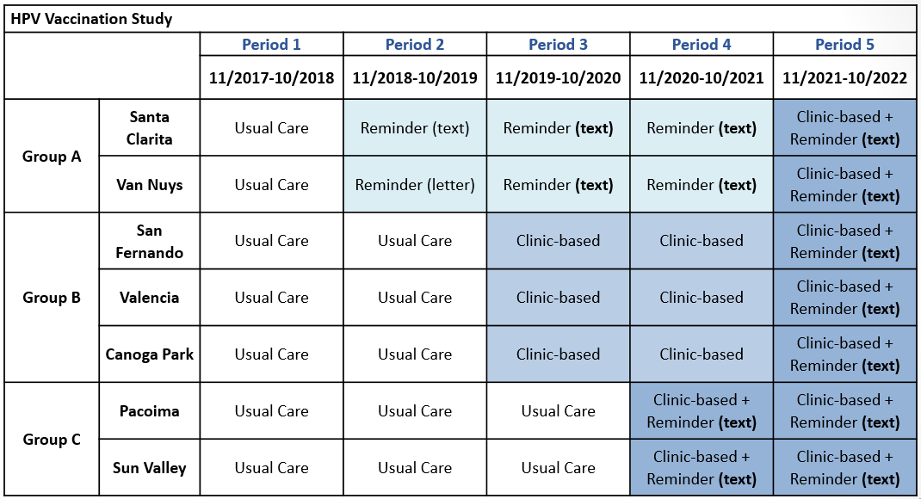
PUTTING IT ALL TOGETHER: Comparative Effectiveness of Interventions
to Increase HPV Vaccine Receipt in Federally Qualified Health Centers
1
2
3
4
5
6
7
PCORI Contract PCS-2017C1-6482: Study Team: Bastani, Glenn, Rosen, Herrmann, Crespi, Johnson, Park

Slide 36
Multilevel Health Outcomes Framework
Health Policy Environment Health Care System | Built Environment Economic Environment | Community Capacity & Engagement | Neighborhood Context
Individual (Parent-Level)
Demographics, Living conditions
Health care coverage
Medical/preventive health history
Knowledge, Attitudes, Beliefs,
Communication with provider
Barriers & Supports
Cue to action
Barriers/Supports:
Individual, Provider, System, Societal
MLI
Provider
Demographics, Specialty
Knowledge, Beliefs, Culture
Communication Style
Barriers & Supports
Practice Related Factors
Achieving threshold for action
Clinic Level
HPV Vaccination Rates
System
Age/Maturity/Size
Type/Structure/Climate/Resources
Patient & Provider Mix
Readiness for Change
Policies/Practices/Procedures
Notes:
1 min

Slide 37
Shaping the Intervention Based on Local Context
Local Context Theoretical Target
Parent Level
Parents generally supportive of vaccines
Parent primary decision-maker for adolescents
Not sure of need for HPV vaccine or timing
Not sure if provider wants them to get it
Individual (Parent-Level)
Demographics, Living conditions
Health care coverage
Medical/preventive health history
Knowledge, Attitudes, Beliefs,
Communication with provider
Barriers & Supports
Cue to action
Provider/Staff Level
Providers generally supportive of vaccination
Some gaps in knowledge (value of vaccine for boys)
Some perception that vaccine is still “new”
Some providers felt need to provide many details (STI prevention)
Provider/ Staff
Demographics, Specialty
Knowledge, Beliefs, Culture
Communication Style
Barriers & Supports
Practice Related Factors
System Level
Clinics express willingness to make changes
Many policies, practices do not match policies
Insufficient checks/balances/redundancies
If step 1 missed, no steps 2-4
System
Age/Maturity/Size
Type/Structure/Climate/Resources
Patient & Provider Mix
Readiness for Change
Policies/Practices/Procedures

Slide 38

Intervention Levels
Parent
Provider/Staff
System
t
Text message reminders in parents’ preferred language
One-month follow-up reminder for parents whose children had not received dose
Targets: cues to action & perceived importance
Provider/Staff engagement & training
Quarterly audit, feedback, & recognition
Targets: provider beliefs, knowledge gaps, communication skills, barriers, and system changes, readiness to change
Creation and strengthening of existing policies
Systematized & integrated workflow modifications
Targets: clinic workflow and policies to reduce missed opportunities, readiness to change

Slide 39
Provider Intervention Elements
Provider & Staff Training
Provider Audit & Feedback Reports
Multiple trainings and booster trainings with each site
Each pediatric provider will receive a report on missed opportunities at the provider and clinic level
Summary of HPV Vaccination rates at clinic
Detailed review of workflow standardization and clinic-based intervention activities
Role-Playing Activity (strengthening vaccine recommendations)
Overview of HPV Vaccination and Cancer Prevention

Slide 40

Excerpt from Provider/Staff Training
Goal: Reduce Missed Opportunities for HPV Vaccination
A missed opportunity is any visit during which a patient who is due for a dose of the HPV vaccine does not receive it (and no refusal was documented).
Adolescents come to the clinic infrequently, so it is important to vaccinate at every visit
Refusal are uncommon: Parents at NEVHC refuse an HPV vaccine only 5 times out of 100 when it is offered during sick or well visits.

Slide 41
Except from Provider/Staff Training:
Suboptimal Provider-Patient Conversation about HPV Vaccine
Provider: Meghan is due for some shots today: Tdap and the meningococcal vaccine. There is also the HPV vaccine…
Parent: Why does she need an HPV vaccine? She’s only 11!
Provider: We want to make sure she gets the shots before she becomes sexually active.
Parent: Well I can assure you Meghan is not like other girls- she’s a long way off from that.
Provider: We can certainly wait if that would make you feel more comfortable.
Separating the HPV vaccine, emphasizing sexual activity versus cancer prevention, and waiting to administer the vaccine may result in missed opportunities.
https://rtips.cancer.gov/rtips/uploads/RTIPS/-=RT=-/WHE/DoHHS/NIH/NCI/DCCPS/7588.pdf

Slide 42
Excerpt from Provider/Staff Training
Routinize and Bundle Vaccine Recommendations
Focus on Cancer Prevention
Inform vaccines are best at a younger age
Avoid singling out the HPV vaccine
Emphasize importance of getting all shots in the series
Avoid talking about sexual activity
Emphasize there is a stronger immune response at a younger age
Emphasize less doses are needed if series is initiated at a younger age
Remind parents that all doses are needed and inform them of when the follow-up doses will occur

Slide 43
Workflow Modifications:
Intervening at Key Steps in the Vaccination Process
Determine if patient is eligible for HPV vaccine
Print and review of vaccine registry routing slip for every patient at every visit
Recommend Vaccine & Document Refusals
At Every Visit
Provide a strong recommendation for the HPV vaccine at every visit type (sick & preventive)
Document all vaccine refusals in electronic health record system
Scheduling Follow-up Doses
Schedule recalls using the recall system for any needed follow-up dose due in over 3 months OR
Schedule a nurse visit for patient who is due for a follow-up dose within the next 3 months

Slide 44
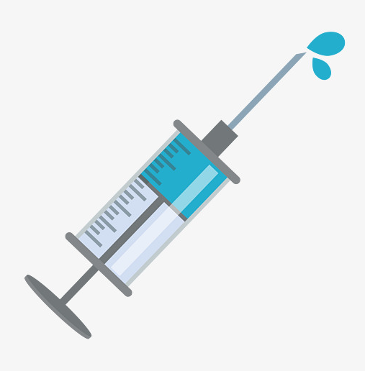







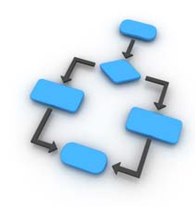


Study Measures
Child Level (Electronic health records, parent report)
Parent Level (Exit interviews)
HPV Vaccination
PRIMARY OUTCOME
Health care utilization
Socio-demographics
Provider recommendation
Receipt of Reminders
Perceptions of practice changes
Provider Level (Administrative data, Interviews)
System Level (Electronic health records, Administrative data, interviews)
Provider characteristics
Provider report of implementation
Clinic characteristics
Workflow change implementation
Training session attendance
Organizational readiness

Slide 45
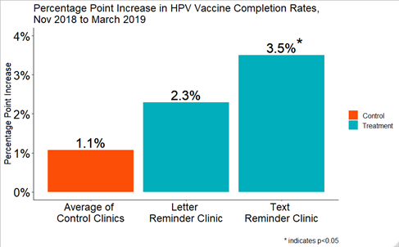
Preliminary Findings for Parent Reminders
HPV Vaccine Series Completion Rates:
% Point Change through early 2019

Slide 46
Promoting the HPV Vaccine in Context of COVID-19
HPV Vaccination Study
 |  | Period 1 | Period 2 | Period 3 | Period 4 | Period 5
 |  | 11/2017-10/2018 | 11/2018-10/2019 | 11/2019-10/2020 | 11/2020-10/2021 | 11/2021-10/2022
Group A | Santa Clarita | Usual Care | Reminder (text) | Reminder (TBD) | Reminder (TBD) | Clinic-based + Reminder (TBD)
 | Van Nuys | Usual Care | Reminder (letter) | Reminder (TBD) | Reminder (TBD) | Clinic-based + Reminder (TBD)
Group B | San Fernando | Usual Care | Usual Care | Clinic-based | Clinic-based | Clinic-based + Reminder (TBD)
 | Valencia | Usual Care | Usual Care | Clinic-based | Clinic-based | Clinic-based + Reminder (TBD)
 | Canoga Park | Usual Care | Usual Care | Clinic-based | Clinic-based | Clinic-based + Reminder (TBD)
Group C | Pacoima | Usual Care | Usual Care | Usual Care | Clinic-based + Reminder (TBD) | Clinic-based + Reminder (TBD)
 | Sun Valley | Usual Care | Usual Care | Usual Care | Clinic-based + Reminder (TBD) | Clinic-based + Reminder (TBD)
1
2
3
4
5
6
7
PCORI Contract PCS-2017C1-6482: Study Team: Bastani, Glenn, Rosen, Herrmann, Crespi, Johnson, Park

Slide 47
References Cited & Additional Relevant Readings
Bastani, R., Glenn, B.A., Taylor, V.M., Chen, M.S., Nguyen, T.T., Stewart, S.L., Maxwell, A.E. (2010). Integrating theory into community interventions to reduce liver cancer disparities: The Health Behavior Framework. Preventive Medicine, 50(1-2):63-67. PMCID: PMC3243444
Bastani, R., Glenn, B., Chang, A., Eaton, E., Chuang, A., Herrmann, A., Nonzee, N., Singhal, R., Taylor, V. (2016). Organization-level intervention to increase HPV vaccine uptake among ethnic minority adolescents in a community clinic system. Oral Presentation within symposium titled, “Population level implementation of interventions to enhance cancer outcomes: Challenges and successes.” 14th International Congress of Behavioral Medicine, Melbourne, Australia.
Bastani, R., Glenn, B.A., Tsui, J., Chang, L.C., Marchand, E., Taylor, V.M., Singhal, R. (2011). Understanding sub-optimal HPV vaccine uptake among ethnic minority girls. Cancer Epidemiology, Biomarkers & Prevention, 20(7):1463-1472. PMCID: PMC3132826
Glenn, B.A., Herrmann, A., Rosen, D., Nonzee, N., Espiritu, M., Chang, L.C., Hernandez, A. Bastani, R. (2017). Comparing Effectiveness and Implementation of Three Types of Parent Reminders to Increase Adolescent HPV Vaccine Receipt. Presentation at the 10th Annual Conference on the Science of Dissemination and Implementation, Arlington, VA.
Glenn, B.A., Tsui, J., Singhal, R., Sanchez, L., Nonzee, N.J., Taylor, V.M., Bastani, R. (2015). Factors associated with HPV awareness among mothers of low-income, ethnic minority adolescent girls in Los Angeles. Vaccine, 33 (2):289-293. PMCID: PMC4479277
Glenn, B.A., Tsui, J., Coronado, G., Fernandez, M., Savas, L., Taylor, V., Bastani, R. (2014). Understanding HPV vaccination among Latino adolescent girls in three U.S. regions. Journal of Immigrant and Minority Health, 17(1):96-103. PMID: 24557745
Bastani, R., Glenn, B.A., Singhal, R., Crespi, C.M., Tsui, J., Herrmann, A., Nonzee, N., Chang, C., Taylor, V. Outcomes of a randomized trial to increase HPV vaccination among low income, ethnic minority adolescents in Los Angeles. Proceedings of the March, 2017 meeting of the Annual American Society of Preventive Oncology Conference, Seattle, WA.

Slide 48

Multilevel Intervention Mapping
Maria E. Fernandez, Ph.D.
University of Texas

Slide 49


Planning Multilevel Interventions and Implementation Strategies Using Intervention Mapping
María E. Fernández, PhD
Lorne Bain Distinguished Professor in Public Health and Medicine
Professor of Health Promotion and Behavioral Sciences
Director, Center for Health Promotion and Prevention Research
School of Public Health, University of Texas Health Science Center at Houston

Slide 50
The Plan
What is Intervention Mapping?
Intervention Mapping steps and tasks
Planning implementation strategies using Implementation Mapping
Provide examples throughout

Slide 51
Multiple Levels of Influence
Local Community
Community Level Resources
Medical care offerings
Population SES
Lay support networks
Private cancer organizations
Local Hospital & Cancer Services Market
Market structure
Level of competition
Third party payers/insurance
Pay for performance initiatives
HMO / managed care
penetration
Percent non-profit
Specialty mix
Local Professional Norms
MD practice organizations
Use of guidelines
Practice patterns
National Health Policy
Medicare reimbursement
Federal efforts to reform
healthcare
National cancer initiatives
Accreditations
Professional standards
National Health Policy Environment
State Health Policy Environment
State Health Policy
Medicaid reimbursement
Hospital performance data policies (dissemination, visibility,
etc.)
State cancer plans/programs
Regulations/limitations on
reimbursement of clinical trials
Activities of state-wide advocacy
groups
Local Community Environment
Organization and/or
Practice Setting
Provider / Team
Knowledge, communication skills
Perceived barriers, norms, test
efficacy
Cultural competency
Staffing mix & turnover
Role definition
Teamwork
Provider/Team
Organization / Practice Setting
Leadership
Organizational structure, policies
and incentives
Delivery system design
Clinical decision support
Clinical information systems
Patient education & navigation
Family & Social
Supports
Individual
Patient
Individual Patient
Biological factors
Socio-demographics
Insurance coverage
Risk status
Co-morbidities
Knowledge, attitudes, beliefs
Decision-making preferences
Psychological reaction/coping
Family / Social Supports
Family dynamics
Friends, network support
Improved Quality of Cancer Care
Improved Cancer-Related Health Outcomes
(Taplin, et al., 2012)

Slide 52
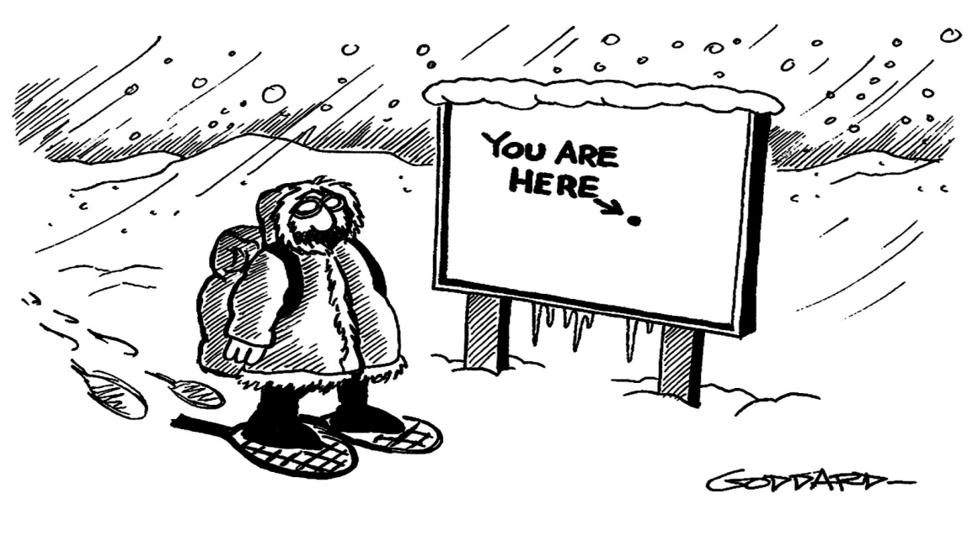
Frameworks for the Development of Multilevel Interventions
MATCH (Multiple Approaches to Community Health)(Simons-Morton et al., 1995)
PRECEDE-PROCEED (Green & Kreuter, 2005; new edition Fall 2020)
THE BEHAVIOR CHANGE WHEEL (Michie et al., 2014)
INTERVENTION MAPPING (Bartholomew-Eldredge et al., 1998; 2016; new edition Spring 2021)

Slide 53

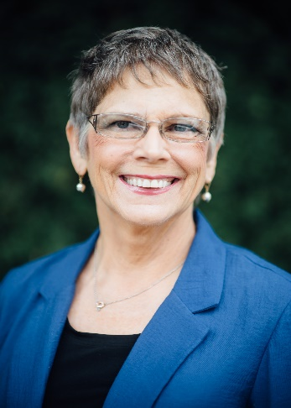
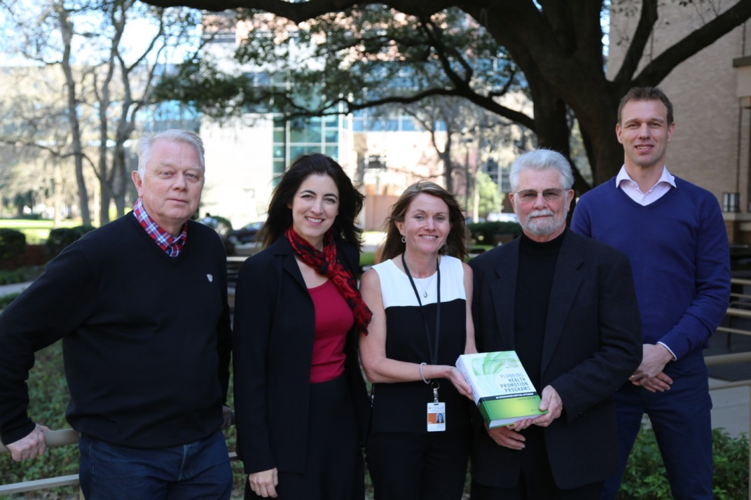
What is Intervention Mapping?
A systematic approach to multilevel intervention development, implementation & evaluation
Uses an ecological approach
Provides a framework for decision-making at each step of development
  Theory
  Empirical evidence
  New data
  Community input
Incorporates community participatory processes
Bartholomew Eldredge, LK, Markham, CM, Ruiter, RAC, Fernández, M.E., Kok, G, Parcel, GS (Eds.). Jan 2016. Planning health promotion programs: An Intervention Mapping approach (4th ed.). San Francisco, CA: Jossey-Bass
Notes:
Stimulated by questions that included how and when to:
take an ecological approach to program planning?
use theory and frameworks to inform planning?
incorporate empirical evidence?
address changing the behavior of people in the environment?
address the complexity of multi-causation of problems and multi-level intervention points?
...to create effective behavior or systems change interventions

Slide 54
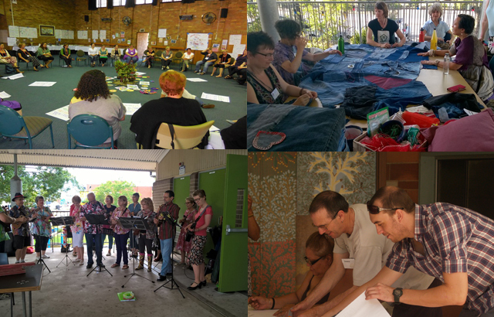
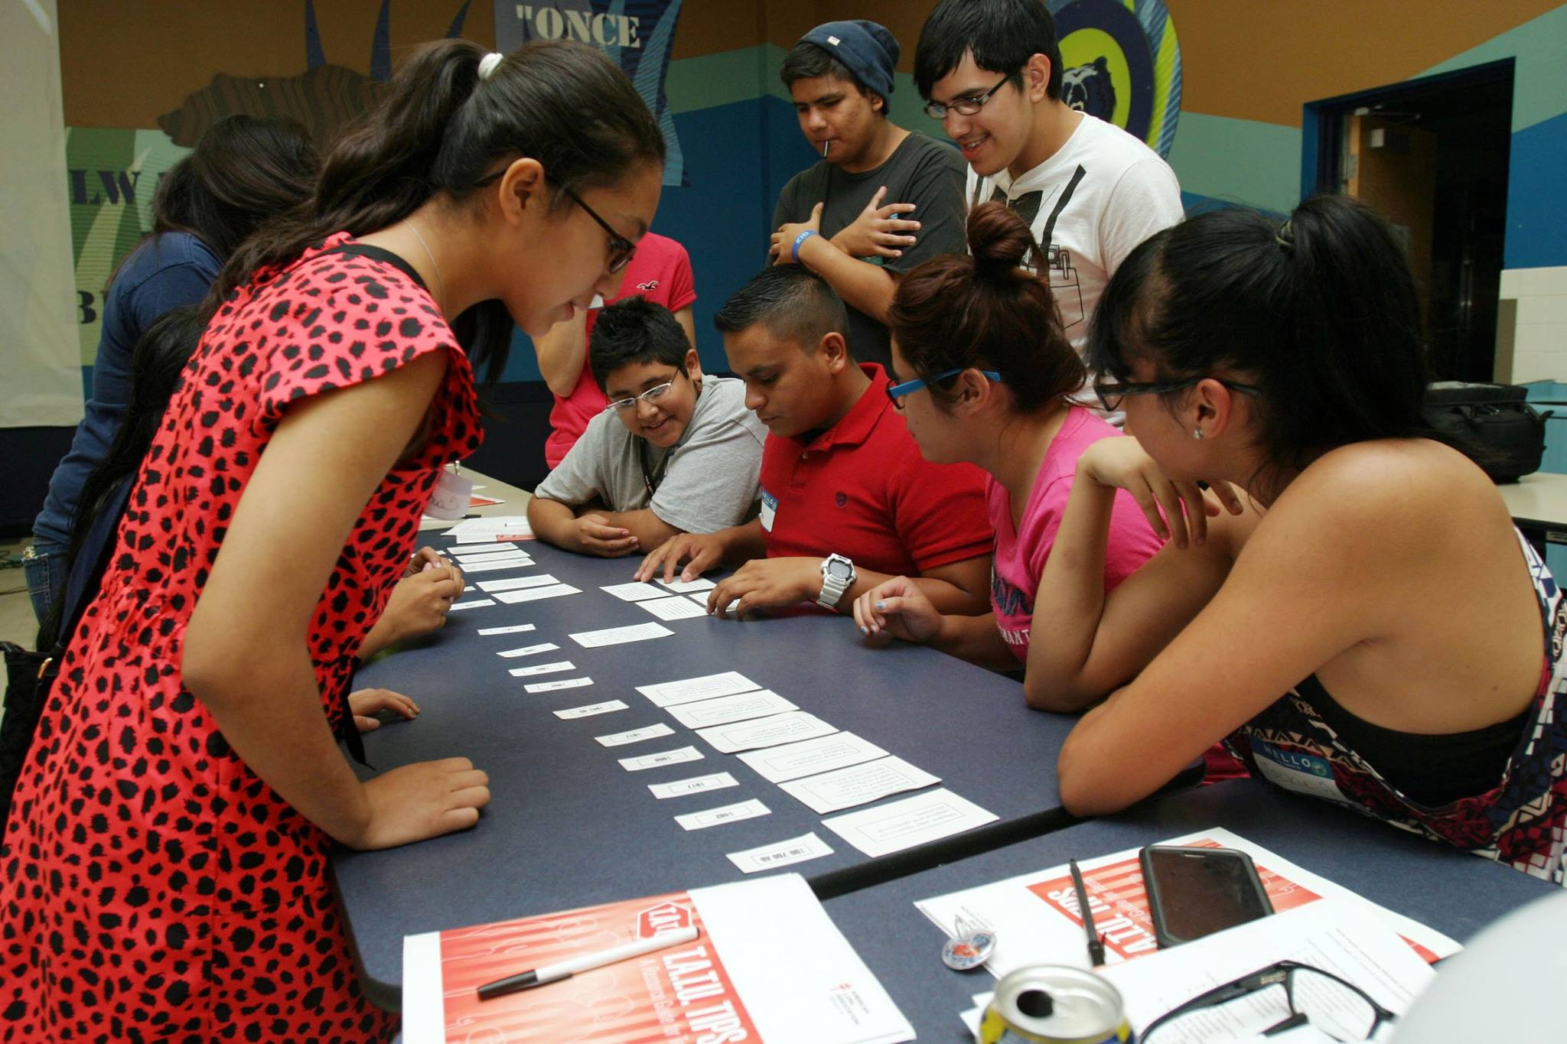
Community and Stakeholder Engagement
Knowledge generation comes from the hands of practitioners/implementers as much as it comes from those usually playing the role of intervention researcher.
Reference:
Hawe, P. (2015). Lessons from Complex Interventions to Improve Health. Annual Review of Public Health, 36(1), 307–323. doi: 10.1146/annurev-publhealth-031912-114421
Notes:
Equitable community/clinic participation:
Ensures that program focus reflects community/clinic concerns
Brings greater breadth of skills, knowledge, and expertise
Improves external validity

Slide 55
Remember Dr. Bryan Weiner’s “Take-Aways”
Recognize that “level” means different things to different people
We need a multilevel theory of the problem and a multilevel theory of the intervention
Avoiding kitchen-sink approaches means thinking through the interdependence of the determinants and the strategy-mechanism-determinant path
There are many organizational determinants, organizational interventions, and organization theories – but the connections among them have yet to be clarified or elaborated

Slide 56

Intervention Mapping Steps
Logic model of the problem
Program outcomes and objectives (logic model of change)
Program design (theoretical change methods and practical applications)
Program production
Program implementation plan
Evaluation plan

Slide 57
Step 1: Logic Model of the Problem
Conducting a needs and assets assessment
Establish and work with a planning group that includes program stakeholders,
Conduct a needs assessment to create a logic model of the problem
Describe the context for the intervention including the population, setting and community
State program goals

Slide 58
Logic Model of the Problem
Phase 4
Determinants
Phase 3
Behavior (At-risk group) and Environmental Factors
Phase 2
Health Problems
Phase 1
Quality of Life
Personal Determinants: What theory- and evidence-based factors are causally related to the behavior(s)?
Behaviors: What behaviors increase risk, incidence, prevalence, and burden?
Health Problems: What is the priority health problem(s) in the population or subgroup?
Quality of Life: What is the impact of the health problem(s) on quality of life?
Personal Determinants of environmental actors: What theory-and evidence-based factors are causally related to the behavior of agents in the environment who control the environmental factor(s)?
Environment: What interpersonal, organizational, community, and societal factors influence health directly or through influence on the behavior of the at-risk group?
* Modified PRECEDE Model,
Green & Kreuter (2005)

Slide 59

Logic Model of the Problem
Personal Determinants
Low levels of Knowledge about CRC and CRCS (delate and procedural)
Low perceived risk of CRC
Cancer misconceptions
Negative attitudes towards screening (gear and shame)
Low self-efficacy
Low health literacy
Perceived social norms/perceived barriers (time, cost, machismo, transportation…)
Outcome expectations
Behavior Factors
Lack of or inconsistent CRCS
Health Problem
Colorectal cancer
Quality of Life
Shortened lifespan
Emotional and sexual issues
Loss of self-esteem
Rejection
Absenteeism
Employee productivity losses
Loss of work
Environmental factors
Interpersonal
Lack of recommendation by providers
Organizational
High turnover of providers in clinics 330 (FQHCs)
Decrease in the number of specialists
Increased ratio for primary care physicians
Difficulty in obtaining a referral to a gastroenterologist among GHP patients
Long wait times to make an appointment with the provider
Clinics with external laboratories
Multiple steps in the process of getting screening and obtaining results
Personal Determinants
Lack of knowledge about CRCS guidelines by health providers
Low levels of communication skills
Low perceived outcome expectations

Slide 60

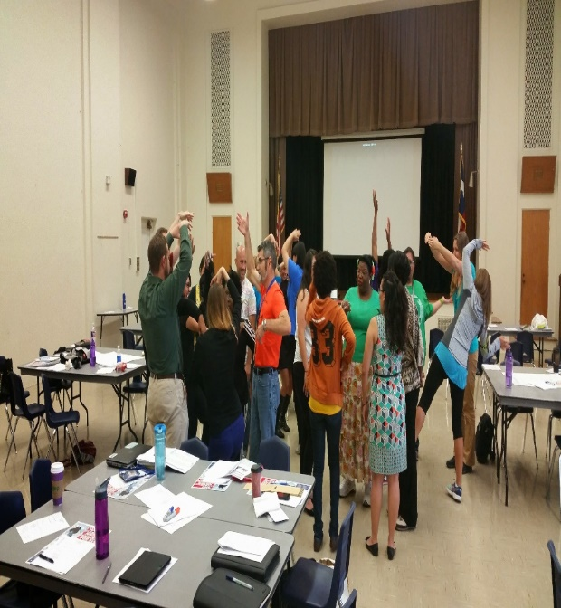
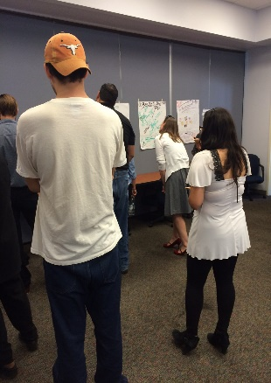
Environmental Asset Mapping Framework (Springer & Evans, 2016)
Policy Environment
Example: Child Out-of-School Program
Frontline staff code of conduct
OST program family agreements
OST district level policy
Schedule that includes 30 minutes of recess
Social/Cultural/ Org. Environ.
Example: Child Out-of-School Program
In-service staff trainings
Student talent show
Student mentoring groups
OST program partners
Settings
What are the settings that can be harnessed to reach the priority population?
Example: Promotion of child physical activity among children living in X community.
Key settings for children in X community include:
School
Out-of-school (OST) programs
Church
Neighborhood
Community recreational organizations
Information Environment
Example: Child Out-of-School Program
Parent bulletin board
Parent flyer/newsletter
School website
OST program webpage
Physical Environment
Example: Child Out-of-School Program
Cafeteria
Gym
School garden
Playgrounds & field
Tables/wall space
Participatory inquiry

Slide 61

Step 2: Program Outcomes and Objectives
- Logic Model of Change
State expected outcomes for behavioral and environmental change (at multiple levels)
Specify performance objectives for behavioral and environmental outcomes
Select determinants for behavioral and environmental outcomes
Construct matrices of change objectives
Create a logic model of change

Slide 62
Figuring out the WHAT before the HOW
Specify Implementation Performance Objectives:
What are the subcomponents of the Implementation behavior?
  What do the program implementers need to do to deliver the essential program components with acceptable completeness, fidelity and adaptation?

Slide 63

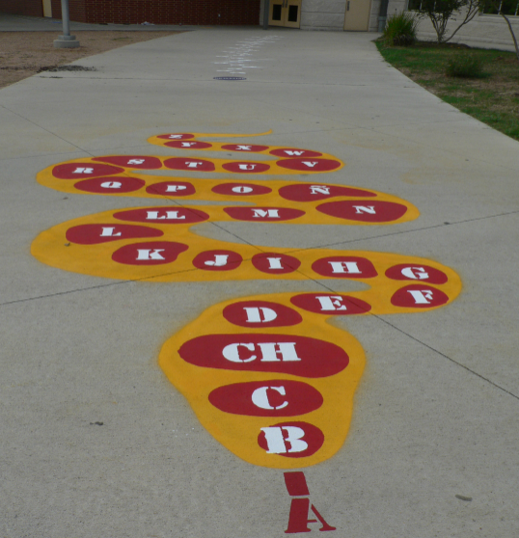
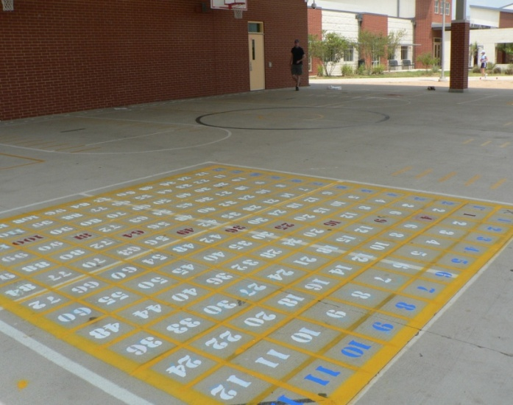
Active Play – Active Learning Project (Pueblo, CO & Austin, TX): “Behavioral & Environmental Outcomes”
Behavioral outcomes
Students participate in 30 minutes of physical activity during school.
Environmental conditions:
Schools improve play areas with playground markings (organizational environment - built environment)
Teachers lead their students in active learning 2 or more times during the week (social/and interpersonal level)
Notes:
Blurred the faces on this picture.

Slide 64
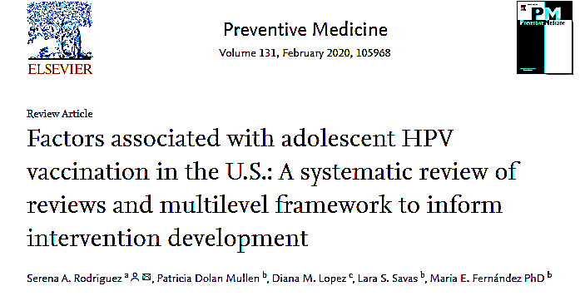
Multilevel Framework of HPV Vaccination
among Adolescents in the U.S.
Outcomes
Individual-level
Determinants of Vaccination
Parental psychosocial factors
Knowledge
Beliefs
Intention to vaccinate
Experience with preventive healthcare
Parent behavioral factors
Accessing preventive healthcare
HPV vaccine uptake
Reduction of HPV-related cancers and genital warts
Adolescent behavioral factors
Interaction with the healthcare system
  Regular healthcare provider visits
  Receipt of other adolescent vaccines
Provider-level
Behavior
HPV vaccine recommendation
Clinic-level
Patient-focused clinic systems
Reminder/recall systems
Phone calls
Text message reminders
Mailed letters
Outreach visits
Provider-focused clinic systems
Assessment & feedback
AFIX
  Provider reminders
Rodriguez, SA et al. (2020)

Slide 65
Create Matrices of Change Objectives
 | Determinant 1 | Determinant 2
Performance Objective 1 | Change Objective | Change Objective
Performance Objective 2 | Change Objective | Change Objective

Slide 66


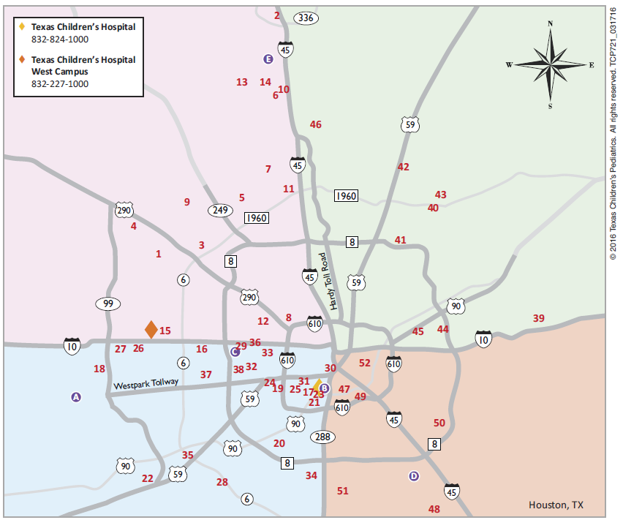
Using IM to increase HPV Vaccination
Texas Children’s Pediatric (TCP) Clinics
Adolescent Vaccination Program (AVP)
Houston’s largest FQHC
14 service delivery sites
  In 2015, 18.5% of age-eligible patients had initiated the HPV vaccine
  Of those that initiated, 57% had completed the series
Largest general pediatrician group in the
US. 51 pediatric practices in 6
nearly 30% of the pediatric population in these areas.
Funded by the Cancer Prevention and Research Institute of Texas (CPRIT)
Evidence-Based Cancer Prevention Services & Individual Investigator Research Awards for Prevention and Early Detection
Notes:
Aim 1: Develop, pretest, and implement two multi-component interventions, targeting providers and parents of adolescent patients to increase HPV vaccination initiation.
Aim 2: Evaluate the effectiveness of the multicomponent interventions on HPV vaccination initiation and completion rates in TCP clinics.
Aim 3: Evaluate the cost-effectiveness of the multicomponent interventions.

Slide 67
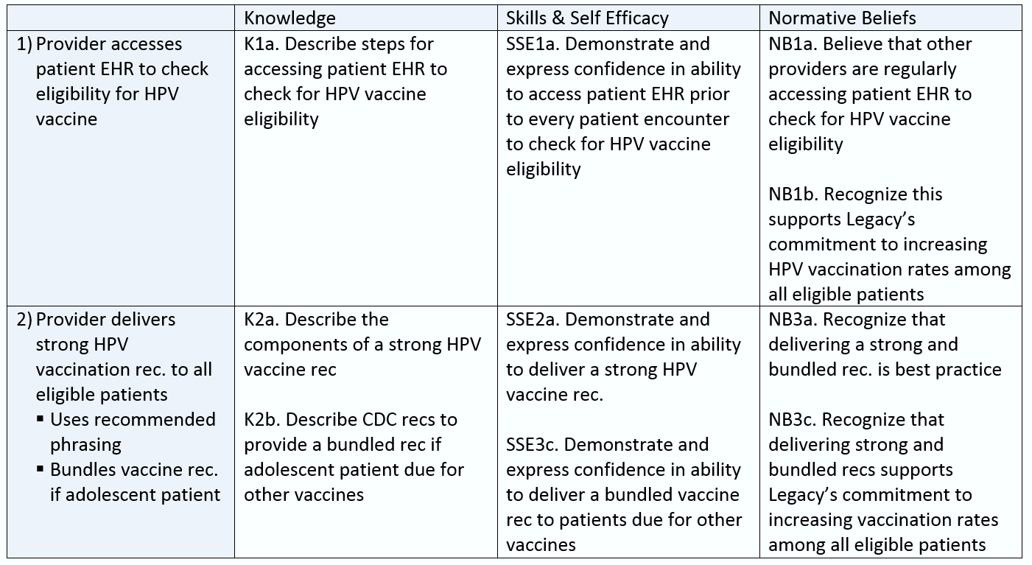
Creating Matrices of Change Objectives
  Identifying sub-behaviors:
  Partners developed a detailed flowchart outlining all Legacy provider behaviors required to ensure patient receives HPV vaccine.
Determinants
  Specifying determinants and creating matrices:
  “why would providers perform these behaviors” and select determinants (constructs) from theory. Matrices of change objectives in cells created by crossing sub-behaviors and determinants.
Sub-behaviors
Change Objectives

Slide 68
Logic Model of Change
Quality of life
Programa
METHODS
&
APPLICA-TIONS
Personal Determinants
(Priority Group)
Performance Objectives
Behavioral Outcomes
Change Objectives
Health
Personal Determinants
(Env. Agents)
Performance Objectives
(env. Agents)
Change Objectives
Environmental Outcomes

Slide 69
Now the How…
Implementation Strategies have change Methods and Practical Applications
A method is a general process for influencing changes in the determinants of behavior and environmental conditions
(element of core functions)
A practical application is a concrete, real-word technique for the operationalizing methods in ways that fit with the intervention group and the context in which the intervention will be conducted
  =how you will present and deliver the theoretical method
  (Forms- activities that operationalize, carry out & achieve the functions)

Slide 70

Step 3: Program Design
Generate program themes, components, and scope and sequence
Choose theory- and evidence-based change methods
Select or design practical applications
to deliver change methods

Slide 71

Selecting Theoretical Change Methods: Taxonomy of Behavior Change Methods (Kok et al., 2016)
Basic methods for individual level:
  Modeling (SCT): providing an appropriate model being reinforced for desired action
  Active Learning (SCT): encouraging learning from activity-based experience
  Tailoring (Trans-Theoretical Model)
Basic methods for environmental conditions
  Systems Change (Systems Theory): Change elements and relationship among elements of a system at any level (aka: structural redesign)
  Participatory Problem Solving (Org Dev. Theories): Diagnosing the problem, generating solutions, developing priorities, making action plan, & obtaining feedback after implementing plan.
  Advocacy & Lobbying (e.g., Agenda Building Theory): Arguing and mobilizing resources on behalf of a particular change
  Technical Assistance (e.g., Diff. of Innovations): Providing technical means to achieve desired behavior.
Methods also organized by Determinants (e.g., methods for increasing knowledge, awareness, social norms)
Parameters for use of method
Method—modeling
Parameters for use—attention, remembrance, reinforcement of model, identification with model

Slide 72
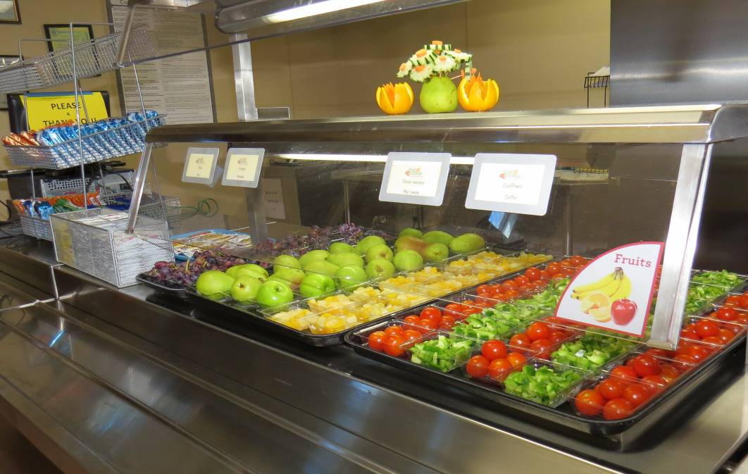
Re-engineering school cafeteria serving lines
Behavioral outcome:
Students eat fruit and vegetables daily
Environmental condition/outcome:
School cafeterias promote consumption of fruit and vegetable
Environmental Change Method
Structural Redesign (Systems theory change)
Nudging (Behavioral Economics)
Stimulus Control (Theories of Automatic/Impulsive behaviors)
Practical application
Reengineering of serving line to promote FV first
Frerichs et al (2015): Influence of school architecture and design on healthy eating: review of evidence
(AJPH, 2015)
Notes:
Frerichs L, Brittin J, Sorenson D, Trowbridge MJ, Yaroch AL, Siahpush M, et al. Influence of school architecture and design on healthy eating: a review of the evidence. Am J Public Health. 2015;105(4):e46-e57. doi: 10.2105/ AJPH.2014.302453.

Slide 73
Example of methods and practical applications used in AVP to impact determinants for vaccination behavior
Physicians will vaccinate eligible patients against HPV in accordance with ACIP guidelines
Performance objective: PO.2. Review quarterly assessment and feedback (A&F) report for HPV vaccination
# OBJECTIVE | METHOD | PRACTICAL APPLICATION
KNOWLEDGE
K.2a: Identify when and how A&F reports will be delivered K.2b: Describe the content of the A&F reports K.2c: Recognize that A&F is one of the most effective strategies to promote vaccination | Skill building and guided practice Chunking Tailoring Feedback Consciousness raising | Champions receive one champion binder to hold A&F reports, newsletters, and information about webinars for providers to access. Champions send logs recording each provider’s receipt of the A&F report back to the project team. Champions educate providers about the effectiveness of A&F reports. Providers engage in CEs, which provide education regarding the effectiveness of A&F reports.
OUTCOME EXPECTATIONS
OE.2a: Expect that reviewing A&F reports will allow his/her clinic and staff to track progress toward HPV vaccination goals OE.2b: Expect that reviewing A&F reports will improve personal and clinic-level HPV vaccination rates | Self-assessment | Quarterly A&F reports are stored in the champion binder for tracking provider and clinic vaccination rate progress from quarter to quarter.
NORMATIVE BELIEFS
NB.2: Recognize that vaccinating all eligible patients against HPV in accordance with ACIP guidelines is part of TCP’s expectation for optimal physician performance | Persuasive communication Information about others’ approval | Physician newsletters from the clinic network director provides messaging regarding the network’s vaccination initiation and completion goals.

Slide 74

Step 4: Program Production
Refine program structure and organization
Prepare plans for program materials
Draft messages, materials, and protocols
Pretest program materials and protocols

Slide 75
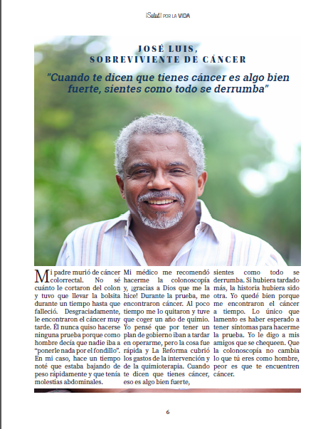

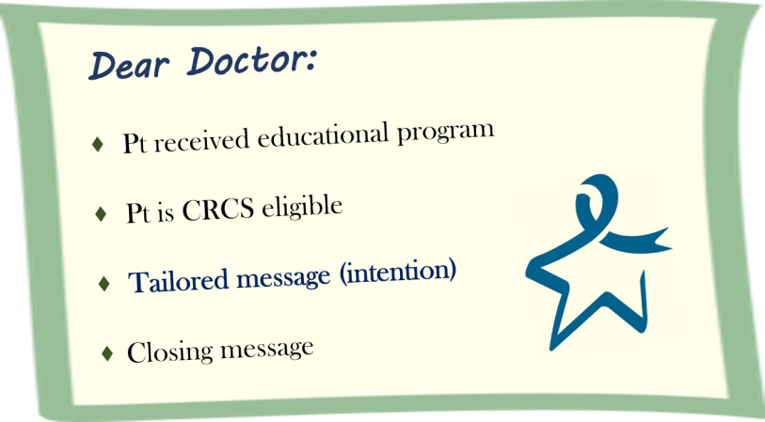
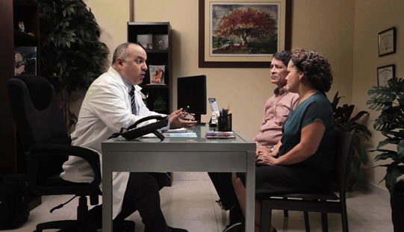
Program Production
Program Production
TIMI-Tailored Interactive Multimedia Intervention
Printed materials:
Newsletter
Fact sheets
Infographics
Action Plan
Provider prompts
Reminder/support calls
Modeling, reinforcement, persuasion (Social Cognitive Theory)
Tailoring (Trans-Theoretical Model), Anticipatory regret (Theory of Planned Behavior)
Consciousness raising (Health Believe Model)
Providing cues to action (Theories of Information Processing).

Slide 76
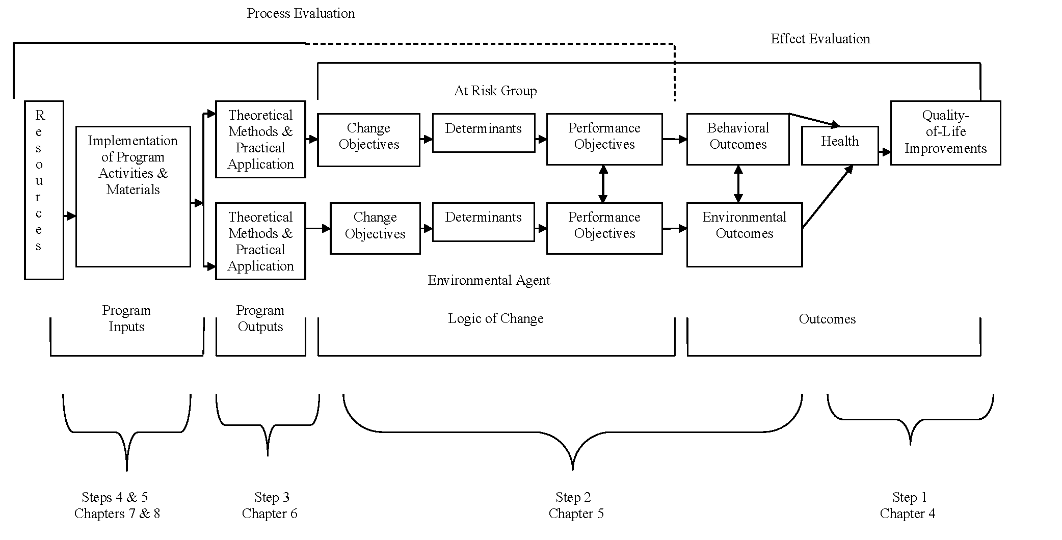
Intervention Logic Model
Figure 9.1

Slide 77
Step 5: Program Implementation Plan
Identify potential users (adopters, implementers, and maintainers)
State outcomes and performance objectives for program use
Construct matrices of change objective for program use
Design implementation interventions

Slide 78
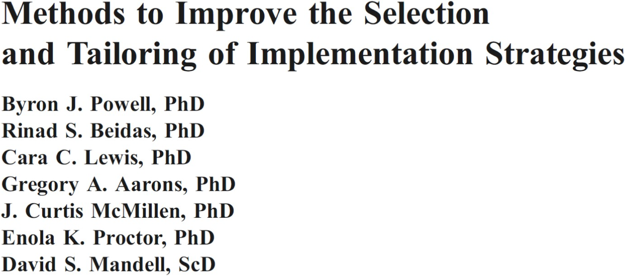
Methods for Designing and Tailoring Implementation Strategies
Group Model Building
Conjoint Analysis
Concept Mapping
Intervention Mapping
Baker et al. (2015); Bosch et al. (2007); Colquhoun et al. (2017); Grol et al. (2013); Powell et al. (2017)

Slide 79

Intervention Mapping:
A Systematic Approach for Intervention Development, Implementation and Adaptation
Three ways to use IM for D&I
Designing multi-level interventions in ways that enhance its potential for being adopted, implemented, and sustained
Designing implementation strategies to influence adoption, implementation and continuation (Implementation Mapping)
Using IM processes to adapt existing
evidence-based interventions
Bartholomew Eldredge, LK, Markham, CM, Ruiter, RAC, Fernández, M.E., Kok, G, Parcel, GS (Eds.). Jan 201). Planning health promotion programs: An Intervention Mapping approach (4th ed.). San Francisco, CA: Jossey-Bass.

Slide 80

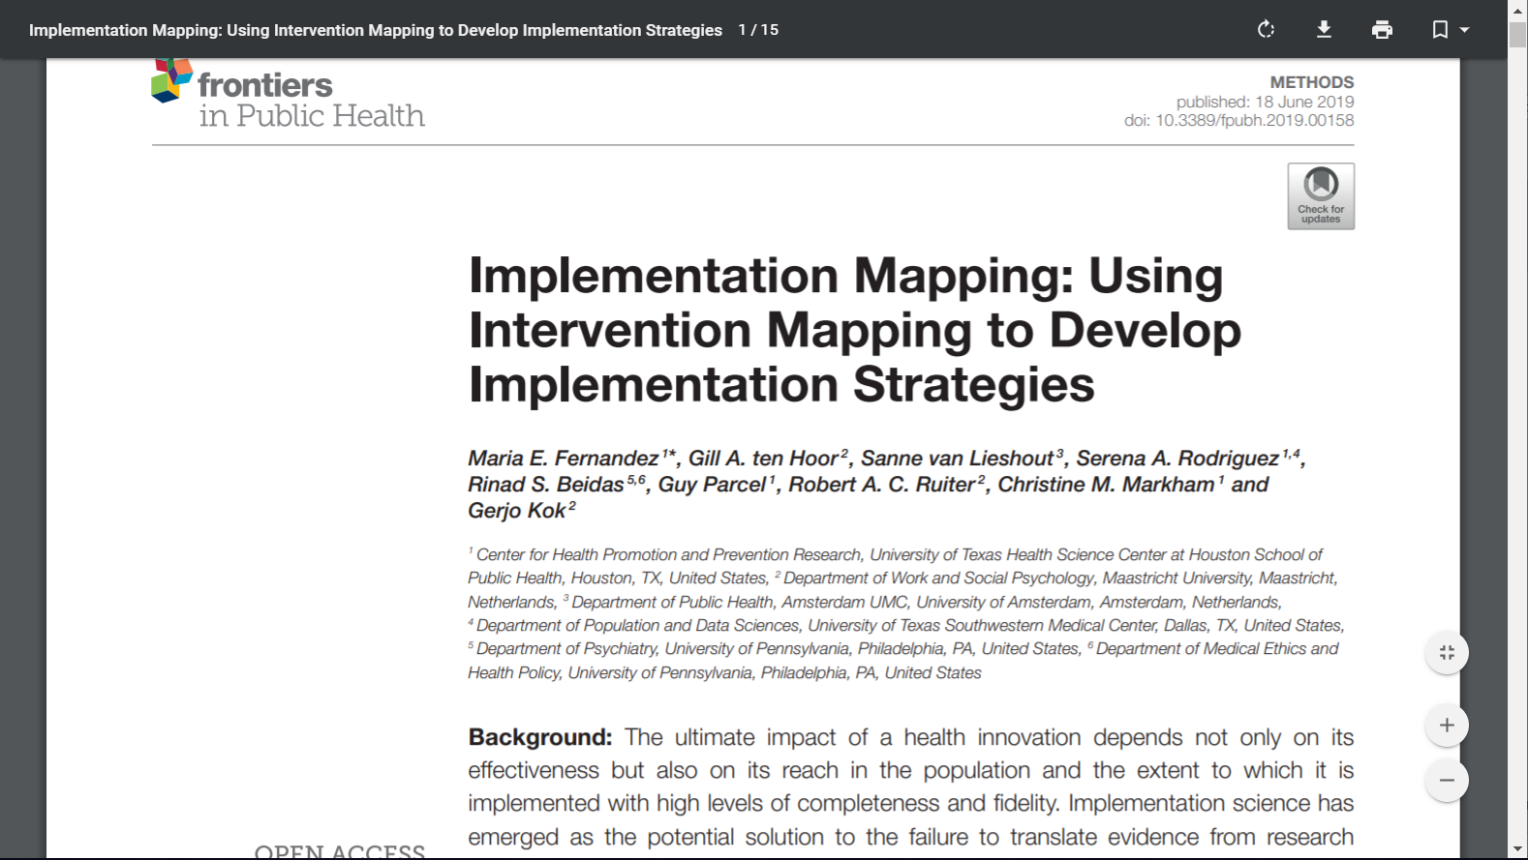
What is Implementation Mapping?
The Use of the Intervention Mapping Protocol for planning Implementation Strategies
(Implementation Interventions).
Implementation Science + Intervention Mapping = Implementation Mapping
Fernández ME, et al.Implementation Mapping: Using Intervention Mapping to Develop Implementation Strategies, Frontiers in Public Health, 2019, 7:158. doi: 10.3389/fpubh.2019.00158. eCollection 2019. PMID: 31275915; PMCID: PMC6592155.

Slide 81
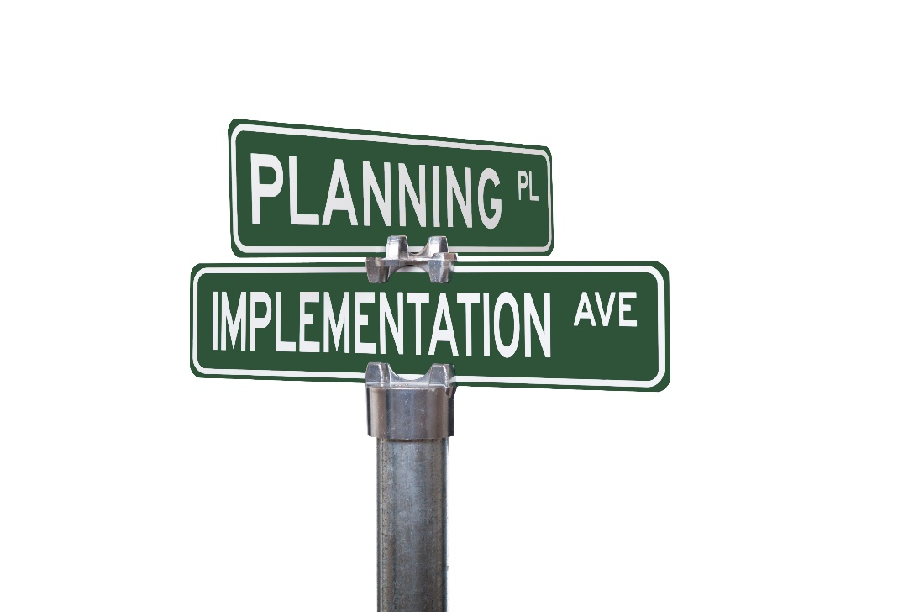
Implementation Mapping Tasks
Task 1. Conduct a needs and assets assessment and identify adopters and implementers
Task 2. Identify adoption and implementation outcomes, performance objectives, and determinants; create matrices of change.
Task 3. Choose theoretical methods; Select or create implementation strategies.
Task 4. Produce implementation protocols and materials.
Task 5. Evaluate Implementation Outcomes
Guides the D&I planner/researcher
to answer the following questions:
Who will decide to use the program?
Who will implement the program?
Who will assure that the program continues over time?
What do they need to do?
Why would they do it (determinants)?
How (what methods and strategies) do we influence these adoption, implementation, and maintenance behaviors and conditions?

Slide 82
Implementation Mapping Logic Model
EBI Implementation Outcomes
Implementation Strategies
Determinants of Program Use
Program Use Tasks (Performance Objectives)
Program Use Outcomes
Evidence-Based Intervention (EBI)
Program, Guideline or other Health Innovation
Contain methods (techniques)
and
practical applications…
to change determinants
Determinants of Adoption
Adoption Performance Objectives
Adoption
Implementation
Intervention (Strategies)
Determinants of Implementation
Implementation
Performance Objectives
Implementation
Determinants of
Maintenance
Maintenance Performance Objectives
Maintenance
Multilevel Implementation Context
Setting characteristics, policy climate, culture, readiness, resources
Health and Quality of Life Outcomes
Planning process
How?
Why?
What?
Who?
Notes:
Program components for target population and environmental agents
Contain methods (techniques) and practical applications to change determinants of Implementation behaviors and implementation environment

Slide 83
Implementation Mapping Logic Model
EBI Implementation Outcomes
Implementation Strategies
Determinants of Program Use
Program Use Tasks (Performance Objectives)
Program Use Outcomes
Evidence-Based Intervention (EBI)
Program, Guideline or other Health Innovation
Function
Adoption Performance Objectives
Contain methods (techniques)
and
practical applications to change determinants
Determinants of Adoption
Adoption
Implementation
Intervention (Strategies)
Determinants of Implementation
Implementation
Performance Objectives
Implementation
Form
Determinants of
Maintenance
Maintenance Performance Objectives
Maintenance
Multilevel Implementation Context
Setting characteristics, policy climate, culture, readiness, resources
Health and Quality of Life Outcomes
Planning process
How?
Why?
What?
Who?
Notes:
Program components for target population and environmental agents
Contain methods (techniques) and practical applications to change determinants of Implementation behaviors and implementation environment

Slide 84
EBI Implementation Strategy Outcomes
Implementation Strategies
Determinants of EBI Use
Tasks to enable EBI Use (Performance Objectives)
Implementation
Outcomes
Effectiveness outcomes
Evidence-Based Intervention (EBI)
Program, Guideline or other Health Innovation
Contain methods (techniques) and practical applications to create change in determinants of Implementation behaviors and implementation environment
Determinants of Adoption
Determinants of Implementation
Determinants of Maintenance
Adoption Performance Objectives
Implementation
Performance Objectives
Maintenance Performance Objectives
Adoption
Health and Quality of Life Outcomes
Implementation
Contextual/
Environmental influences on implementation
Maintenance
Select or create strategies that deliver methods creating change in determinants
Implementation science frameworks inform identification of implementation behaviors, context, performance objectives, and determinants
Task 1 (understanding needs and assets)
Tasks 3 & 4
(Choosing and operationalizing strategies)
Task 2 (planning change)
Planning process
Task 5 (Evaluate)

Slide 85
Peace of Mind Program Implementation Plan
Stage | Agent | Determinants/Change Objectives | Theoretical Change Methods | Practical Applications/ Strategy
Implementation | Program Champion Navigator | Awareness/ Perceptions Outcome Expectations Skills and Self-efficacy Feedback and Reinforcement | Information Persuasion Skill building and guided practice Modeling Monitoring and feedback Technical assistance / capacity building Facilitation Vicarious reinforcement | Face to face training held over two four hour sessions. BHC navigators model EBI behavior and provide ongoing implementation support on-site PMP research team available via email, phone and training booster sessions as needed Paperwork processes to provide funds for patients needing financial assistance from PMP
Highfield, L, Valeria MA, Fernandez, ME, Bartholomew-Eldridge, K. Development of an implementation intervention using intervention mapping to increase mammography among low income women.(2018) Frontiers in Public Health | doi: 10.3389/fpubh.2018.00300.

Slide 86
Types of Evidence-Based Interventions (EBIs) that can be implemented and disseminated:
Is it a MLI or a ML Implementation Strategy?
  Clinical Practice Guidelines
  Clinical Innovations (e.g. new screening technology)
  Interventions (Packaged programs) – including MLIs
  Policies
  Strategies (USPSTF Community Guide Recommendation; e.g. mass media, one on one, provider reminders)
Fernández ME, Mullen PD, Leeman J, Walker TJ. Evidence-Based Cancer Practices, Programs, and Interventions. In: Advancing the Science of Implementation across the Cancer Continuum. 2018, Oxford Press.

Slide 87
What HPV Vaccination Research Products Can be Implemented?
HPV Vaccination Guidelines (Use Intervention Mapping – Steps 1-6 to develop MLI)
General approaches/strategies for increasing HPV vaccination (e.g. community guide recommended approaches) (Use Intervention Mapping – Steps 1-6)
  Enhancing Access
  Increasing Community demand
  Provider or System-Based Interventions
Specific evidence-based intervention programs (Use Step 5 – Implementation Mapping)
  Specific protocols, materials (DOSE HPV, Hull Intervention)
Notes:
Because we use the term “implementation strategies” to mean what can be very different approaches, it is important to take a closer look at how we are understanding strategies or interventions to increase HPV vaccination uptake.
Why is this important? Differentiating these terms is important because they have distinct characteristics; are derived from different types of evidence bases; and present unique considerations for adoption, adaptation, and implementation. Here, and consistent with the literature, we define three types of research innovations that result from the translation of research findings for use in practice: clinical practice guidelines, general interventions, and specific interventions or programs.
An important focus of implementation science—the development of implementation strategies
Like CPGs, general interventions, called “strategies” in The Guide to Community Preventive Services (Community Guide) also are generated through systematic reviews of the literature.

Slide 88

Texas CDC Colorectal Cancer Control Program (CRCCP)
Clinic Data
- Clinic & patient characteristics
- CRCS rates
R=MC²
- Motivation
- General Capacity
- Innovation Specific Capacity
Clinic Work Flow
- Patient flow
- Screening procedures
Organizational Needs & Readiness Assessment
Implementation Supports
- Patient Navigators
- Small media
EHR Use
- Monitoring system
- Patient data
- Process improvement
EBI Use
- Use of Community Guide EBIs

Slide 89


Texas CDC Colorectal Cancer Control Program
Conceptual Framework for Implementation Strategy
Development and Tailoring
Formative Work
Implementation Mapping
Implementation Plan
RE-AIM Outcomes
Theories/Frameworks
Social Cognitive Theory, Interactive Systems Framework, R=MC²
Identify performance objectives (PO) (i.e. who has to do what to implement the EBI) & determinants for each implementation behavior and contextual factor
Create matrices of change objectives
(determinants x PO)
Identify methods and strategies to influence determinants
Plan implementation strategies
Develop implementation protocols and materials for implementation strategies
Implementation Strategies
Practice facilitation
EHR Optimization
Telementoring (via ECHO)
Use of Champions
Professional training and technical assistance
Reach
Eligible patients who receive CRCS recommendation
Effectiveness
Screened eligible patients
Followed-up with colonoscopy among those who screen positive
Adoption
All EBI components
Implementation
Fidelity, Implementation level
Organizational Needs & Readiness Assessment
Stakeholder Input

Slide 90
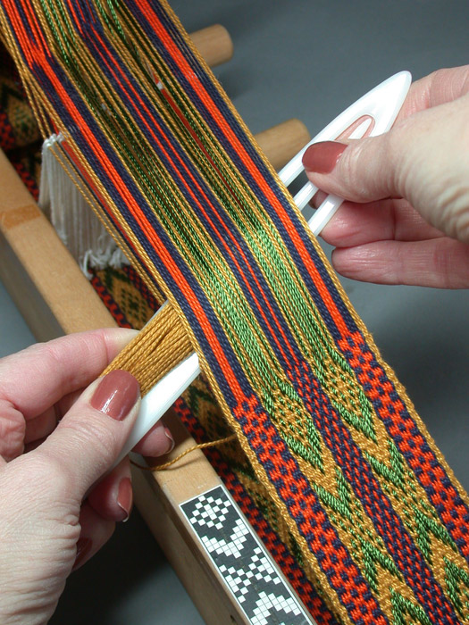
Interweaving health promotion into environments and settings
Designing interventions in concert with context:
Health promotion interweaving into context: Designing health promotion interventions (strategies, practices, programs & policies) to fit within, complement, and build from existing settings and environments.
“Coupling” & “Embedding” (Hawe et al. ‘09; May et al.’16)
Embraces an indigenous health intervention development perspective: Interventions build from site-specific knowledge, practices and values (Miller & Shinn, 2005)
Contrasts w/pipeline approach to knowledge generation: interventions designed under optimal conditions (efficacy trials) and then tested under ‘real world’ conditions, where ‘real world’ = potential for dilution of intervention effects. (Hawe, 2016)
Moves from a conceptualization of context as a backdrop to intervention, to one that recognizes context as integral to the intervention design
Springer, Evans, Ortuño, Salvo, Varela (Frontiers in Public Health, 2017)
Notes:
To examine theoretical and practice-based interweaving concepts in relation to:
the policy environment
the information environment
the social/ organizational environment
the physical envir

Slide 91
Summary
There is much to learn about how we can develop effective multilevel interventions.
Systematic planning of intervention components at multiple levels is key.
Intervention Mapping guides the use of theories/frameworks, empirical literature, community and stakeholder engagement and new data to:
  help understand determinants of health at multiple levels; and
  develop multilevel interventions to improve health and quality of life and implementation strategies to accelerate and improve scale up and spread of effective interventions.

Slide 92


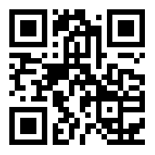
Post-doctoral Fellowship
AVAILABLE SUMMER 2021!
POSITION ELIGIBILITY
Individuals with a PhD, DrPH, MD, or other doctoral degree in public health, health promotion, a behavioral or social science, epidemiology, health services research, health economics, biostatistics, or medicine.
Open to U.S. citizens and permanent residents only.
Particularly interested in recruiting Postdocs interested in Implementation Science
For more information:
ncifellowships@uth.tmc.edu
Go.uth.edu/NCI2021
About UTHealth School of Public Health
The UTHealth School of Public Health Houston campus is located in the world’s largest medical center with regional campuses in Austin, Brownsville, Dallas, El Paso, and San Antonio
About the Center for Health Promotion and Prevention Research
CHPPR’s mission is to conduct research to develop, evaluate, and disseminate health promotion and disease prevention programs in diverse settings and populations.
Notes:
JOB DESCRIPTION
The Cancer Control Research Training Program in the Department of Health Promotion and Behavioral Sciences is seeking a postdoctoral fellow. Potential candidates should how outstanding promise of scholarly achievement that contributes to cancer prevention and control. Applicants with experience and/or interest in health equity, community engaged research, and implementation science and applicants from underrepresented minority groups are strongly encouraged to apply. The position is funded by the National Cancer Institute (T32 grant), a quality postdoctoral training program with a thriving interdisciplinary environment with collaborations in diverse populations and areas of Texas.
The candidate will receive support for up to 3 years and annual stipend starting at $50,004, depending on experience plus health insurance, tuition, fees, etc. Opportunities will include ?

Slide 93



Slide 94
Prepare questions in advance for the
panel discussion with faculty
Module 5, March 18, 2021

