Slide 1

The presentation will begin shortly
Division of Cancer Control and Population Sciences
Healthcare Delivery Program

Slide 2
Series Purpose – for NCI
Solicit opinions from four sectors of the community regarding problems in the quality of cancer care
  researchers, clinicians, healthcare managers and care providers
Clinical case study identifies a clinical problem, conflict or dilemma.
Focus a research agenda on major underlying factors affecting the processes of cancer care.

Slide 3
For Participants
Understand the perspectives of researchers, clinicians, healthcare managers and care providers with respect to problems in cancer care delivery
Learn conceptual, analytic, and practical approaches to understanding and addressing problems in cancer care delivery
Contribute to the development of NCI’s research agenda

Slide 4
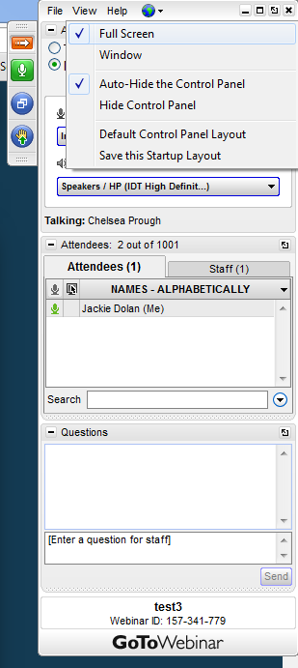
CONTROL PANEL AND FULL SCREEN FEATURES
A GoToWebinar control panel will appear in the upper right-hand corner of your computer screen once you’ve entered the meeting.
To expand the control panel:
Select the orange arrow button
To make the webinar full screen:
Click the blue window icon to toggle between full screen and window view.

Slide 5
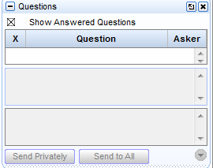
Instructions – Q&A session
If you would like to be unmuted and ask your question out loud, please click on the Raise Hand button (below the orange arrow) to be unmuted.
If you would like to type in a question and have a staff member read it to the group, please type it into the “Questions” box.
Type question here and send to Staff

Slide 6
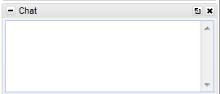
Instructions
All lines will be in listen-only mode. If you have technical difficulties or questions during the webinar,
  please type into the “Questions” box
If you need to view live closed captioning, please click on the link that will appear in the Chat box.
Type question here and send to Staff
Closed captioning link will appear here

Slide 7
Poll Question
On the next screen a poll question will appear. You will have 30 seconds to select your answer. Your individual answer will not be shared.

Slide 8
Review Case Study

Slide 9
Comments on Case?

Slide 10


Let the left hand know what the right is doing
A vision for care coordination and electronic health records
Robert S. Rudin
RAND Corporation
Photos via Fotolia/Rido (above), Levente Gyori (below)
Notes:
An important problem that is getting more important every day (inadequate care coordination), and how we might help solve it with IT.
We don’t have all the answers – so looking forward to the discussion and your ideas for moving forward.
Many of these issues apply beyond care coordination, beyond cancer. But acutely felt in cancer.

Slide 11


Engineering
Systems thinking
Photos via Fotolia/sveta (left), Brian Jackson (right)
Notes:
These two perspectives shape my thinking/education
Increasingly important in clinical and health services research
Engineering -> Building things.
Systems thinking -> understanding context, holistically within complex socio-technical systems, components and interactions.
These themes are reflected throughout this talk

Slide 12
Objectives
Show how innovation in using IT for care coordination is stuck in a rut
Highlight an under appreciated barrier: the developer-user disconnect
Present a framework and vision to help bridge the gap
Suggest ideas for how to achieving the promise of IT in care coordination

Slide 13
Poll Question
On the next screen a poll question will appear. You will have 30 seconds to select your answer. Your individual answer will not be shared.

Slide 14
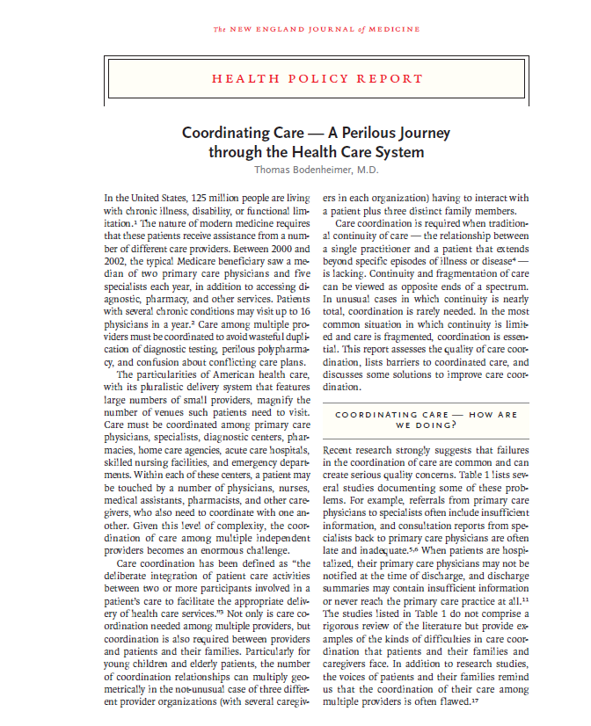
The need for innovation in care coordination
“Recent research strongly suggests that failures in the coordination of care are common and can create serious quality concerns.”
Notes:
Care coordination is poor, causing a lot of problems for patients and providers.
Inefficiencies.
This one wasn’t about cancer in particular, but…

Slide 15

The need for innovation in care coordination
“Coordination of complex cancer care, using a common electronic health record, with treating specialists who jointly discuss the patient’s case and then confer with the patient about their recommendations, is the exception and not the rule.”

Slide 16
Poll Question
On the next screen a poll question will appear. You will have 30 seconds to select your answer. Your individual answer will not be shared.

Slide 17
The promise of IT and care coordination
  Coordination is the act of organizing or integrating activities of two or more participants
  Information technology helps organize and integrate all kinds of things in other sectors (project management, supply chain, social networks)
EHRs are now widespread. How about care coordination?
Notes:
*In cancer care, great need for coordination – highly interdependent processes, different settings, currently fragmented.
Other sectors – engineers have figured it out.

Slide 18
Poll Question
On the next screen a poll question will appear. You will have 30 seconds to select your answer. Your individual answer will not be shared.

Slide 19
The reality of IT and care coordination
Longitudinal care plans “do not exist”¹
EHRs lack integrated care management software, care plans, and tracking ability²
Few coordination products are designed for physician-users³
Coordination products require changes in workflows and aren’t integrated with EHR³
¹ Samal et al. ,“A patient-centered longitudinal care plan: vision versus reality,” J Am Med Inform Assoc, Vol. 21, No. 6, Nov-Dec 2014, pp. 1082-90.
² O’Malley et al., “Electronic health records and support for primary care teamwork” J Am Med Inform Assoc, Vol. 22, No. 2, Mar 2015, pp. 426-34.
³ Rudin et al., Knowledge gaps inhibit health IT development for coordinating complex patients' care, Am J Manag Care, Vol. 22, No. 9, Sept 2016, pp. e317-22.

Slide 20
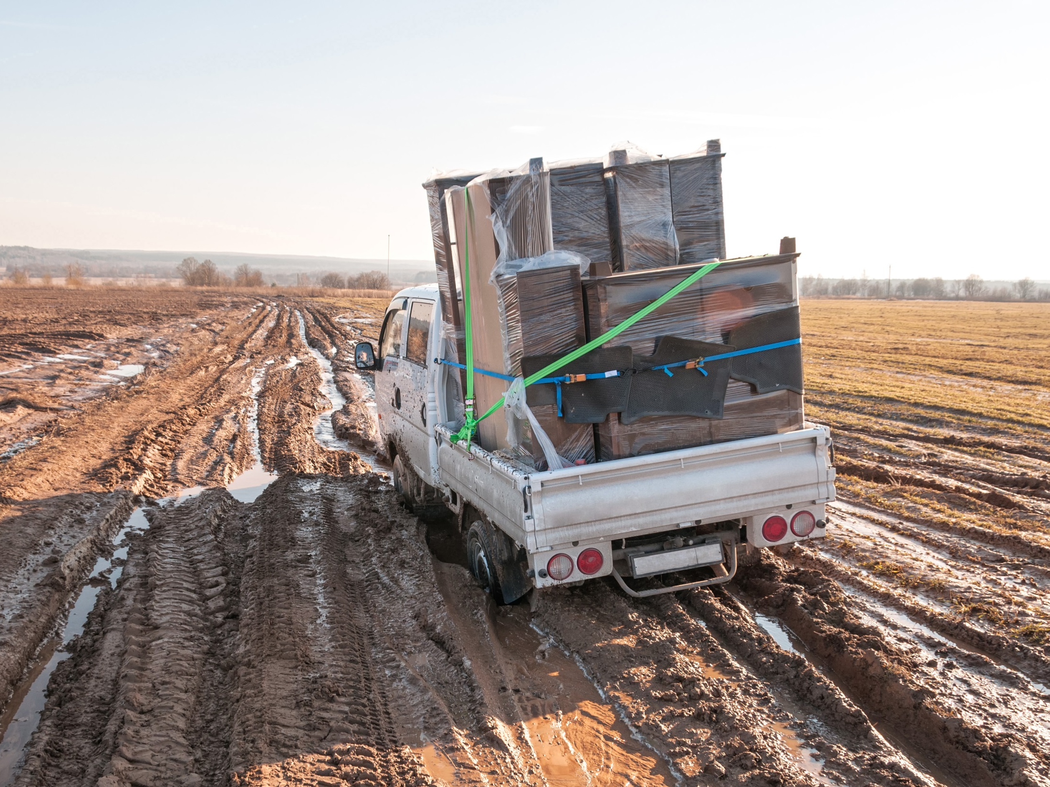
Verdict: Stuck in a rut
Photo via Fotolia/shujaa_777

Slide 21

Barriers
Incentives
    working on it (alternate payment models, ACOs)
Technical integration with EHRs
    working on it (technical standards for interoperability)
Let’s say we solve those problems – then what?
Developers still don’t know what tools to build
Notes:
All of these barriers are for innovation in health IT in general, not only care coordination, not only for cancer.

Slide 22
Poll Question
On the next screen a poll question will appear. You will have 30 seconds to select your answer. Your individual answer will not be shared.

Slide 23
Poll Question
On the next screen a poll question will appear. You will have 30 seconds to select your answer. Your individual answer will not be shared.

Slide 24
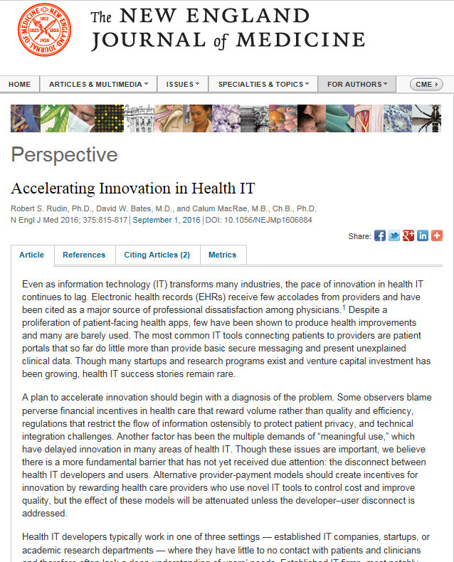
The developer-user disconnect
Notes:
Successful software requires the people making the technology to understand the people using the technology.
Core tenet of user-centered design.

Slide 25
Poll Question
On the next screen a poll question will appear. You will have 30 seconds to select your answer. Your individual answer will not be shared.

Slide 26
Users needs are complex
Diverse users: primary care physician, specialists, nurses, patient, patient surrogate, care coordinators, social services…
Desired roles, responsibilities, control over decision-making vary by patient, team members
Team members change over time
Workflows may not be standardized
Notes:
In cancer, often involves coordination with specialists like urologists, GI, OBGYN, ortho, PCP, pharmacists.

Slide 27

Developers need a target they can hit
Photo via Fotolia/nenetus
Notes:
Overwhelming for developers

Slide 28
Why a care coordination framework?
Helps describe what people do to coordinate care
Facilitate communication between developers and users
Help identify opportunities for using IT to improve care coordination
Notes:
Let’s start thinking about solutions to this problem.
Care Coordination is a collection of activities and processes. What are those activities/processes in particular?
Helps decompose a complex phenomenon into more manageable components – systems approach.
Provides a language and lens for analysis

Slide 29
Framework: an anatomy of care coordination
Identify collaborator
Establish contact
Collaborate
Monitor
Rudin and Bates,“Let the Left Hand Know what the Right is Doing: A Vision for Care Coordination and Electronic Health Records,”J Am Med Inform Assoc, 2013.
Notes:
Typology of the activities involved in care coordination
Not all need to happen all the time
Innovations may focus on one or more
Helpful when thinking about care coordination problems and generating ideas for new coordination tools

Slide 30
Examples of IT capabilities
Identify | Establish contact | Collaborate | Monitor
Ability to view all of a patient’s previous providers and role in care team Decision support for whom to refer to | Ability to request a phone meeting that includes degree of urgency Ability for physicians to set an “interruptability” status | Asynchronous messages (e.g., text, images, video message, multi-mode) Synchronous messages (e.g., text chat, phone, video, multi-mode) | Ability to track team member responsibility “Dropping-the-baton” alerts
Notes:
ID: Easy way to keep track of care team membership.
Monitor: Drop baton - especially in survivorship, and transitions – not closed loop.

Slide 31
Application to case study
67 yr old post menopausal woman visits PCP for routine care and c/o symptoms consistent with depression.
PCP recommends a selective serotonin reuptake inhibitor for symptom relief.
PCP discovered in the medical record the patient had been treated for breast cancer 10 years earlier.
Prescription is delayed pending a telephone consultation with PCP and the patient’s oncologist.
A week later, when the physicians connect, the discussion reveals, a potentially negative interaction of the selective serotonin uptake inhibitory with the earlier cancer therapy.

Slide 32
Application to case study
Identify | Establish contact | Collaborate | Monitor
Ability for PCP to know if she needs to discuss with patient’s own oncologist or one more available Decision support for oncologist to provide documentation anticipating PCP request for info | Ability to include degree of urgency in request Scheduling wizard to help find the soonest time slot for PCP, oncologist, and patient | Ability for PCP and oncologist exchange secure messages within patient note in EHR | Ability for patient to view in portal that info request is waiting for a response Care manager is alerted if question is unresolved within a specified time
Notes:
Degree of urgency - may in part depend on patient preference.

Slide 33
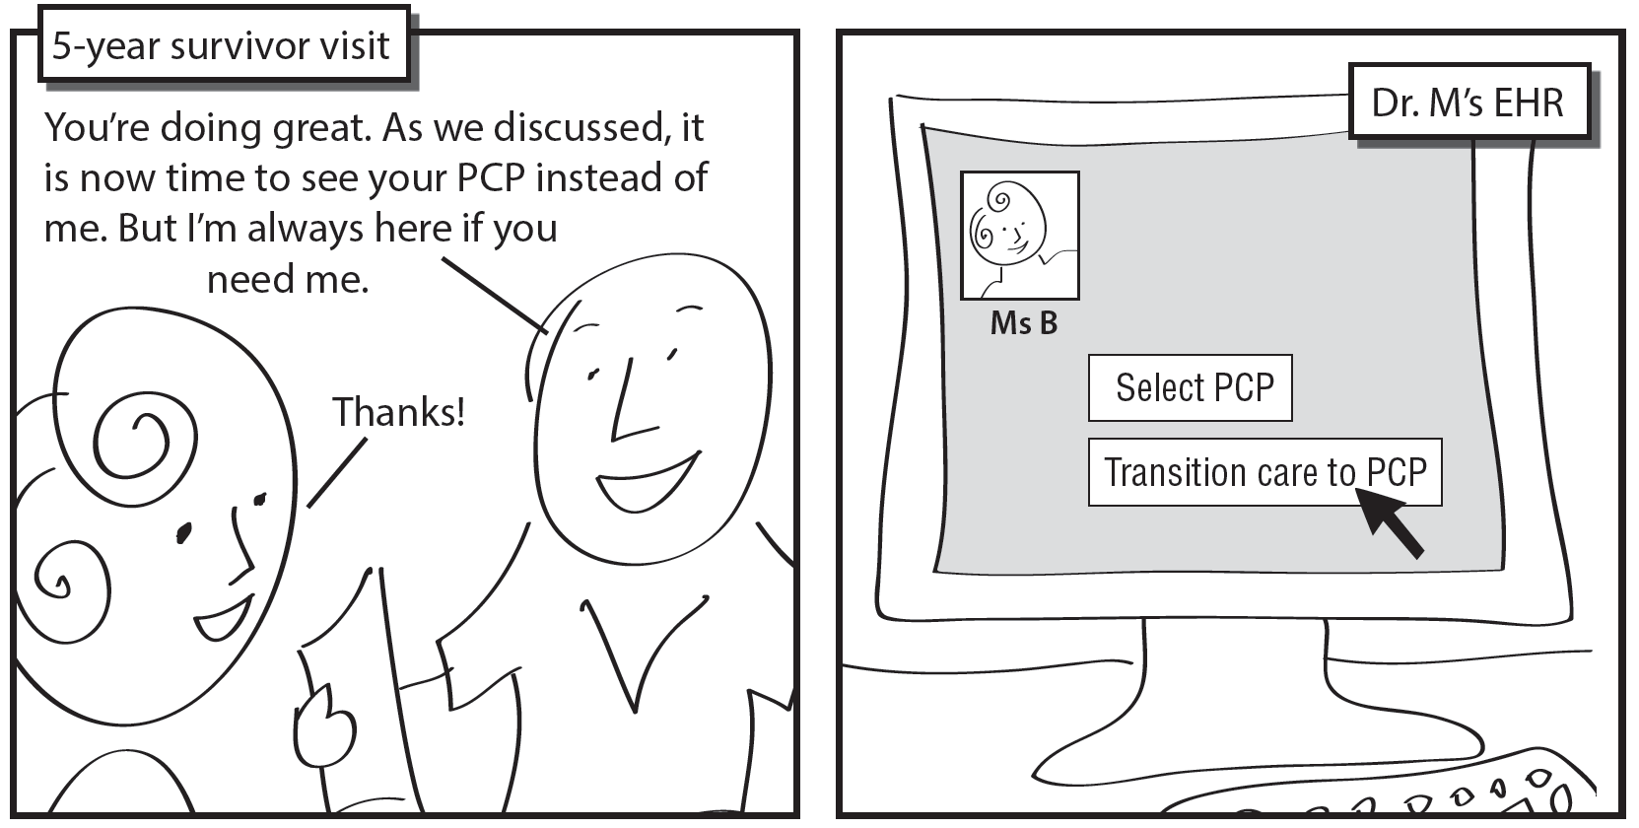
Monitoring example (survivorship)
Notes:
Example of monitoring to make sure baton isn’t dropped – in survivorship care

Slide 34
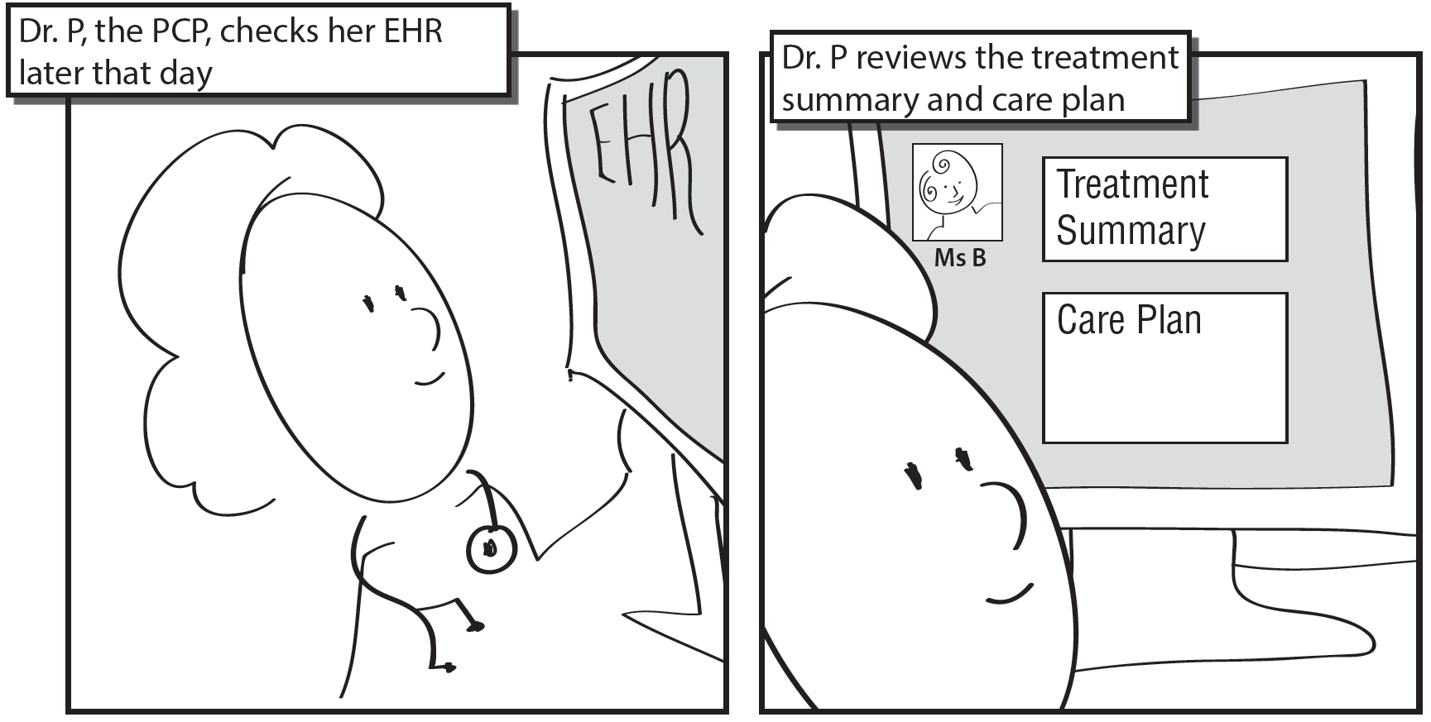
Monitoring example (survivorship)

Slide 35
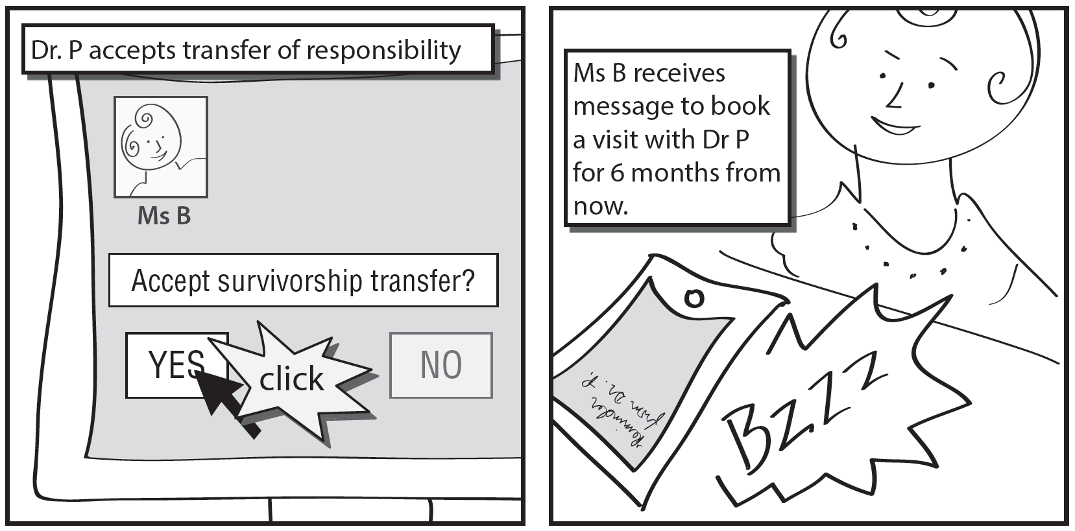
Monitoring example (survivorship)
Notes:
Doesn’t exist in current EHRs as far as I know.
Just an idea at this point - will take some work pilot this, identify barriers, how to implement.

Slide 36
Realizing the promise?
McGlynn et al.¹: “It takes a system” to fundamentally improve quality
  Requires significant work by health care professionals on front lines with patients
  Requires engagement on the ground
Implications for IT and care coordination: Don’t wait for new incentives, interoperability
¹ McGlynn et al., “The Quest to Improve Quality Measurement Is Necessary but Not Sufficient,” JAMA Intern Med., Vol. 176, No. 12, 2016, pp. 1790-1791.
Notes:
Stake to where the puck will be.
Incremental – not viral

Slide 37
Help developers help clinicians and patients
Structure: Create institutional structures for facilitating developer-user interaction
Process: Identify building blocks - core use cases and workflows that can be standardized and automated
Outcomes: Build, pilot, and persuade with evidence
Notes:
*Organizational support needed to create structures and bridge disconnect
Building blocks - simple and universal.
Need industry consensus, some standardization: High configurability = high complexity = not worth it. Not efficient or feasible for every care center to have customized software

Slide 38
Acknowledgements
Coauthor
  David W. Bates, MD (Brigham and Women’s Hospital, Harvard)
Storyboards
  Ann Partridge, MD (Dana Farber Cancer Institute)
  Nancy Keating, MD (Brigham and Women’s Hospital, Harvard)
  David W. Bates, MD (Brigham and Women’s Hospital, Harvard)
  Dori Walker, Graphics Designer (RAND)

Slide 39
Thank You!
More Questions?
HCTcyberdiscussions@nih.gov
Next Session
Thursday May 18, 2017
1:00PM- 2:30PM
Raymond U. Osarogiagbon, MD
Building a Multidisciplinary Bridge across the Quality Chasm in Thoracic Oncology http://healthcaredelivery.cancer.gov/cyberseminars/

