Slide 1



The presentation will begin shortly
Division of Cancer Control and Population Sciences
Healthcare Delivery Program

Slide 2
Series Purpose – for NCI
Solicit multidisciplinary input on team functioning and teamwork processes in cancer care.
Build upon the 2015 initiative between NCI and ASCO to apply the science of team-based care to oncology.
Focus a research program to support continuous improvement of cancer care by facilitating the dissemination and integration of this knowledge into practice.

Slide 3
For Participants
Understand the perspectives of four communities with respect to challenges in cancer care delivery.
Learn conceptual, analytic, and practical approaches to understand and address problems in cancer care delivery.

Slide 4

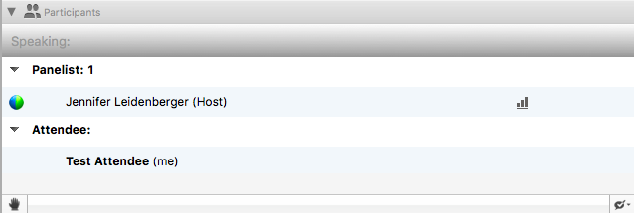
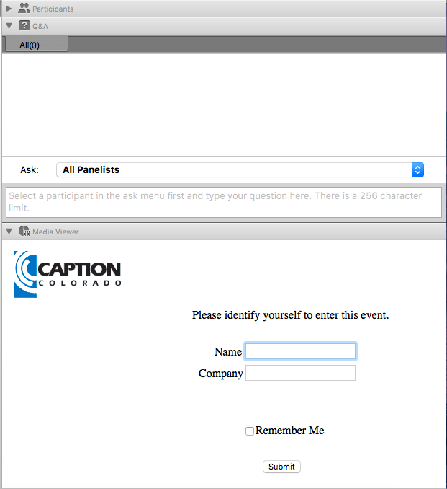
WebEx and Webinar Logistics
All lines will be in listen-only mode
Submit questions at any time during the presentation. Type into the Q&A Panel on the right hand side of the interface and press “send”
To “raise your hand” to ask a question, select the hand icon found under the Participant Panel
If you have questions or feedback following the presentation, please contact HCTcyberdiscussions@nih.gov

Slide 5
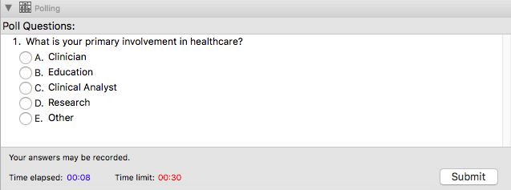
WebEx and Webinar Logistics
Make sure icons are selected for them to appear as a drop down option
Closed captioning is available by selecting the Media Viewer Panel on the right hand side of your screen
Questions will appear in the Poll Panel, select your answer and hit “submit”

Slide 6
Who’s on the Call
Clinician
Educator
Clinical Analyst
Researcher
Other

Slide 7
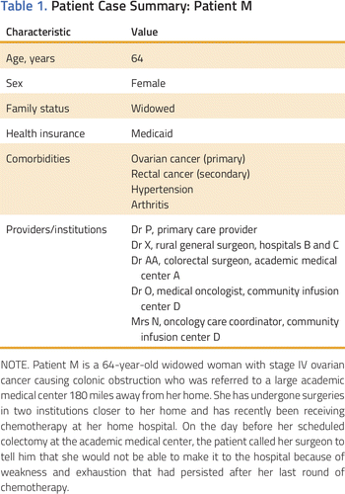
Case Discussion

Slide 8
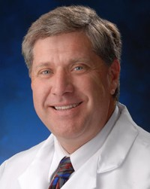
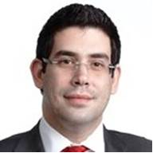

Introduction
Dr. Nick Sevdalis
Professor of Implementation Science & Patient Safety
Kings College London
nick.sevdalis@kcl.ac.uk
Presentation title:
“Teamwork and team performance in multidisciplinary cancer teams: development and evaluation of an observational assessment tool”
Note: Please do not reproduce figures without permission.

Slide 9






Teamwork & team performance in multidisciplinary cancer teams: development & evaluation of an observational assessment tool
Professor Nick Sevdalis PhD
Professor of Implementation Science & Patient Safety | Director, Centre for Implementation Science | Chief Editor, BMJ Simulation & Technology Enhanced Learning | Associate Editor, Implementation Science
nick.sevdalis@kcl.ac.uk
@NickSevdalis
www.clahrc-southlondon.nihr.ac.uk
Notes:
9

Slide 10
Disclosures
Research infrastructure funding through the National Institute for Health Research (NIHR) and King’s Health Partners
Research project funding through the NIHR, Economic and Social Research Council, JDRF, Sanofi Pasteur, Urology Foundation
Chief Editor, BMJ Simulation & Technology Enhanced Learning
Director, London Safety & Training Solutions ltd
Notes:
10

Slide 11
Talk outline
Why should we care about assessing teams in cancer care?
Introduction of an instrument: MDT-MODe
Rationale
Elements
Learning curve
Sample applications & findings
Reflections: what can team assessment in cancer care tell us?
Discussion
Notes:
11

Slide 12
Getting the terms right
MDT: A group of people of different health-care disciplines, which meets together at a given time (whether physically in one place, or by video or teleconferencing) to discuss a given patient and who are each able to contribute independently to the diagnostic and treatment decisions about the patient
MDT members:
Chair
Physicians: surgeons, oncologists, radiologists, pathologists, other physicians
Nurses: clinical nurse specialists (specialised in Ca care)
Allied health professionals: social workers, dieticians, others
Coordinator: administrator (documentation, data collection)
Department of Health, 2004
Notes:
12

Slide 13
Getting the terms right
MDT: A group of people of different health-care disciplines, which meets together at a given time (whether physically in one place, or by video or teleconferencing) to discuss a given patient and who are each able to contribute independently to the diagnostic and treatment decisions about the patient
MDT members:
Chair
Physicians: surgeons, oncologists, radiologists, pathologists, other physicians
Nurses: clinical nurse specialists (specialised in Ca care)
Allied health professionals: social workers, dieticians, others
Coordinator: administrator (documentation, data collection)
Department of Health, 2004
Notes:
13

Slide 14

Why MDT assessment?
Clinically:
Strong policy drive for MDT-driven treatment
In both Ca & non-malignant disease
Example: Current policy drive in England
96 recommendations
3 on MDTs
Rec. No 38: MDTs should be should be supported to use validated tools to self assess and improve their effectiveness
Notes:
14

Slide 15
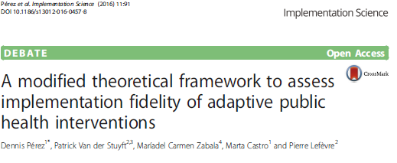
Why MDT assessment?
Scientifically:
Having a MDT in place does not mean all its benefits are achieved consistently
Effectiveness of team-based interventions depends on quality of their implementation
Concept of implementation fidelity: is an intervention delivered as intended?
Question: do human factors impact on MDT effectiveness?
Notes:
15

Slide 16
In your opinion what factors affect the performance of multidisciplinary cancer care teams?
a) Access to proper imaging and histopathological information
b) Consideration of co-morbidities
c) Open and equal contribution of team members
d) Patient preferences
e) All the above
Notes:
16

Slide 17
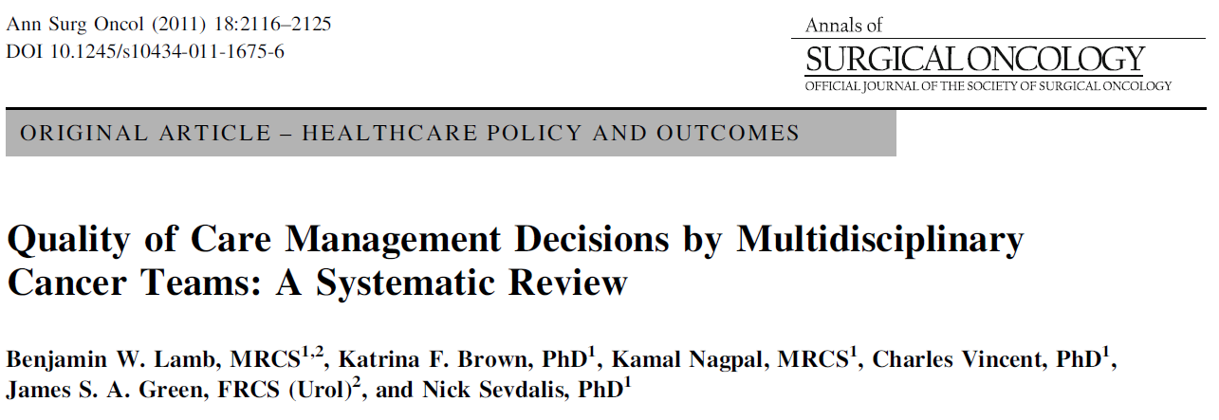
MDTs impact on care
We reviewed 37 studies
MDTs changed treatment plan in 2-52% of cases
Notes:
17

Slide 18
But MDTs are affected by human factors
We reviewed 37 studies
MDTs changed treatment plan in 2-52% of cases
Decision making largely driven by physicians & biomedical information regarding the tumor
Nurses largely silent; psychosocial elements of care & patient preferences not covered
Poor teamworking & leadership → poor information coverage
Notes:
18

Slide 19
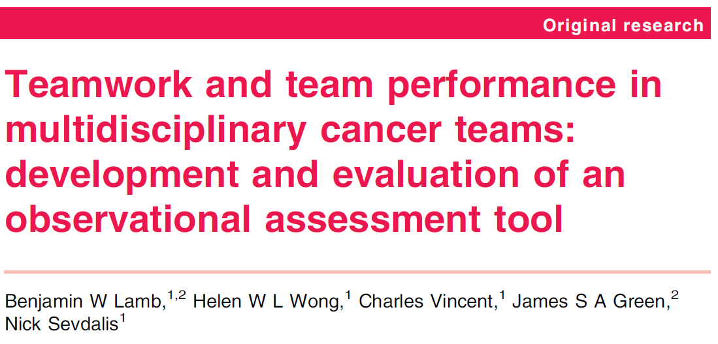

Assessing the ‘human element’ of Ca MDTs
What do MDTs do?
Process information
What do they need to process that information?
Information needs to be available
Information needs to be reviewed by the whole team (discussed as needed)
Hence, 2 major components in the assessment:
Quality of information
Quality of team-members’ contributions
Notes:
19

Slide 20
Behavioural markers approach
Identify relevant behaviours / skills
Define them, incl exemplar demonstrations of these skills
Attach the demonstrations to a numerical scale
Well-established technique
Notes:
20

Slide 21
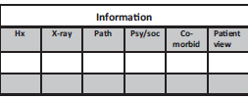
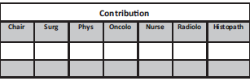
Behavioural markers approach
Assessing quality of information
Identify relevant behaviours / skills
Define them, incl exemplar demonstrations of these skills
Attach the demonstrations to a numerical scale
Well-established technique
Assessing quality of contributions
Lamb et al, BMJ Qual Saf 2011;20:849-56.
Notes:
21

Slide 22
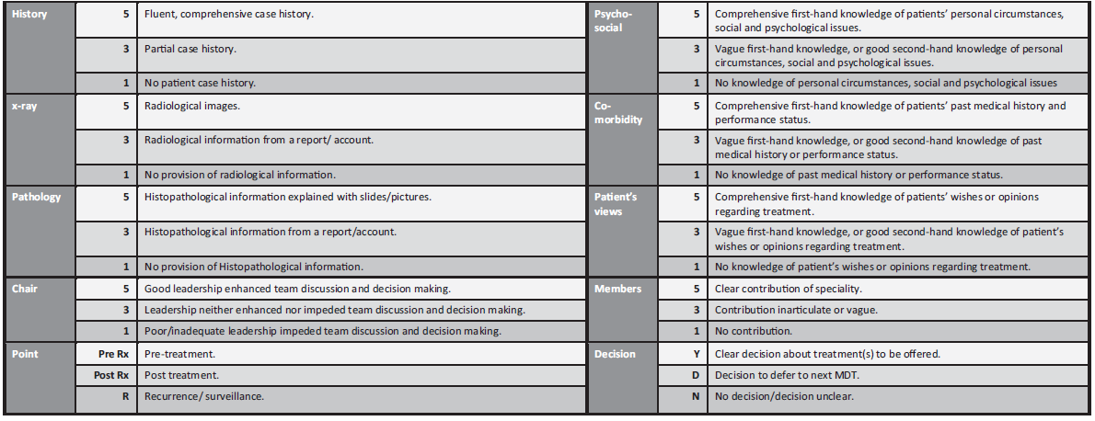
Behavioural scale descriptors
Soukup et al, Medicine 2016;95:24.
Notes:
22

Slide 23


Slide 24
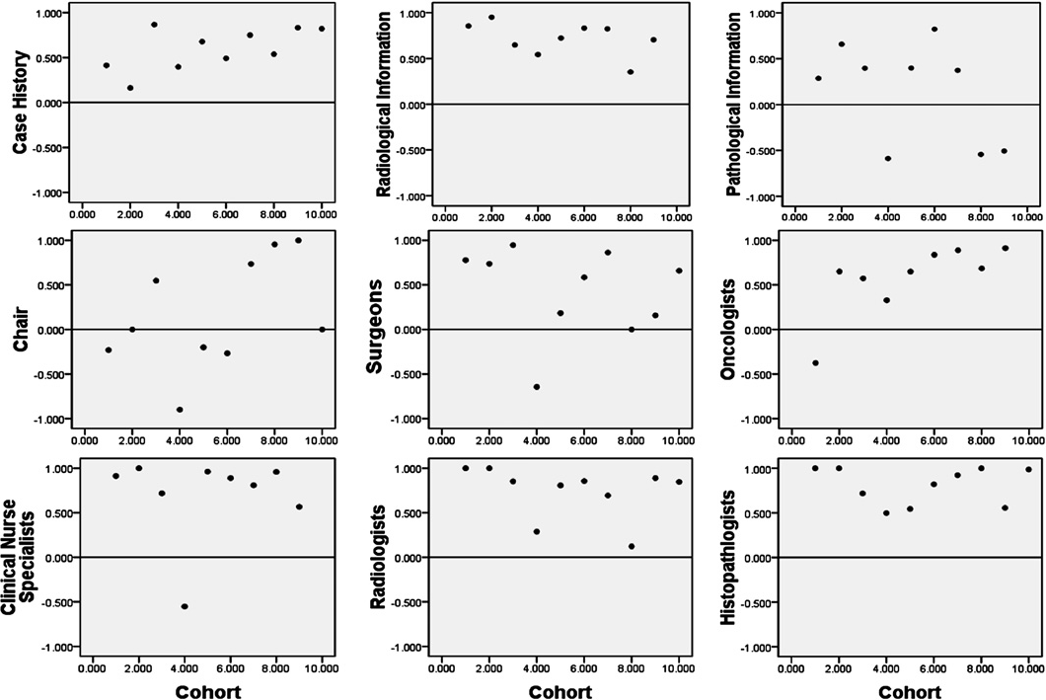
1. Team assessment has a learning curve
Lamb et al, BMJ Qual Saf 2011;20:849-56.
Notes:
24

Slide 25
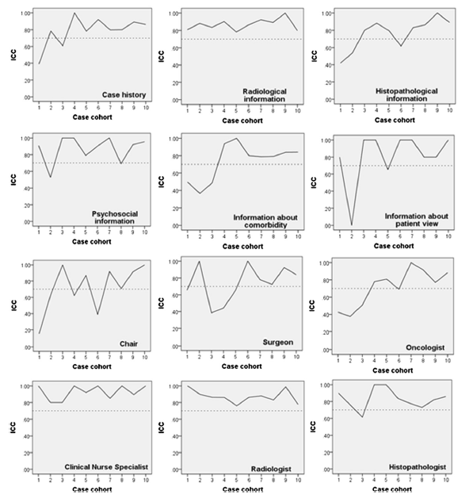
1. Team assessment has a learning curve
MDT-MODe can be used by physicians, nurses and psychologists
They ALL require training
MDT-MODe can be done in vivo or retrospective (video-based assessment)
MDT-MODe does not assess coordinators well (they don’t talk!)
Jalil et al, J Urol 2014;192:191-8.
Notes:
25

Slide 26
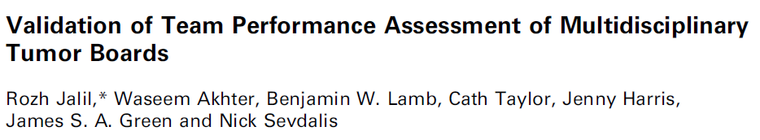
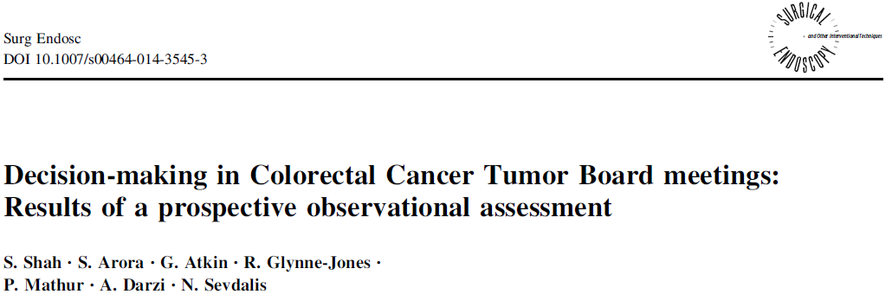
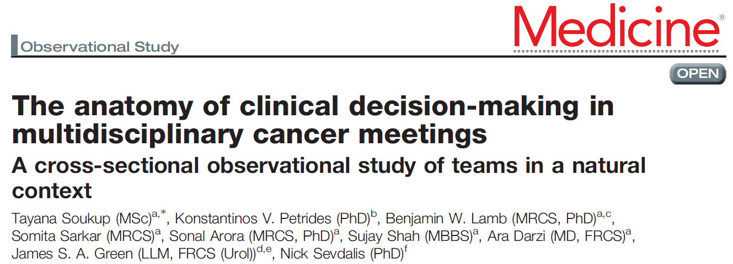

2. Team assessment is feasible
Median case review duration across 000s of cases = 2-3mins/case
MDT-MODe applied to teams in:
Urology
Colorectal
Upper GI
Head & Neck
Breast
Lung
Notes:
26

Slide 27
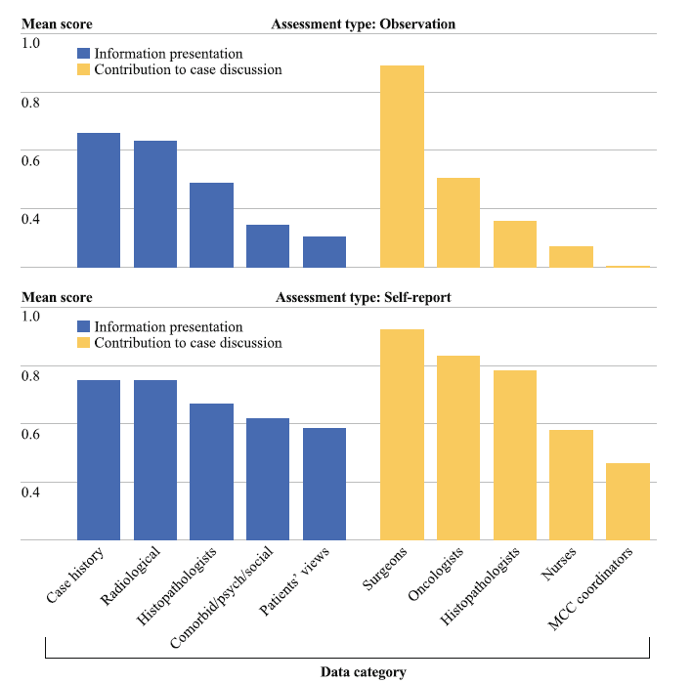
3. Team assessment vs. self-assessment
MDT-MODe picks up similar pattern with self-assessment
But self-assessment WAY more flattering!
Lamb, Sevdalis, Mostafid et al,
Ann Surg Oncol 2011;18:3535-43.
Notes:
27

Slide 28
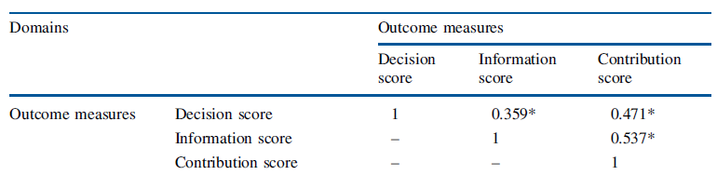
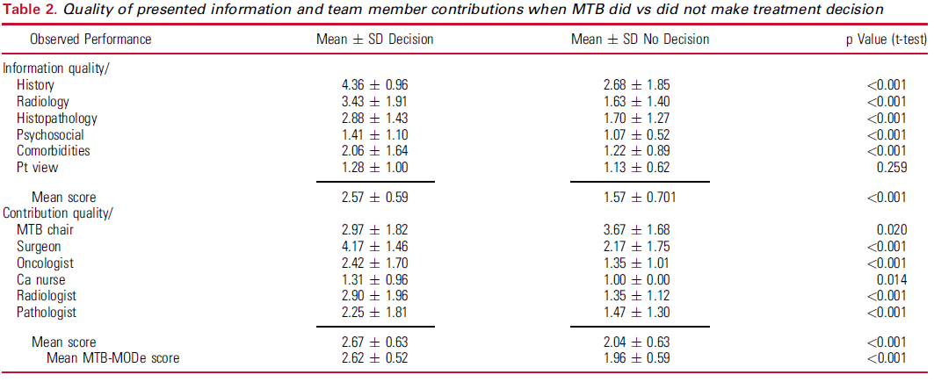
4. Quality of teamworking matters
Higher scores on quality of information and quality of contributions are associated with higher probability of the MDT reaching a treatment recommendation on first case presentation
Lamb, Sevdalis, Benn et al, Ann Surg Oncol 2013;20:715-22.
Jalil et al, J Urol 2014;192:191-8.
Notes:
28

Slide 29
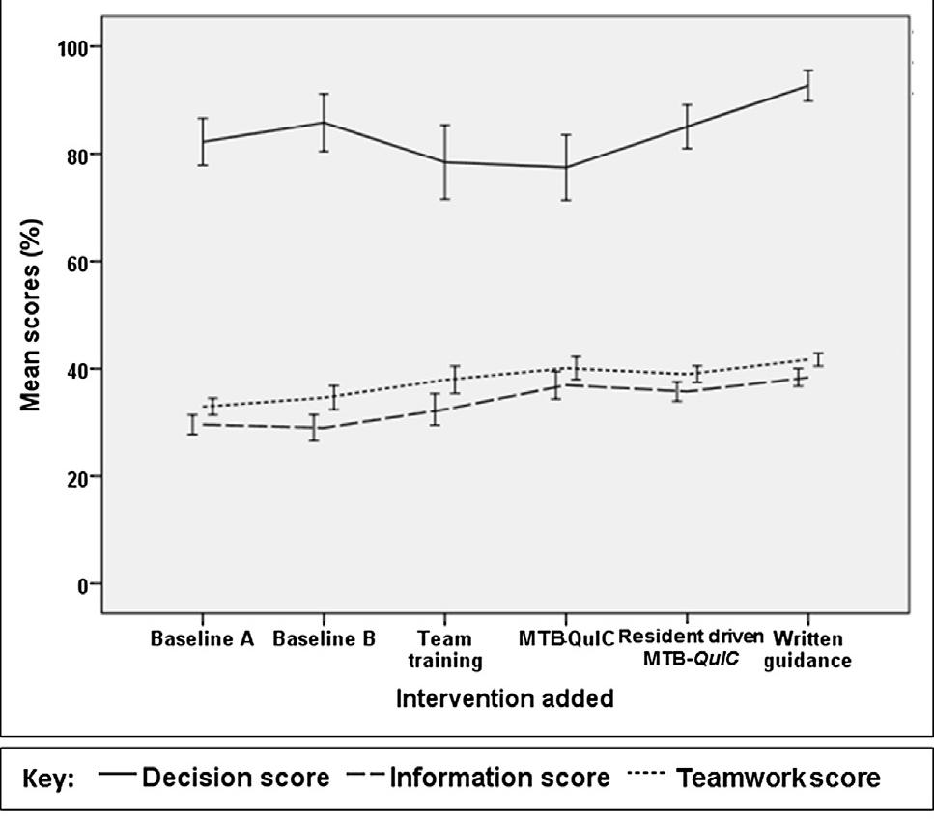
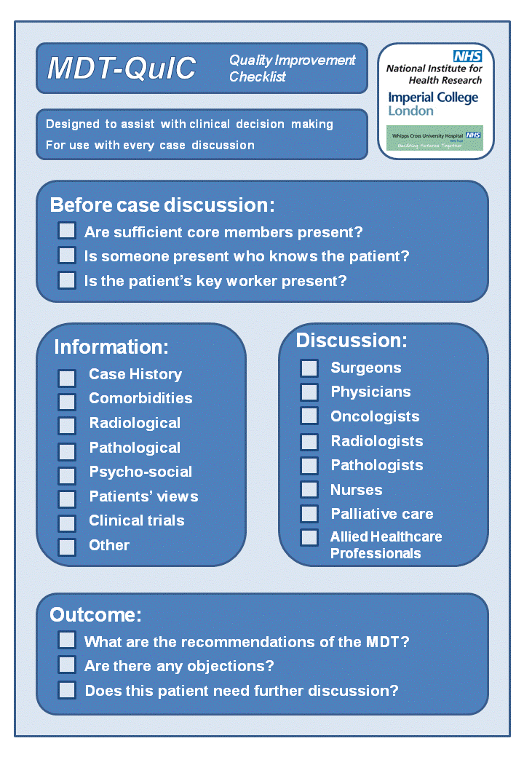
5. Quality of teamworking can be improved
Successive intervention introduction over 16 months
36 MDTs
1421 patients
Standardised Checklist
Lamb et al, J Am Coll Surg 2013;217:412-20.
Lamb et al, Ann Surg Oncol 2012;19:1759-65.
Notes:
29

Slide 30
Which of the following contributes to sustaining effective team behaviors in Ca MDTs?
a) Teamwork behavior culturally embraced across the organization
b) Multiple opportunities to practice use of teamwork behavior
c) New employee orientation
d) Provide continuous teamwork and communication skills training to clinicians only
e) a and b
Notes:
30

Slide 31
Reflections
MDT-MODe:
Allows analysis of the psychology of MDTs
Offers a useful metric for team self-reflection
Can be used for team improvement
Can be used to evaluate interventions
Is not designed to appraise the wider infrastructure for effective MDT implementation
Requires some understanding of the principles of observational skill assessment (Hawthorne effect, learning curves, etc)
Requires understanding/assessment of the organizational context (e.g., team size, location, caseload etc)
Notes:
31

Slide 32



Slide 33
Thank You! Next Session March 30, 2018 12:00 – 1:00 PM ET Presenters: Christine Weldon and Julia Trossman “How well is interdependent care managed across specialties in breast cancer? Metrics and pre-implementation data from the 4R in Oncology” http://healthcaredelivery.cancer.gov/cyberseminars/

