Slide 1

2022 Multilevel Intervention Training Institute Module 10
March 24, 2022

Slide 2

Part III: Quantitative Analytic Techniques II:
Moderation and Context
Richard Emsley, Ph.D. King’s College
London, UK

Slide 3



Quantitative Analytic Techniques III: Moderation, mediation and multilevel models
Professor Richard Emsley
NIHR Research Professor of Medical Statistics and Trials Methodology
Department of Biostatistics and Health Informatics, Institute of Psychiatry, Psychology and Neuroscience, King’s College London
Slides and joint work with Dr Kimberley Goldsmith
Notes:
Introduce lecturers.
Workshop is meant to be practical and interactive.
It consists of lectures and STATA exercises. In general we will motivate methods by real-life problems, and introduce relevant STATA commands that allow the researcher to apply methods in practice.
We encourage ongoing discussion and also have scheduled a session on the last day to discuss outstanding design and analysis issues relating to participants study designs/data sets.
We will hand out a content sheet that will allow you to make notes under relevant sessions. Please fill this in as we along – then it will be easy to return to unresolved issues in the last session.

Slide 4
Learning objectives
Understand what is meant by mediator and moderator analysis.
Understand aspects of study designs allowing such analyses to be applied.
To identify suitable quantitative methods for addressing these questions in multi-level interventions.

Slide 5
Outline of session
Part 1:
Explanatory questions in clinical effectiveness and implementation settings
Moderation by baseline variables
Part 2:
Mediation of effects via post-treatment variables
Extensions to multilevel models

Slide 6
Explanatory Questions in Clinical Effectiveness and Implementation Settings

Slide 7
Some explanatory questions in Clinical Effectiveness Trials
Moderation of treatment effect/prediction of treatment response
For whom does the treatment work?
Moderator measured at baseline
Mediation of treatment effect via treatment target
How does the treatment work? Via which clinical targets?
Mediator measured post-baseline
Therapeutic process evaluation/post-randomisation modification of treatment effect
Is the treatment effect stronger dependent on some therapeutic process?
Measure therapeutic process post-baseline
Also need strong baseline predictors of process status

Slide 8
Some explanatory questions in Implementation Effectiveness Trials
MOD: Moderation of effect of implementation strategy
For whom is the implementation strategy effective?
For which type of therapist/clinic was the implementation strategy effective?
MED: Mediation of treatment effect via implementation aspect
How much of the treatment effect is transmitted via implementation aspects?
PRM: Implementation strategy process evaluation
Is the treatment effect stronger dependent on some therapeutic/organisational process?

Slide 9
Key: unit of measurement
Clinical effectiveness – usually at the level of the individual participant
Implementation effectiveness – at the level of:
Individual participant
Trainer/therapist
Organisation (e.g. clinic, hospital system, workplace)

Slide 10
Moderation by baseline variables

Slide 11
Notation slide (for reference)
Y = outcome
R = treatment or exposure
X = moderator or effect modifier
M = mediator
C = confounder
U = unmeasured confounders

Slide 12
If there is a significant correlation between two variables R and Y, then either:
R causes Y
Y causes R
R and Y share a common cause C
R and Y are conditioned on a common descendent
R
Y
R
Y
R
Y
C
R
Y
S

Slide 13
Moderation of treatment effects
Key point: The association between R and Y is not the same at different values or levels of X. In other words, a modifier is a variable that alters the relationship between the independent R and dependent Y variables.
“Treatment moderators specify for whom or under what conditions the treatment works.” (Baron and Kenny 1986)
Informs clinicians which of their patients might be most responsive to the treatment and for which patients other, more appropriate, treatments might be sought.
→ Personalized/stratified medicine
Moderators may identify subpopulations with possibly different causal mechanisms or course of illness
→ restructuring diagnostic classification

Slide 14
Prognostic versus predictive/moderation
Prognostic:
A “prognostic biomarker” is a biological measurement made before treatment to indicate long-term outcome for patients either untreated or receiving standard treatment
Baseline variables indicating which participants will have an improved outcome or survival regardless of treatment
Predictive/Moderation:
A “predictive biomarker” is a biological measurement made before treatment to identify which patient is likely or unlikely to benefit from a particular treatment
Baseline variables related to differential response to treatment indicating which participants are most likely to benefit
Example (Buyse, 2007):
Overexpression of the HER2-neu gene in patients with early breast cancer provides an example of a biomarker that has both prognostic value (patients with HER2-neu overexpression having a worse prognosis) and predictive value for herceptin (patients with HER2-neu overexpression deriving a benefit from this treatment)
See Dunn et al. Clinical Trials 2013; 10: 709–719

Slide 15
Prognostic vs Predictive Markers
Age - prognostic Age - moderator
Improvement
Treatment arm
Improvement
Treatment arm
Control arm
Control arm
Give control
Give treatment
Age
Age

Slide 16
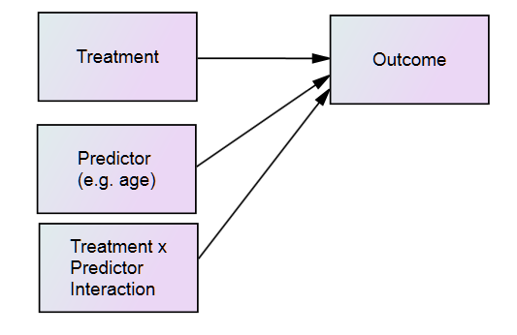
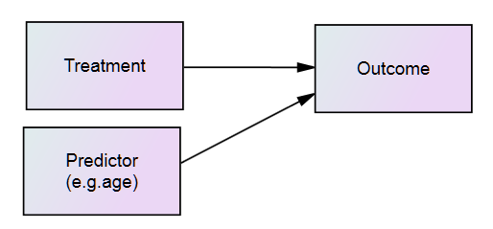
Prognostic vs Moderating
Prognostic of treatment response
Moderator of treatment response
Answers the question: for whom does the treatment work?
Personalised/Precision Medicine

Slide 17
Assessing effect modification
Regression model including baseline moderators of treatment outcome variables
Include as predictors (independent variables) in model:
Treatment arm variable
Baseline moderator variable
Treatment arm x baseline variable interaction
So, in context of regression analysis, assessing effect modification or moderation is the same as assessing interaction effect
This is true in the single-level or the multi-level modelling setting

Slide 18
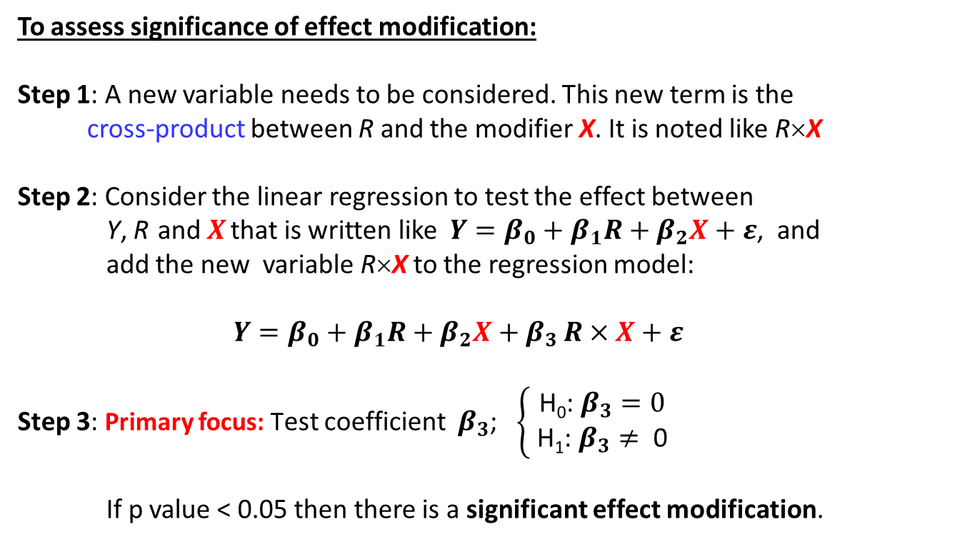
Establishing effect modification
To assess significance of effect modification:
Step 1: A new variable needs to be considered. This new term is the
cross-product between R and the modifier X. It is noted like R×X
Step 2: Consider the linear regression to test the effect between
Y, R and $X$ that is written like $Y=β_{0}+β_{1}R+β_{2}X+ε$, and
add the new variable R×X to the regression model:
$Y=β_{0}+β_{1}R+β_{2}X+β_{3 }R×X+ε$
Step 3: Primary focus: Test coefficient ${ β}_{3}$; $\left\{\begin{aligned}\text{H}\text{0}\text{:}{ β}_{3}=0 \\ \text{H}\text{1}\text{:}{ β}_{3}≠ \text{0 }\end{aligned}\right.$
If p value < 0.05 then there is a significant effect modification.

Slide 19

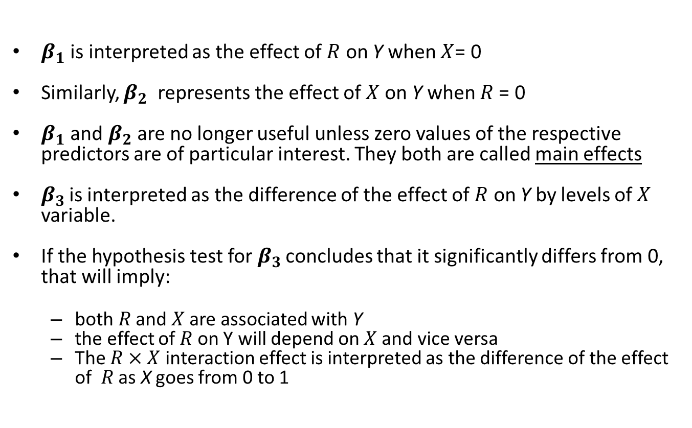
Interpretations of regression coefficient $β^{′}s$
$$Y=β_{0}+β_{1}R+β_{2}X+β_{3 }R×X+ε$$
$β_{1}$ is interpreted as the effect of $R$ on Y when $X$= 0
Similarly, $β_{2}$ represents the effect of $X$on Y when $R$= 0
$β_{1}$ and $β_{2}$are no longer useful unless zero values of the respective predictors are of particular interest. They both are called main effects
$β_{3 }$is interpreted as the difference of the effect of $R$ on Y by levels of $X$ variable.
If the hypothesis test for$β_{3 }$concludes that it significantly differs from 0, that will imply:
both $R$ and $X$ are associated with Y
the effect of $R$ on Y will depend on $X$ and vice versa
The $R×X$ interaction effect is interpreted as the difference of the effect of $R$ as X goes from 0 to 1

Slide 20
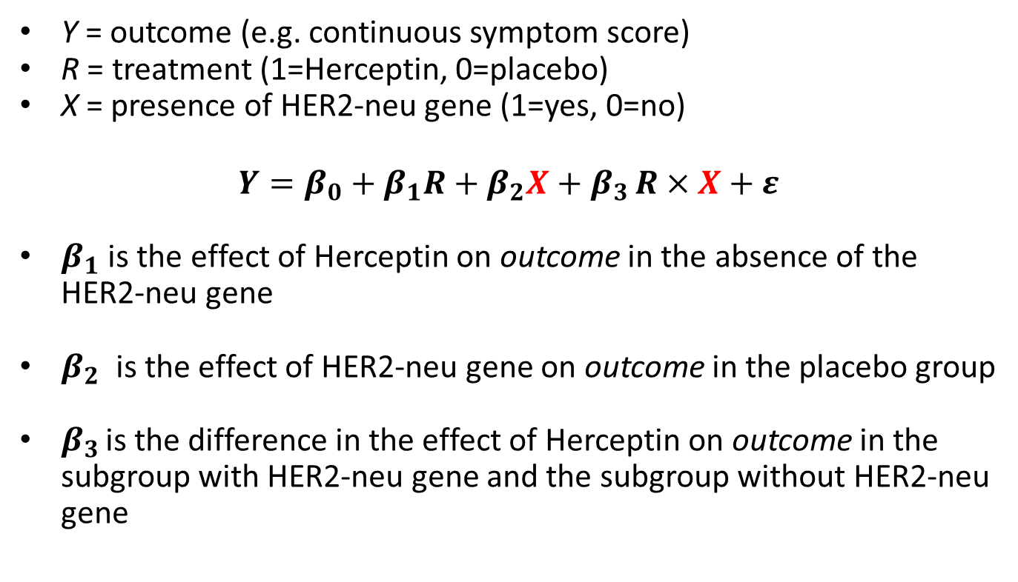
Example: differential treatment effects
Y = outcome (e.g. continuous symptom score)
R = treatment (1=Herceptin, 0=placebo)
X = presence of HER2-neu gene (1=yes, 0=no)
$$Y=β_{0}+β_{1}R+β_{2}X+β_{3 }R×X+ε$$
$β_{1}$ is the effect of Herceptin on outcome in the absence of the HER2-neu gene
$β_{2}$ is the effect of HER2-neu gene on outcome in the placebo group
$β_{3 }$is the difference in the effect of Herceptin on outcome in the subgroup with HER2-neu gene and the subgroup without HER2-neu gene

Slide 21
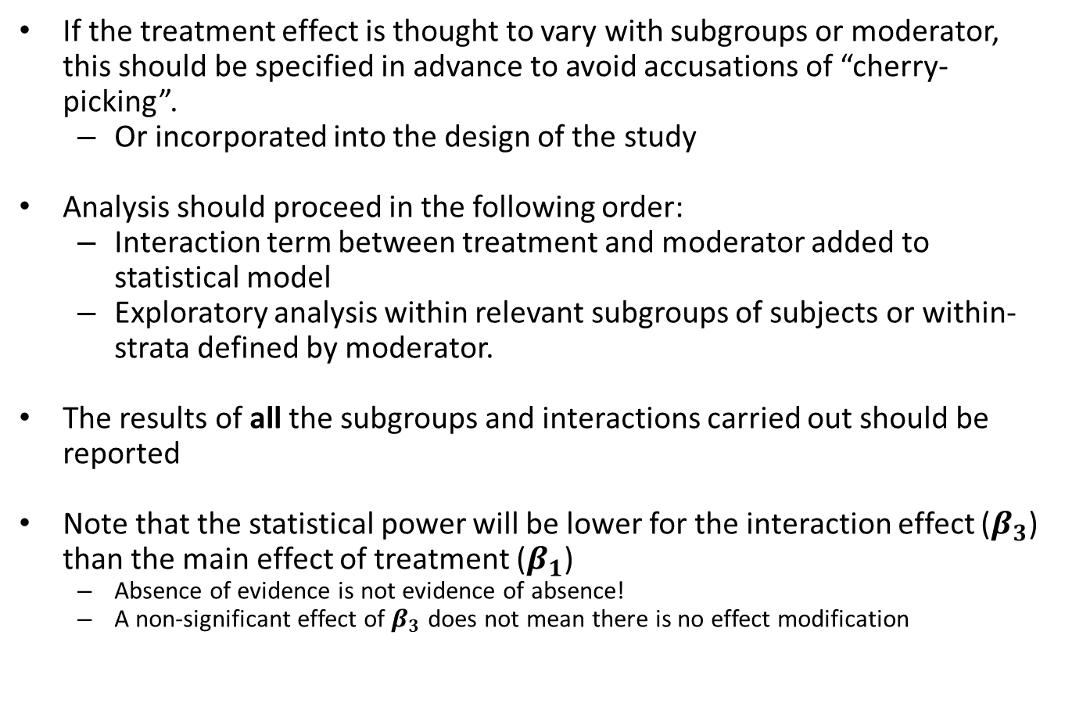
Summary: effect modification/moderation
If the treatment effect is thought to vary with subgroups or moderator, this should be specified in advance to avoid accusations of “cherry-picking”.
Or incorporated into the design of the study
Analysis should proceed in the following order:
Interaction term between treatment and moderator added to statistical model
Exploratory analysis within relevant subgroups of subjects or within-strata defined by moderator.
The results of all the subgroups and interactions carried out should be reported
Note that the statistical power will be lower for the interaction effect ($β_{3}$) than the main effect of treatment ($β_{1}$)
Absence of evidence is not evidence of absence!
A non-significant effect of $β_{3}$ does not mean there is no effect modification

Slide 22


Quantitative Analytic Techniques III: Mediation and Components
Richard Emsley, Ph.D. King’s College
London, UK

Slide 23
Quantitative Analytic Techniques III: Moderation, mediation and multilevel models
Professor Richard Emsley
NIHR Research Professor of Medical Statistics and Trials Methodology
Department of Biostatistics and Health Informatics, Institute of Psychiatry, Psychology and Neuroscience, King’s College London
Slides and joint work with Dr Kimberley Goldsmith
Notes:
Introduce lecturers.
Workshop is meant to be practical and interactive.
It consists of lectures and STATA exercises. In general we will motivate methods by real-life problems, and introduce relevant STATA commands that allow the researcher to apply methods in practice.
We encourage ongoing discussion and also have scheduled a session on the last day to discuss outstanding design and analysis issues relating to participants study designs/data sets.
We will hand out a content sheet that will allow you to make notes under relevant sessions. Please fill this in as we along – then it will be easy to return to unresolved issues in the last session.

Slide 24
Mediation of effects via POST-TREATMENT variables

Slide 25
What is mediation?
Hyman, 1955:
“When the analyst interprets a relationship, he determines the process through which the assumed cause is related to what we take to be its effect. How did the result come about? What are the ‘links’ between the two variables? …. Described in formal terms, the interpretation of a statistical relationship between two variables involves the introduction of further variables and an examination of the resulting interrelationships between all of the factors”.
David Kenny (on his website):
“One reason for testing mediation is trying to understand the mechanism through which the causal variable affects the outcome”.
In other words, mediation allows for MECHANISM EVALUATION.

Slide 26
Mediation and mediators
Baron RM & Kenny DA (1986). The moderator-mediator variable distinction in social psychological research: conceptual, strategic, and statistical considerations. Journal of Personality and Social Psychology 51, 1173-1182.
Baron and Kenny defined mediation as the “generative mechanisms through which the focal independent variable is able to influence the dependent variable of interest”
A mediator (M) is a variable that occurs in the causal pathway from an exposure (R) to an outcome variable (Y). It causes variation in the outcome and itself is caused to vary by the exposure variable.
This causal chain implies a temporal relation
R occurs before M and
M occurs before Y

Slide 27
Complete mediation
To reflect the mediated effect we need a path from R to M and a further path from M to Y.
The following diagram illustrates complete mediation by M.
Note that the diagram implies that M is the only mechanism by which R can change Y.
M
R
Y

Slide 28
“The mediation triangle”
We might not want to rule out effects of R on Y other than those operating by changing M.
The following triangle illustrates partial mediation by M.
M
R
Y

Slide 29
Why assess mediation in studies?
Why are we interested?
Develop or confirm a mechanistic theory of how treatment benefits outcome.
Explain why a trial has produced negative finding.
treatment failed to change the hypothesized M? M failed to influence Y? Effects via mediator counterbalances with other harmful effect?
To improve the treatment by identifying target variables.
Early phase trials are typically concerned with exploratory analyses to identify putative mediators from a pool of potential variables.
Note that such investigations are hypothesis generating; any hypothesis will then need to be confirmed using an independent sample later
Later phase trials are typically concerned with confirming or otherwise of an existing mediation hypothesis.

Slide 30
Target mechanisms
Target intermediate variables:
Some treatments target a particular intermediate variable in order to bring about change in a clinical outcome.
Cognitive behaviour therapy → thinking → symptoms
Beta blockers → blood pressure → stroke risk
An explanatory analysis of a trial would seek to establish that this is indeed the case; i.e. assess the mediated path.
Mechanism
Intervention
Symptoms
Notes:
New paradigm for designing trials – targeted interventions – sleep as an example

Slide 31
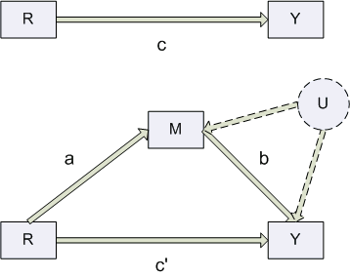
Single mediator model
Total effect
R = binary random treatment offer (or could be exposure)
M = mediator
Y = outcome
U = unmeasured confounders
Indirect/mediated effect
Direct effect

Slide 32
Direct and indirect effects
Mediation investigations aim to partition total (causal) treatment effects into
effects that operate via changing the putative mediator
indirect treatment effects
and non-mediated effects
direct treatment effects.
Note that direct effects include effects via any mediating variable not included in the model.
So the meaning of a direct effect is always relative to the variable whose mediating effect is being modelled.

Slide 33



Product of coefficients method
ε_{M}
M
Total effect = c
Direct effect = c’
Indirect (mediated) effect = ab
Total effect = c = ab + c’
Indirect (mediated) effect = ab = c – c’
(for the same subset of complete data)
a
b
R
Y
c'
ε_{Y}
$$Y_{i}=intercept_{C}+cR_{i}+error_{iC}$$
$$M_{i}=intercept_{M}+aR_{i}+error_{iM}$$
$$Y_{i}=intercept_{Y}+c′R_{i}+bM_{i}+error_{iY}$$
Note: we are not getting a new estimate of the total effect, but rather partitioning the total mechanistic effect on the outcome into that which proceeds directly and that which is transmitted indirectly through an intermediate variable.

Slide 34


Difference in coefficients method
Total effect = c = ab + c’
So can also calculate the indirect/mediated effect as:
Indirect (mediated) effect = ab = c – c’
Which only requires fitting:
Often used in epidemiology
Will proceed with ab, but similar methods apply (such as for obtaining CI)
$$Y_{i}=intercept_{C}+cR_{i}+error_{iC}$$
$$Y_{i}=intercept_{Y}+c′R_{i}+bM_{i}+error_{iY}$$

Slide 35
Complete and partial mediation
A mediator can account for either all or a part of the total effect (c) of the causal variable on the outcome.
Complete mediation would occur if the mediator accounts for all of the total effect (path c).
this will be the case if the direct effect (path c’) drops to zero (statistically insignificant) after controlling for the mediator variable
Partial mediation would occur if the mediating variable accounts for some, but not all, of the total effect (path c).
in this case the direct effect (path c’) will be weaker than the total effect (|c’|<|c|), but not fully eliminated after controlling for the mediator variable
Note: mediation is generally sensible when ab and c′ have the same sign.
Sometimes the c’ paths and ab act in different directions (mathematically have different signs)
So c’ and ab might be statistically significant but c is not
Called inconsistent mediation or suppression, see MacKinnon 2008 for more information

Slide 36
Target effect
The difference in coefficient method is popular in epidemiology as it only involved fitting models for the clinical outcome Y.
(Epidemiologists are used to looking at change in regression coefficients after including covariates in the model.)
However, in trials we actually want to see the treatment effect on the intermediate variable M (a) in addition to the indirect effect
So here we focus on the product of coefficient approach.
We refer to a as the target effect
In any approach, it is essential to show that the treatment has shifted the mediator for mediation through this variable to occur.

Slide 37
Inferences for indirect and direct effects
Sobel (1982) derived a formula for the estimating the asymptotic standard error (SE) of the product of coefficients estimator.
The formula only requires estimates and SEs provided after fitting the individual regression equations for M and Y.
Symmetric confidence intervals derived using this SE rely on asymptotic normality.
As the distribution of the product estimator is likely to be skewed for finite samples alternative inferences derived by bootstrapping are to be preferred.

Slide 38
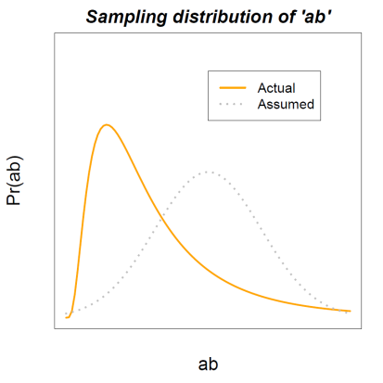
Getting a bootstrapped CI for indirect effect
Bootstrapping requires taking a large number of samples (with replacement) from the original dataset
Indirect effect (ab) is estimated for each of the bootstrap samples
These bootstrap estimates are used to form a non-parametric distribution of the indirect effect
For a test with level of significance α (e.g., α=0.05)
A 100(1- α) % confidence interval is constructed by calculating the α/2 and (1- α/2)th percentiles of the bootstrap distribution
Indirect effect is significant if the confidence interval excludes zero
Note: bootstrap estimate depends on seed value of the number of random generator, need to set it to get same result from run to run
2.5%
97.5%

Slide 39
Challenge of estimating causal effects
U – the unmeasured confounders
error
U
Mediator
Random
allocation
Outcomes
error
Covariates

Slide 40
Example: mediation using simulated data
e1
C
0.25
M
0.25
0.25
0.25
R
0.25
Y
e2
Total effect = direct effect + indirect effect
= 0.25 + 0.25*0.25
= 0.25 + 0.0625

Slide 41
Example: regression approach for total effect

Slide 42
Example: regression model for mediator

Slide 43
Example: regression model for outcome
We get biased estimates of both M and R if we have unmeasured confounders of the M-Y relationship

Slide 44
Example: regression model for outcome with covariates

Slide 45
Example: inference for indirect effects
Sobel-Goodman Mediation Tests
Coef Std Err Z P>|Z|
Sobel .06143805 .00642849 9.557 0
Goodman-1 (Aroian) .06143805 .00643346 9.55 0
Goodman-2 .06143805 .00642352 9.565 0
Coef Std Err Z P>|Z|
a coefficient = .254267 .010974 23.1691 0
b coefficient = .241628 .023031 10.4913 0
Indirect effect = .061438 .006428 9.55715 0
Direct effect = .254071 .012723 19.9696 0
Total effect = .31551 .011599 27.2005 0
Proportion of total effect that is mediated: .19472646
Ratio of indirect to direct effect: .24181405
Ratio of total to direct effect: 1.2418141
The indirect effect is the estimate of ab
The direct effect is the estimate of c’
The proportion mediated is the ratio of indirect effect to total effect

Slide 46
Example: inference for indirect effects
Example with bootstrap inferences (2000 bootstrap reps)
The observed coefficients are the same as previously, and we would choose to report the percentile 95% confidence intervals
Notes:
Note that since the reason for using bootstrap were concerns over non-normality of the sampling distribution of the indirect effect estimator we use the percentile methods to construct CIs; those can be asymmetric; but here for a large sample (n=2000) asymptotic normality is probably achieved (percentile intervals very similar to symmetric bootstrap confidence interval).
Inferences for direct effect are little affected and very similar to the regression results.

Slide 47



Parallel two-mediator model
ε_{M1}
M₁
Total effect = c
Direct effect = c’
Indirect (mediated) effect 1 = a₁b₁
Indirect (mediated) effect 2 = a₂b₂
Total effect = c = a₁b₁+a₂b₂+ c’
Indirect (mediated) effect =
a₁b₁+a₂b₂ = c – c’
(for the same subset of complete data)
a₁
b₁
R
Y
c'
a₂
M₂
b₂
ε_{Y}
ε_{M2}
$$Y_{i}=intercept_{C}+cR_{i}+error_{iC}$$
$$M_{i_{1}}=intercept_{M_{1}}+a_{1}R_{i}+error_{iM_{1}}$$
$$M_{i_{2}}=intercept_{M_{2}}+a_{2}R_{i}+error_{iM_{1}}$$
$$Y_{i}=intercept_{Y}+c′R_{i}+b_{1}{M_{i}}_{1}+b_{2}{M_{i}}_{2}+error_{iY}$$
Note: there is assumed no relationship between the two mediators. This is an assumption often made to simplify the analysis. It is probably often not a plausible assumption.

Slide 48
Challenges for establishing mediation
Possible confounding of the effect of mediator on outcome
Mediator measured with error
Possibility of multiple mediators working in parallel or sequentially
Complicates the definition and interpretation of indirect effects
Data structure: e.g. serial assessments of both mediator and clinical outcome, or serial assessments of the mediator and a survival time for the outcome

Slide 49
Many other considerations
Different types of variables: binary, count
Proper 95% confidence intervals for mediated effects
Confounding of the b path
Measurement error (in the mediator)
What effects to report
How to interpret the effects

Slide 50
Combining mediation and moderation
Mediated moderation: an interaction that acts through a putative mediator
Moderated mediation: the effect of a mediator differs across levels of a moderator
X
M
R
Y
X
M
R
Y

Slide 51
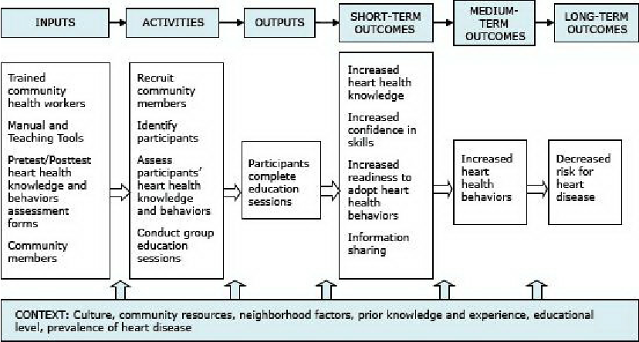
Logic model for assessing mechanisms
Source: Hurtado et al. (2014). Knowledge and Behavioral Effects in Cardiovascular Health: Community Health Worker Health Disparities Initiative 2007-2010. Preventing chronic disease 11(2):E22

Slide 52
Logic model for assessing mechanisms
Exposures
Mediators
Outcome
Moderators
Source: Hurtado et al. (2014). Knowledge and Behavioral Effects in Cardiovascular Health: Community Health Worker Health Disparities Initiative 2007-2010. Preventing chronic disease 11(2):E22

Slide 53
Summary: inferential assumptions for mediation analysis using regression models
Data are a random sample from population of interest
Measures are reliable and valid
(i.e. no measurement error, especially in M)
Correct temporal ordering of mediation chain: R before M before Y
Coefficients, a, b, c’ reflect true causal relations and correct functional form
(i.e. linear relationships)
No R by M moderator (interaction) effects on Y
No unmeasured confounders U
(i.e. all confounders measured and included in the models)
No confounding by post-randomisation variables
(i.e. all measured confounders C are baseline variables).

Slide 54
Extensions to multilevel models

Slide 55
Multilevel modelling for mediation
When you have multilevel data, the variables may come from different levels of the model.
In a multilevel modelling approach, the outcome will always be a level one variable.
Depending on your data, the independent variable (or exposure) and mediator may be either level 1 or level 2 variables.
Rule: An independent variable may be mediated by a variable at the same level or lower.
Thus a level 2 exposure may be mediated by a level 2 or level 1 variable.
A level 1 exposure may only be mediated by another level 1 variable.
Logically, a level 1 predictor cannot affect a level 2 mediator.
Krull,J.L. & MacKinnon,D.P. (2001) Multilevel modeling of individual and group level mediated effects. Multivariate Behavioral Research, 36(2), 249-277.

Slide 56
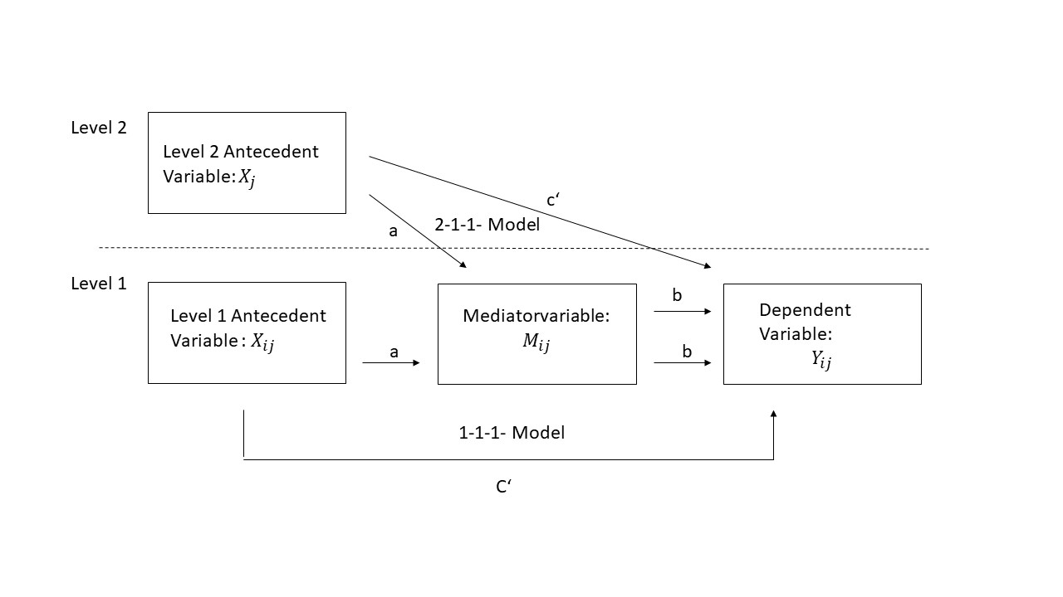
Multilevel mediation
Source: https://www.statalist.org/forums/forum/general-stata-discussion/general/1452689-multilevel-mediation-analysis-2-1-1-and-1-1-1-mediation-models

Slide 57
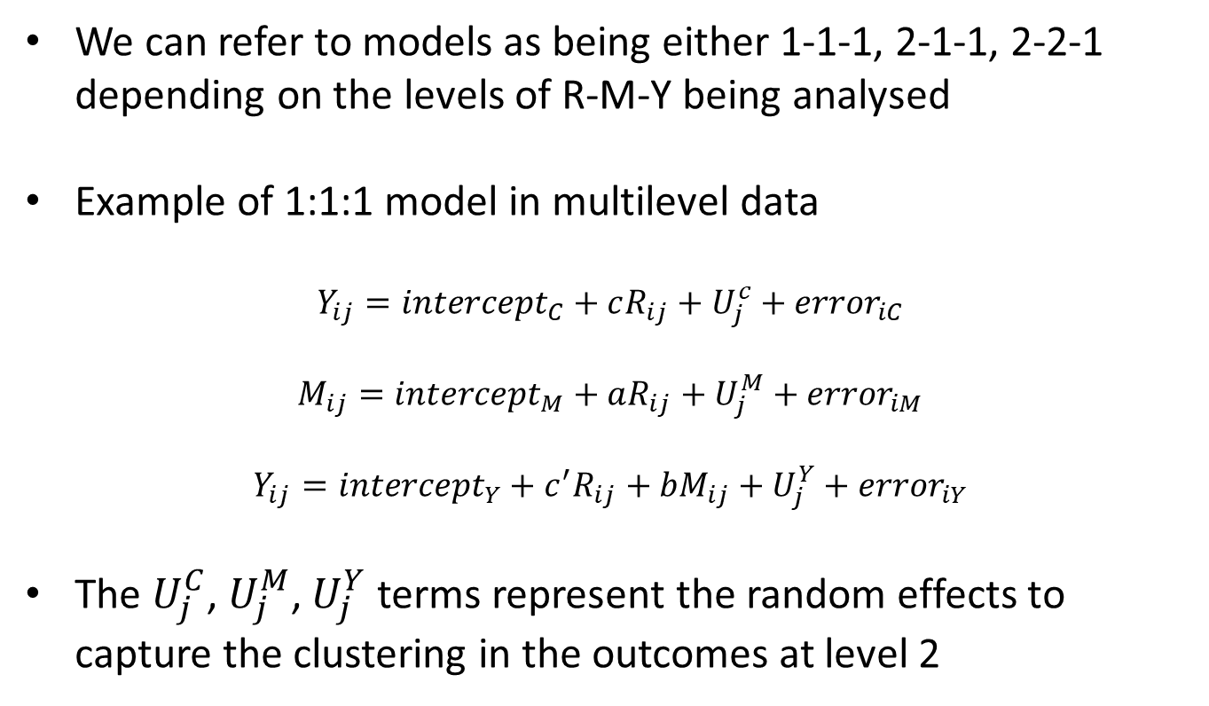
Multilevel mediation
We can refer to models as being either 1-1-1, 2-1-1, 2-2-1 depending on the levels of R-M-Y being analysed
Example of 1:1:1 model in multilevel data
$$Y_{ij}=intercept_{C}+cR_{ij}+U_{j}^{c}+error_{iC}$$
$$M_{ij}=intercept_{M}+aR_{ij}+U_{j}^{M}+error_{iM}$$
$$Y_{ij}=intercept_{Y}+c^{′}R_{ij}+bM_{ij}+U_{j}^{Y}+error_{iY}$$
The $U_{j}^{C}$, $U_{j}^{M}$, $U_{j}^{Y}$ terms represent the random effects to capture the clustering in the outcomes at level 2

Slide 58
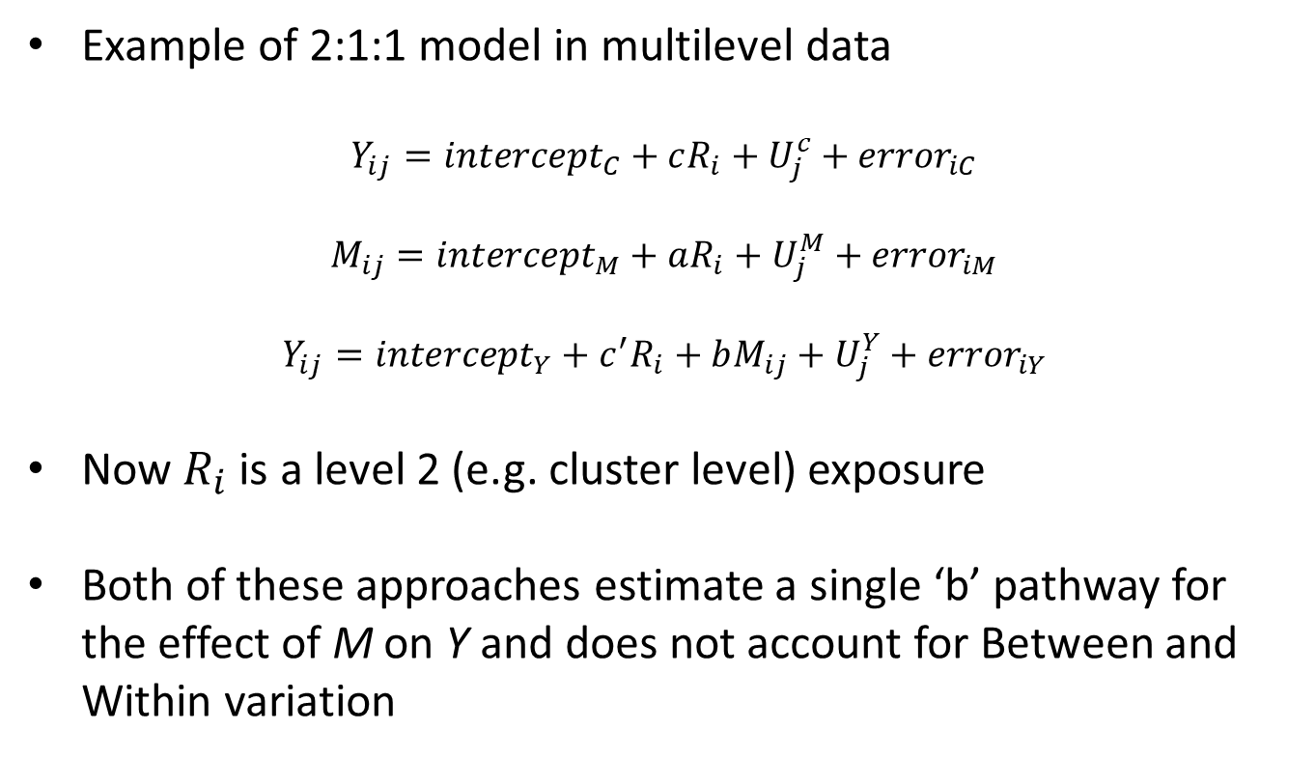
Multilevel mediation
Example of 2:1:1 model in multilevel data
$$Y_{ij}=intercept_{C}+cR_{i}+U_{j}^{c}+error_{iC}$$
$$M_{ij}=intercept_{M}+aR_{i}+U_{j}^{M}+error_{iM}$$
$$Y_{ij}=intercept_{Y}+c^{′}R_{i}+bM_{ij}+U_{j}^{Y}+error_{iY}$$
Now $R_{i}$ is a level 2 (e.g. cluster level) exposure
Both of these approaches estimate a single ‘b’ pathway for the effect of M on Y and does not account for Between and Within variation

Slide 59
Multilevel Structural Equation Models
Limitations of MLM Framework for Multilevel Mediation:
The multilevel approach does not allow for outcome variables at level 2
So no 1-1-2, 1-2-2 or 2-1-2 models permitted
In a 2-1-1 or 1-1-1 model, there is conflation of Between and Within effects of M on Y (i.e., only one mean b slope is estimated) whereas this can vary across levels
A general MSEM framework for investigating multilevel mediation and moderation overcomes these issues.

Slide 60
Multilevel Structural Equation Models

Slide 61
Session summary
Evaluation of moderation or effect modification can be assessed by including interaction effects in regression models
Can be used in mediation models as well e.g. mediated moderation and moderated mediation
In a randomised trial, if the treatment doesn’t effect the mediator, then there can’t be mediation through that variable.
Only aspect which can be tested unbiasedly?
The models for mediation should be the same as used for modelling the outcomes
This is particularly important for multilevel interventions that require multilevel modelling to account for different levels of exposures, mediators and outcomes
Mediation analysis contains a lot of implicit assumptions but validity of the estimates depend on these assumptions!

Slide 62

Thank you for the invite and your attention
Email: richard.emsley@kcl.ac.uk
Twitter: @richardaemsley

