Slide 1

2022 Multilevel Intervention Training Institute
April 7, 2022

Slide 2
Module 12: MLTI Agenda
May 6, 2021
Part I. Qualitative and mixed methods techniques in multilevel research
12:05-12:15pm 12:15-12:30pm | Principles and practice of qualitative methods Application of qualitative methods to research | Deborah Cohen Deborah Cohen
12:30-12:45pm | Principles and practice of mixed methods | Lawrence Palinkas
12:45-1:00pm | Application of mixed methods to research | Lawrence Palinkas

Slide 3

Principles and practice of Qualitative methods
Two-part lecture: Part I
Deborah J. Cohen Ph.D.
Oregon Health & Science University
Portland, OR

Slide 4

Principles and practices of qualitative research methods
2021 Multilevel Intervention Training Institute
Deb Cohen, PhD

Slide 5

Hello!
I am Deb Cohen
I am a qualitative and mixed methods researcher, professor, and vice chair of research in the Department of Family Medicine.
You can find me at cohendj@ohsu.edu

Slide 6


This is Murray and Lucy
They are cute and noisy. You may hear them in the background of this recording.

Slide 7
Today’s agenda
1
2
3
4
What is the usefulness of qualitative research methods
What are the common qualitative research traditions
What are common qualitative methods, and tips for using them
What is qualitative research
Notes:
What topics will this presentation cover
What is qualitative research
What is the usefulness of qualitative research methods
What are the different types of qualitative methods
I will take a more in depth look at two common qualitative methods
Observation
Interviewing
How can you learn more about qualitative methods and how might these methods be used in a capstone project?

Slide 8
What is qualitative research
1
2
3
4

Slide 9
For more details on today’s topics
Visit qualres.org

Slide 10
Qualitative research is a form of social inquiry
Qualitative
Research
Interpretive
Naturalistic
Notes:
What is qualitative research?
Qualitative research is a form of social inquiry.
It is important to understand that qualitative research is not a single type of social inquiry.
Qualitative research emerges from a number of different research traditions or disciplines.
As a result, there is great variation in approaches for doing qualitative research, and these approaches can be quite different.
While there is great variation in qualitative research approaches, the following two features emerge across approaches:
interpretive - qualitative research focuses on understanding the way people interpret and make sense of their experiences and the world in which they live
naturalistic - qualitative research studies social phenomena in their natural settings

Slide 11

Qualitative research is an inquiry approach that involves:
Researchers exploring deeply one or more concepts or a central phenomenon
Observing the natural world where a phenomenon manifests
Asking broad questions
Collecting participants’ perceptions and behaviors
Collecting data with reciprocity and respect in mind
Notes:
The intent o qualitative research is to:
Understand meaning that individuals give to a phenomenon inductively
Learn participants’ views of a phenomenon
Observe actual behavior of participants in their natural setting

Slide 12
What is the usefulness of qualitative methods
2
3
4

Slide 13

Numbers
Quantitative Data
Narratives
Qualitative Data
Notes:
Numbers can tell you what happened, what outcome change. Qualitative data can help you understand how and why something happened.

Slide 14
What are the different qualitative research traditions
3
4
5

Slide 15
Ethnography
Grounded Theory
Phenomenology
Narrative Research
Case Study Research
Creswell JW. Five Qualitative Inquiry and Research Designs: Choosing among five approaches. Sage. 2012. 3rd Edition.
Notes:
ETHNOGRAPHY
Anthropology
Participant Observation & Key Informant Interviews
GROUNDED THEORY
Sociology
Interviews & Observation
PHENOMENOLOGY
Philosophy and Psychology
Interviews
CASE STUDY
Education
Mixed methods (quantitative & qualitative)
NARRATIVE RESEARCH
Sociology and others
Life history
Biography
Chronology

Slide 16
Ethnography
Hallmark of anthropology
Multiple methods, particularly participant observation and key informant interviews
Researchers develop a holistic account of a group’s daily life or culture
Prolonged exposure
Notes:
Observation of a field setting involves:
prolonged engagement in a setting or social situation
clearly expressed, self-conscious notations of how observing is done
methodical and tactical improvisation in order to develop a full understanding of the setting of interest
imparting attention in ways that is in some sense 'standardized'
recording one's observations

Slide 17
Grounded Theory
Emerged in the 1960s from the work of sociologists Barney Glaser and Anselm Strauss
Seeks to identify the core social processes within a context in order to build theory that is grounded in the realities of those being studied
Employs observation and interviewing techniques
Well-defined process of constantly and recursively coding data, termed the constant comparative method
Notes:
Observation of a field setting involves:
prolonged engagement in a setting or social situation
clearly expressed, self-conscious notations of how observing is done
methodical and tactical improvisation in order to develop a full understanding of the setting of interest
imparting attention in ways that is in some sense 'standardized'
recording one's observations

Slide 18
Case Study Research
Utilizes multiple methods to intensely investigate a particular bounded system with the aim of describing and understanding that system as an integrated whole
Can be traced back to early ethnography, but gained prominence as a tool used by sociologists to study urban environments
Often combines qualitative and quantitative data
Notes:
Observation of a field setting involves:
prolonged engagement in a setting or social situation
clearly expressed, self-conscious notations of how observing is done
methodical and tactical improvisation in order to develop a full understanding of the setting of interest
imparting attention in ways that is in some sense 'standardized'
recording one's observations

Slide 19
What are the different types of qualitative methods
4

Slide 20


Observation
Interviewing
Collecting texts and artifacts
Notes:
What are the different types of qualitative methods?
Observation
Interviewing
Collecting Texts and Artifacts

Slide 21
Observation
Interviewing
Collecting texts and artifacts
Notes:
What are the different types of qualitative methods?
Observation
Interviewing
Collecting Texts and Artifacts

Slide 22
Observation is a systematic data collection approach. Researchers use all of their senses to examine people in natural settings or naturally occurring situations.
Notes:
what is observation?
Observation is a systematic data collection approach. Researchers use all of their senses to examine people in natural settings or naturally occurring situations.

Slide 23
Observation of a field setting involves:
Prolonged engagement in a setting or social situation
Methodical and tactical improvisation in order to develop a full understanding of the setting of interest
Imparting attention in ways that is in some sense 'standardized’
Recording one's observations
Notes:
Observation of a field setting involves:
prolonged engagement in a setting or social situation
clearly expressed, self-conscious notations of how observing is done
methodical and tactical improvisation in order to develop a full understanding of the setting of interest
imparting attention in ways that is in some sense 'standardized'
recording one's observations

Slide 24

Participant
Observation
Non-Participant
Observation
Notes:
what are the different types of observation?
[CLICK] Participant observation
[CLICK] Non-participant observation

Slide 25
Participant observation
combines participation in the lives of the people being studied with maintenance of a professional distance that allows adequate observation and recording of data.
Fetterman, 1998, pp. 34-35
Notes:
Participant observation
Participant observation "combines participation in the lives of the people being studied with maintenance of a professional distance that allows adequate observation and recording of data" (Fetterman, 1998, pp. 34-35).
Participant observation underscores the person's role as participant in the social setting he or she observes. The range of roles one may play as a participant observer have been describe by Gold (1958), Adler and Adler (1984) and others.

Slide 26
Recording field observations - fieldnotes
Participant observers may use multiple methods to gather data.
One primary approach involves writing fieldnotes. There are several guides for learning how to prepare fieldnotes.
Researchers may be interested in creating or using a template to guide observations.
Notes:
Recording field observations - Fieldnotes
Participant observers may use multiple methods to gather data.
One primary approach involves writing fieldnotes. There are several guides for learning how to prepare fieldnotes.
Researchers may be interested in creating or using a template to guide observations.
Templates or observational coding sheets can be useful when data is collected by inexperienced observers
Templates or observational coding sheets should only be developed after observation in the field that is not inhibited by such a template
Theories and concepts can be driven by templates and result in focused data collection
Templates can deflect attention from unnamed categories, unimagined and unanticipated activities that can be very important to understanding a phenomenon and a setting

Slide 27
Recording field observations - fieldnotes
Context
Content
Conceptual ideas
Fetters MD, Rubinstein EB. (2019). The 3 Cs of content, context, and concepts: A practical approach to recording unstructured field observations. Annals of Family Medicine, 17,554-560
Notes:
Context
Who is there as observer? What is reason for being there?
When (timing)?
Why this location? Where are you?
What is your own state of mind? (confused, unhappy, tired, excited)
Content-The Who, What, When, Where, Why, How
Who are subjects? What are they doing?
What are events that you see? What is timing/sequence of events? What are behaviors you see?
When do things happen?
Where do things happen?
Why do things happen?
How do things happen?
Conceptual Ideas
What are your new ideas? What are your light bulbs?
What are implications of what observed?
What linkage can you see with what you observed?

Slide 28
Non-participant observation
is observation with limited interaction with the people one observes.
Notes:
Non-participant observation
Non-participant observation is observation with limited interaction with the people one observes. For example, some observational data can be collected unobtrusively (e.g. worn out carpet as indicators of high use areas in a physical setting).
Researchers who study how people communicate often want to examine the details of how people talk and behave together. Non-participant observation involving the use of recording devices might be a good choice.
This data collection approach results in a detailed recording of the communication and provides the researcher with access to the contours of talk (e.g. intonation) as well as body behavior (e.g. facial expression, eye gaze). Even a great observer cannot record these aspects in detail.
Non-participant observation may provide limited insight into the meaning of the social context studied. If this contextual understanding is important, participant observation might be needed. These two data collection techniques can complement each other and be used together.

Slide 29
When might observation be used?
When the topic is relatively unexplored and little is known to explain the behavior of people in a particular setting
When understanding the meaning of a setting in a detailed way is valuable
When it is important to study a phenomenon in its natural setting
When self-report data (asking people what they do) is likely to be different from actual behavior (what people actually do)
Observation can also help researchers evaluate the fidelity of an intervention across settings and identify when 'stasis' has been achieved
Notes:
when might observation be used?
There are a variety of reasons for collecting observational data. Some of these reasons include:
When the nature of the research question to be answered is focused on answering a how- or what-type question
When the topic is relatively unexplored and little is known to explain the behavior of people in a particular setting
When understanding the meaning of a setting in a detailed way is valuable
When it is important to study a phenomenon in its natural setting
When self-report data (asking people what they do) is likely to be different from actual behavior (what people actually do). One example of this seen in the difference between self-reported versus observed preventive service delivery in health care settings.
When implementing an intervention in a natural setting, observation may be used in conjunction with other quantitative data collection techniques. Observational data can help researchers evaluate the fidelity of an intervention across settings and identify when 'stasis' has been achieved.

Slide 30

Benefits of observation
Notes:
what are the benefits observation?
Immersion and prolonged involvement in a setting can lead to the development of rapport and foster free and open speaking with members.
Observation fosters an in depth and rich understanding of a phenomenon, situation and/or setting and the behavior of the participants in that setting.
Observation is an essential part of gaining an understanding of naturalistic settings and its members' ways of seeing.
Observation can provide the foundation for theory and hypothesis development.

Slide 31
Observation
Interviewing
Collecting texts and artifacts
Notes:
What are the different types of qualitative methods?
Observation
Interviewing
Collecting Texts and Artifacts

Slide 32
Interviewing involves asking questions and
getting answers from participants in a study. Interviewing has a variety of forms including: individual, face-to-face interviews and face-to-face group interviewing. The asking and answering of questions can be mediated by the telephone or other electronic devices (e.g. computers). Interviews can be structured, semi-structured or unstructured.
Notes:
what is interviewing?
Interviewing involves asking questions and getting answers from participants in a study.
Interviewing has a variety of forms including: individual, face-to-face interviews and face-to-face group interviewing.
The asking and answering of questions can be mediated by the telephone or other electronic devices (e.g. computers). Interviews can be structured, semi-structure or unstructured.

Slide 33

Structured Interviews
Semi-Structured Interviews
Unstructured
Interviews
Informal Interviews
Focus Groups
Notes:
what are the different types of interviews?
I discuss five different types of interviews:
Structured Interviews
Semi-Structured Interviews
Unstructured Interviews
Informal Interviews
Focus Groups

Slide 34
Interviewing is useful when you want to understand what is on people’s minds, meaning that you want to explore people’s attitudes, beliefs, experiences and stories and how people lend meaning to and make sense of some aspect of the world in which they live.
Notes:
what is the usefulness of conducting interviews for research
Interviewing is useful when you want to understand what is on peoples’ minds, meaning that you want to explore peoples’ attitudes, beliefs, experiences and stories and how people lend meaning to and make sense of some aspect of the world in which they live.

Slide 35
Characteristics of the semi-structured interview
The interviewer and respondents engage in a formal interview.
The interviewer develops and uses an 'interview guide.' This is a list of questions and topics that need to be covered during the conversation, usually in a particular order.
The interviewer follows the guide, but is able to follow topical trajectories in the conversation that may stray from the guide when they feel this is appropriate.
Notes:
Characteristics of Semi-structured interviews
The interviewer and respondents engage in a formal interview.
The interviewer develops and uses an 'interview guide.' This is a list of questions and topics that need to be covered during the conversation, usually in a particular order.
The interviewer follows the guide, but is able to follow topical trajectories in the conversation that may stray from the guide when he or she feels this is appropriate.

Slide 36
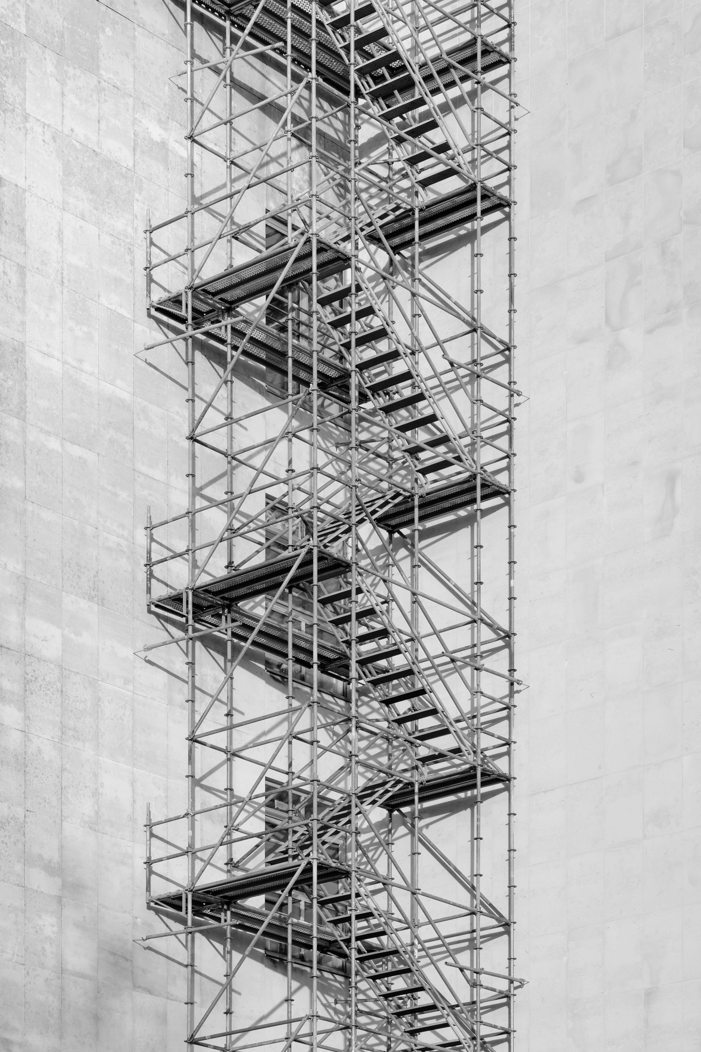
When might you use a semi-structured interview?
According to Bernard (1988), semi-structured interviews are best used when you won't get more than one chance to interview someone and when you will be sending several interviewers out into the field to collect data.
Notes:
When to use semi-structured interviews
Semi-structured interviewing, according to Bernard (1988), is best used when you won't get more than one chance to interview someone and when you will be sending several interviewers out into the field to collect data.
The semi-structured interview guide provides a clear set of instructions for interviewers and can provide reliable, comparable qualitative data.
Semi-structured interviews are often preceded by observation, informal and unstructured interviewing in order to allow the researchers to develop a keen understanding of the topic of interest necessary for developing relevant and meaningful semi-structured questions.
The inclusion of open-ended questions and training of interviewers to follow relevant topics that may stray from the interview guide does, however, still provide the opportunity for identifying new ways of seeing and understanding the topic at hand.

Slide 37
Benefits of semi-structured interviews
Many researchers like to use semi-structured interviews because questions can be prepared ahead of time. This allows the interviewer to be prepared and appear competent during the interview.
Semi-structured interviews also allow informants the freedom to express their views in their own terms.
Semi-structure interviews can provide reliable, comparable qualitative data.
Notes:
what are the benefits of semi-structured interviews
Many researchers like to use semi-structured interviews because questions can be prepared ahead of time. This allows the interviewer to be prepared and appear competent during the interview.
Semi-structured interviews also allow informants the freedom to express their views in their own terms.
Semi-structure interviews can provide reliable, comparable qualitative data.

Slide 38
Recordings
Interviews, outpatient visits, focus groups can be audio-recorded
Often these are professionally transcribed for analysis
Generally, never want to analyze these transcripts without listening to the recording
Notes:
what are the benefits of focus groups
Ability to produce a large amount of data on a topic in a short time
Access to topics that might be otherwise unobservable
Can insure that data directly targets researcher's topic
Provide access to comparisons that focus group participants make between their experiences. This can be very valuable and provide access to consensus/diversity of experiences on a topic

Slide 39
Observation
Interviewing
Collecting texts and artifacts
Notes:
What are the different types of qualitative methods?
Observation
Interviewing
Collecting Texts and Artifacts

Slide 40
Benefits of collecting documents
Written policies, protocols, goals, milestones and their achievement, meeting minutes, tools teams create
Not often the primary data in qualitative health research, but can be informative, particularly in policy research
Can help you understand how a state, system, and / or practice functions and the policies that influence work
Notes:
, how Medicaid policies have changed SUD payment, which may affect SUD treatment facilities

Slide 41
Qualitative research is iterative
4

Slide 42
Crabtree BF, Miller WL. (Editors). Doing Qualitative Research in Primary Care: Multiple Strategies (2nd Edition). Newbury Park, CA: Sage Pub, 1999.

Slide 43
Thanks!
Do you have questions?
You can find me at
cohendj@ohsu.edu
@DebCohenPhD

Slide 44
Application of qualitative methods
Two-part lecture: Part II
Deborah J. Cohen Ph.D.
Oregon Health & Science University
Portland, OR

Slide 45
Application of qualitative methods to research on multilevel interventions
2021 Multilevel Intervention Training Institute
Deb Cohen, PhD

Slide 46
Hello!
I am Deb Cohen
I am a qualitative and mixed methods researcher, professor, and vice chair of research in the Department of Family Medicine at Oregon Health & Science University.
You can find me at cohendj@ohsu.edu

Slide 47
This is Murray and Lucy
They are cute and noisy. You may hear them in the background of this recording.

Slide 48
Today’s Agenda
1
2
3
4
Describe an evaluation of a multilevel intervention
Identify ways to use quantitative methods in evaluation
Identify the ways to use qualitative methods in evaluation
Identify examples of mixing methods
Notes:
What topics will this presentation cover
What is qualitative research
What is the usefulness of qualitative research methods
What are the different types of qualitative methods
I will take a more in depth look at two common qualitative methods
Observation
Interviewing
How can you learn more about qualitative methods and how might these methods be used in a capstone project?

Slide 49
An example of a Multilevel intervention
1
2
3
4

Slide 50





EvidenceNOW
Multilevel Intervention
Notes:
EvidenceNOW is an initiative funded by the AHRQ – the agency for healthcare research and quality. The goal of EN was rapidly disseminate and implement the ABCS of heart health or CVD prevention across the US.
To accomplish this, AHRQ funded 7 regional Cooperatives.
These regional Cooperatives spanned 12 states, and some were single state and some were multi-state regions.
These Cooperatives included a PI or lead organization and then partnerships with people and organizations that had or develop the capacity to engage practice:
(1) each Cooperative was task with engaging over 200 practices in their region. And, they were successful, as 1721 practices were engaged in EN. As you can see here, that means that over 5000 providers and 8.1 million patients were engaged in various ways in EN.

Slide 51
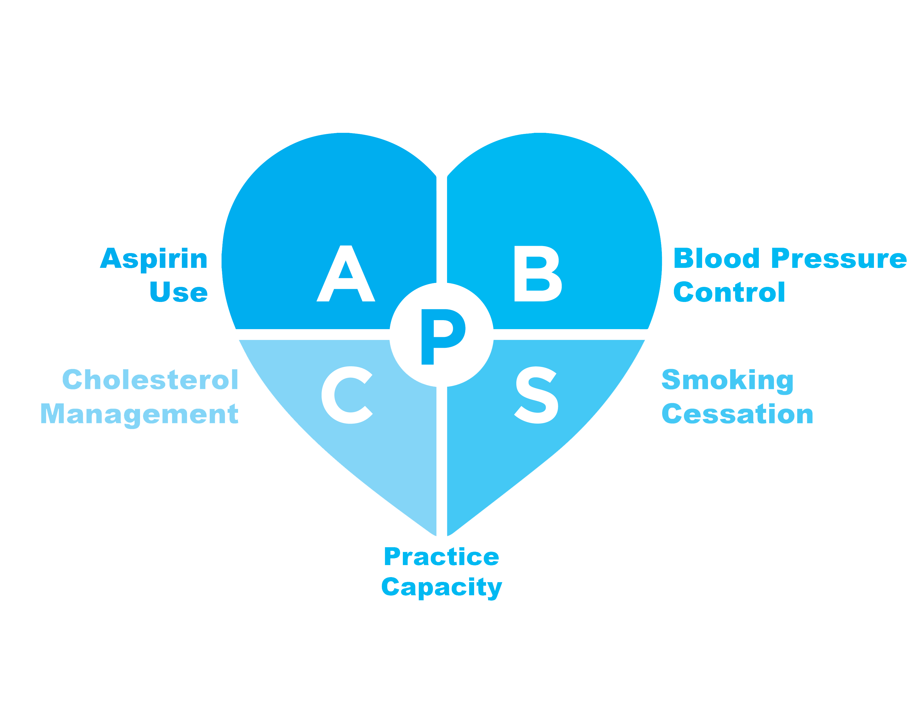

Slide 52
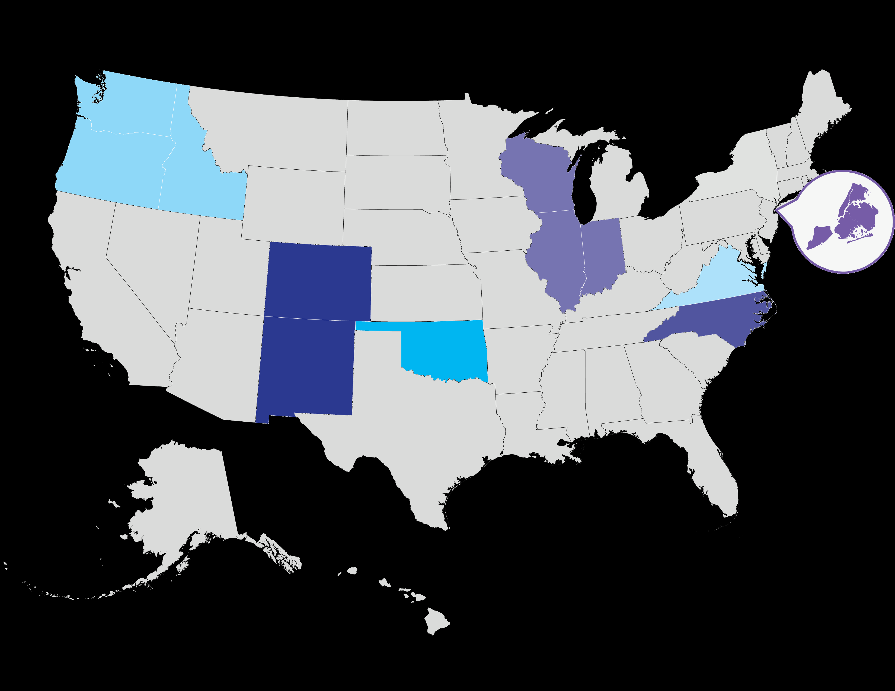
EvidenceNOW
Cooperatives

Slide 53
Ways to use Quantitative Methods to study multilevel interventions
2
3
4

Slide 54





Quantitative Data Sources

Slide 55
What types of multilevel research questions have we answered using quantitative methods?
What is practice-level performance on cardiovascular clinical quality metrics among smaller primary care practices in the US and what are the practice characteristics associated with better performance? In process, Marino et al.
What is the reduction in 10-year atherosclerotic cardiovascular disease risk associated with EvidenceNOW interventions? What is the corresponding reduction in medical costs? Under review, Lindner et al.
What are the factors associated with participating in external support interventions such as EvidenceNOW (e.g., ownership, adaptive reserve, burnout, disruptions). Under review, Hemler et al; Perry et al, in process, Balasubramanian et al.
To what extent do smaller practices use quality improving strategies (baseline) and to what extent does participating in EvidenceNOW improve the use of quality improving strategies? https://www.annfammed.org/content/16/Suppl_1/S35.long
Notes:
What types of research questions might you answer using qualitative methods?
How do patients experience the way prenatal care is delivered when a group visit is used?
What are the factors (barriers / facilitators) that influence why and how a practice integrated medical and psychosocial (behavioral health) care?
How do practices implementing a MAT innovation implement this new approach into practices? How does implementation vary across practices?
And how do clinical team members and patients experience MAT care?
How do variations in implementation explain outcomes and variations in outcomes of this program?

Slide 56
Ways to use Qualitative
Methods to study multilevel interventions
3
4
5

Slide 57







Qualitative Data Sources

Slide 58
What types of multilevel research questions have we answered using qualitative methods?
What it takes to recruit 200 regional primary care practices to a quality improvement initiative? https://www.ncbi.nlm.nih.gov/pmc/articles/PMC5832586/
What infrastructure is needed for large-scale quality improvement. https://pubmed.ncbi.nlm.nih.gov/29632224/
External support interventions
  What are they and how should we describe them (conceptual)? https://www.jabfm.org/content/34/1/32.long;
  What external support interventions did Cooperatives deliver to practices (empirical / conceptual)? https://implementationscience.biomedcentral.com/articles/10.1186/s13012-019-0876-4
  How are EvidenceNOW efforts aligned with the primary care extension? https://www.healthaffairs.org/doi/full/10.1377/hlthaff.2017.1100
Facilitator level strategies to assist practices with overcoming health IT challenges. https://pubmed.ncbi.nlm.nih.gov/29632224/
Practice level turnover and implications for participation in a quality improvement initiative like EvidenceNOW. https://www.ncbi.nlm.nih.gov/pmc/articles/PMC6819201/
Notes:
What types of research questions might you answer using qualitative methods?
How do patients experience the way prenatal care is delivered when a group visit is used?
What are the factors (barriers / facilitators) that influence why and how a practice integrated medical and psychosocial (behavioral health) care?
How do practices implementing a MAT innovation implement this new approach into practices? How does implementation vary across practices?
And how do clinical team members and patients experience MAT care?
How do variations in implementation explain outcomes and variations in outcomes of this program?

Slide 59
Ways to use Mixed Methods to study multilevel interventions
4

Slide 60
Numbers
Quantitative Data
Narratives
Qualitative Data
Notes:
What is the usefulness of qualitative research methods?
When you are trying to understand social life – how people act, behave and interact and how people make sense of the world in a deep and meaningful way, qualitative methods can be useful.
When wanting to learning about people, culture, or a professional setting – such as a health care setting it is helpful to study and appreciate both numbers [CLICK](quantitative data) and narratives, which are the observations and experiences of people in those setting. [CLICK](qualitative data)
When reporting findings, findings that report both numbers and narrative are highly compelling to many different types of “audiences.”

Slide 61
What types of multilevel research questions have we answered using mixed methods?
Primary care’s abilities and challenges in using EHR data for quality improvement. https://www.healthaffairs.org/doi/10.1377/hlthaff.2017.1254
What conditions and operational changes were linked to improvements in clinical outcomes, specifically smoking and blood pressure? Cohen et al., May / June issue of Annals of Family Medicine
How and why practice ownership influenced participation in external facilitation. Perry et al. under review
Effective facilitator strategies for clinical outcome improvement. Sweeney et al. in process
What was the comparative effectiveness of the EvidenceNOW Cooperative, and why were some Cooperatives more effective than others? Cohen et al., in process
Notes:
What types of research questions might you answer using qualitative methods?
How do patients experience the way prenatal care is delivered when a group visit is used?
What are the factors (barriers / facilitators) that influence why and how a practice integrated medical and psychosocial (behavioral health) care?
How do practices implementing a MAT innovation implement this new approach into practices? How does implementation vary across practices?
And how do clinical team members and patients experience MAT care?
How do variations in implementation explain outcomes and variations in outcomes of this program?

Slide 62
We used configurational comparative methods (CCMs) to analyze data that allowed us to connect data across levels
Notes:
what is the usefulness of conducting interviews for research
Interviewing is useful when you want to understand what is on peoples’ minds, meaning that you want to explore peoples’ attitudes, beliefs, experiences and stories and how people lend meaning to and make sense of some aspect of the world in which they live.

Slide 63
Data sources
Quantitative Data Sources
Practice level
  Practice attributes and characteristics (size, ownership, adaptive reserve) - survey
  Clinical metric improvement; we set this at 5-point and 10-point absolute improvement (EHR data)
Cooperative level
  Facilitation dose – tracked by facilitators
Qualitative Data Sources (transposed to quantitative data)
Practice level
  Identified operational changes made in the practice related to blood pressure management and smoking screening / brief cessation counseling - interviews
Notes:
What types of research questions might you answer using qualitative methods?
How do patients experience the way prenatal care is delivered when a group visit is used?
What are the factors (barriers / facilitators) that influence why and how a practice integrated medical and psychosocial (behavioral health) care?
How do practices implementing a MAT innovation implement this new approach into practices? How does implementation vary across practices?
And how do clinical team members and patients experience MAT care?
How do variations in implementation explain outcomes and variations in outcomes of this program?

Slide 64
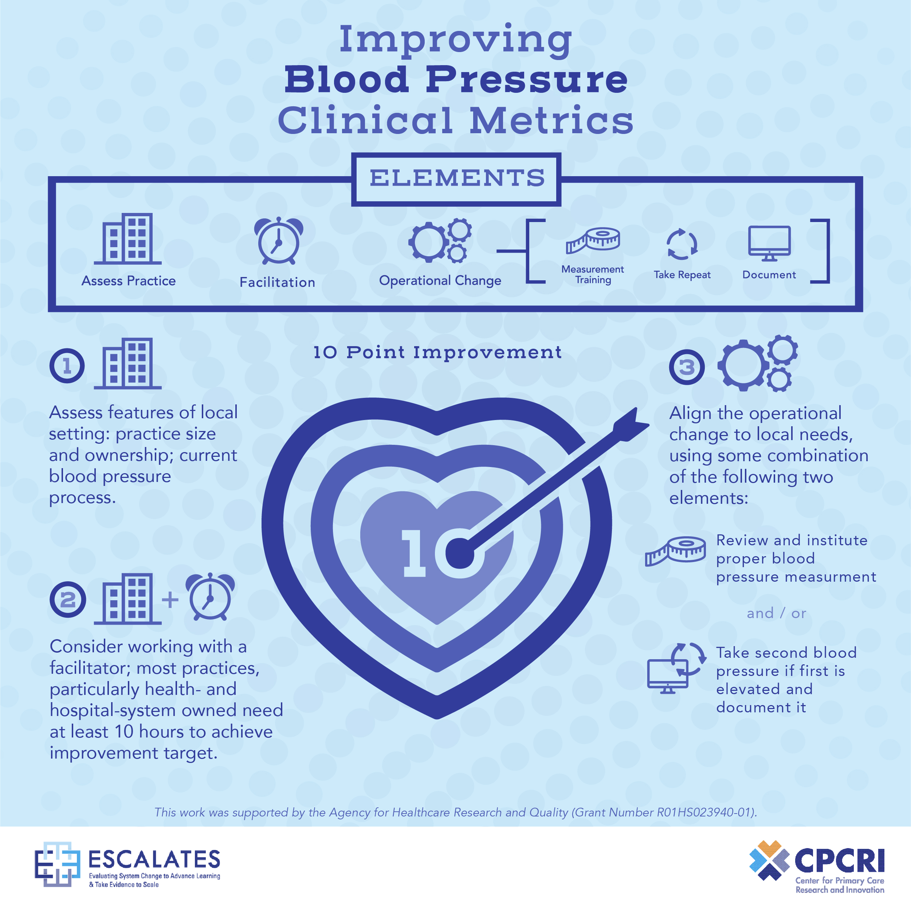

Slide 65
Conclusions
In multilevel designs, qualitative research can help identify
Practice members’ attitudes and experiences with an intervention and the feasibility of an intervention (observation; interviews)
Clinical decision-making processes (interviews)
Patients’ experiences and perceptions with an intervention (interviews)
What was implemented as part of a multilevel intervention (observation; interviews)
The strategies those delivering the intervention use to assist with change (observation, interviews), and it can
Enhance findings from other data sources and quantitative results
Notes:
In multilevel designs, qualitative research can:
help understand clinicians and their decision- making processes;
provide insights into patients’ perceptions and behaviors;
provide insights for understanding practices and the health care system, especially through case studies and ethnographies; and,
enhance understanding results from clinical trials.

Slide 66
Thanks!
Do you have questions?
You can find me at
cohendj@ohsu.edu
@DebCohenPhD

Slide 67


Principles and Practice of Mixed Methods
Two-part lecture: Part I
Lawrence A. Palinkas, Ph.D.
University of California San Diego, CA

Slide 68
Principles and Practice of Mixed Methods
MLTI Multilevel Training Institute
Module 10
Lawrence A. Palinkas, Ph.D.
Albert G. and Frances Lomas Feldman Professor of Social Policy and Health

Slide 69

What are Mixed Methods?
A methodology that focuses on collecting, analyzing, and mixing both quantitative and qualitative data in a single study or series of studies.
Its central premise is that the use of quantitative and qualitative approaches in combination provides a better understanding of research problems than either approach alone.
(Cresswell & Plano Clark, 2011)

Slide 70
Mixed Method Designs
Combine the qualitative and quantitative approaches into the research methodology of a single study or multi-phased study.
  Not merely parallel play
  A model of and for interdisciplinary research
Simultaneously answer confirmatory and exploratory questions, and therefore verify and generate theory in the same study (Teddlie & Tashakkori, 2003).

Slide 71
How to collect data in a mixed method study
Timing of data collection
  Simultaneously (qual + QUAN, QUAL + quan)
  Sequentially (qual → QUAN, QUAL → quan)
Weight or priority assigned to each method
  Priority to qualitative method (quan → QUAL)
  Priority to quantitative method (QUAN → qual)
  Equal priority to both methods (QUAL + QUAN)
Iterative data collection and analysis (e.g., QUAN_{dc/da} → qual_{da} → QUAN2_{dc/da}).

Slide 72
Design Type | Purpose | Data Collection Timing | Integration Timing or “Mixing” | Implementation Order
Exploratory/ Development | Instrument or taxonomy/ typology development | Sequential | Analysis and Interpretation | QUAL → quan
Convergence | Corroboration: analyze data from different sources regarding the same phenomenon | Concurrent | Interpretation | QUAL + QUAN
Complementarity | Understand a phenomenon more completely | Sequential | Analysis and Interpretation | QUAN → qual
Expansion | Assess different phenomenon using different methods | Embedded- Sequential | Analysis and Interpretation | QUAN(qual) or QUAL(quan)
Transformative | Discovery of new ideas and meanings regarding a particular phenomenon | Concurrent | Throughout | QUAL + QUAN
Creswell & Plano Clark, 2017

Slide 73

Mixed Methods Design Typology
Design type | Purpose
Convergence | Corroboration of findings (data + interpretation) generated through quantitative methods with findings generated through qualitative designs (Triangulation). Conversion of one type of data into another (Quantitizing/qualitizing)
Complementarity | Findings generated through qualitative methods answer exploratory questions while findings generated through quantitative methods answer confirmatory questions. Qualitative methods provide depth of understanding to complement breadth of understanding afforded by quantitative methods. Qualitative methods used to study process and context and quantitative methods to study outcomes.
Expansion | Findings from a qualitative study used to expand the depth of understanding of issues addressed in a quantitative study. Findings from a quantitative study used to expand the breadth of understanding of issues addressed in a qualitative study.
Exploratory/Development | Findings from a qualitative study used to develop questions or items for a quantitative survey or instrument, develop or modify a conceptual framework used to generate hypotheses for quantitative analyses, or develop an intervention or program that can be evaluated quantitatively.
Sampling | Use of one set of methods to identify participants who will provide data using the other set of methods (e.g., purposeful sampling of research participants for semi-structured interviews based on information collected from a quantitative survey; random sampling of a subpopulation of participants identified from interviews or participant observation as being of particular interest.

Slide 74
How to decide the function of mixed methods
When seeking answers to the same question (convergence)
When seeking answers to related questions (complementarity)
When findings based on one method raises questions that can be answered by use of the other method (expansion)
When findings based on one method are a prerequisite to use of the other method (development)
When one method can help to define or identify the participant sample for collection and analysis of data representing the other type of method (sampling)

Slide 75
Three ways of mixing quantitative and qualitative data
Merge the data
Qualitative data
Results
Quantitative data
Connect the data
Qualitative data
Quantitative data
Results
Embed the data
Results
Source: Cresswell &
PlanoClark, 2011
Quantitative data
Qualitative data

Slide 76
How to decide which way to mix
Merge the data when seeking answers to the same question.
Connect the data when seeking answers to related questions sequentially.
Embed the data when seeking answers to related questions simultaneously.

Slide 77
Reasons for using mixed method designs in multilevel intervention research
Quantitative methods to measure intervention and/or implementation outcomes and qualitative methods to measure process.
Qualitative methods to explore intervention steps and generate a conceptual model along with testable hypotheses and quantitative methods to confirm the validity of the model by testing the hypotheses.
Quantitative methods to examine intervention content and qualitative methods to examine context.
Quantitative methods to incorporate researcher perspectives and qualitative methods to incorporate consumer perspectives into research.
Use one set of methods to address limitations of the other.

Slide 78
Application of Mixed Method
Two-part lecture: Part II.
Lawrence A. Palinkas, Ph.D.
University of California San Diego, CA

Slide 79
Application of Qualitative Mixed Methods to Research on Multilevel Interventions
MLTI Multilevel Training Institute
Lawrence A. Palinkas, Ph.D.
Albert G. and Frances Lomas Feldman Professor of Social Policy and Health

Slide 80
Examples of Mixed Methods in MLI Research Implementation Research
Study | Design | Structure | Function | Levels
Social Networks and Implementation of Evidence-Based Practice in Public Youth-Serving Systems | Embedded Merged Connected | QUAL + QUAN | Convergence Complementarity Development | Individual Providers Clinic System
Innovation and the Use of Research Evidence in Public Youth-Serving Systems | Embedded Connected | Qual → QUAN | Complementarity Development | Providers Clinic System
Child STEPS Effectiveness Trial Dissemination and Implementation Study | Embedded | QUAN + qual | Complementarity Expansion Development | Patients Providers Clinic
An effectiveness-implementation hybrid trial targeting posttraumatic stress disorder and comorbidity | Embedded Merged | QUAN + qual | Complementarity | Patients Providers Clinic System
Sustainment of Prevention Programs and Initiatives | Merged Connected | Qual → QUAN + Qual | Development Convergence Expansion | Clinic System

Slide 81

Social Networks and Implementation of Evidence-Based Practice in Public Youth-Serving Systems
Background
Interpersonal contacts within and between organizations and communities are important influences on the adoption of new behaviors
Both the influence of trusted others in one’s personal network and having access and exposure to external information are important influences on rates of adoption of innovative practices
Aims
Describe the structure and operation of influence networks of public-youth-serving systems.
Determine the influence of these networks on decisions related to EBP implementation.
Identify the personal and contextual factors that influenced the operation of these networks.

Slide 82
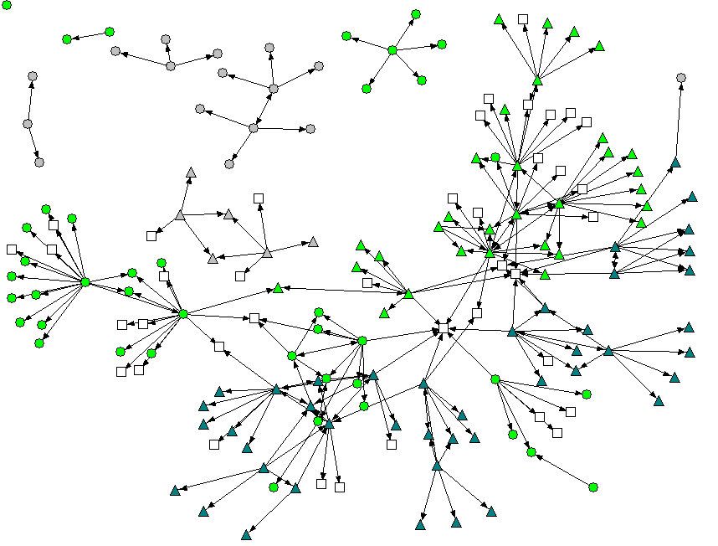
Mixed Methods Design
QUAL
themes
Systems leaders develop and maintain networks of information and advice based on roles, responsibility, geography, and friendship ties.
Social networking is central to implementation of EBPs through two mechanisms,
  Acquisition of information and advice related to EBPs
  Pooling of resources among agencies
Both mechanisms involve collaboration between organizations.
Stage of implementation is associated with network size, ties in urban areas, and members with high in-degree centrality.
Network size is associated with CDT participation.
QUAL
interviews
QUAN
Web-based survey
QUAN
SIC
Collection
Analysis

Slide 83
Innovation and the Use of Research Evidence in Public Youth-Serving Systems
Background
Little is known regarding when, how, and under what conditions research evidence is used in policy and practice that affect youth, and how its use can be improved.
How do policy-makers gain access to, evaluate, and apply research evidence in their decisions to implement innovative and evidence-based practices?
Aims
Understand and measure the use of research evidence (URE) by decision makers of public youth-serving agencies.
Prospectively determine whether use of research evidence predicts stage of EBP implementation

Slide 84
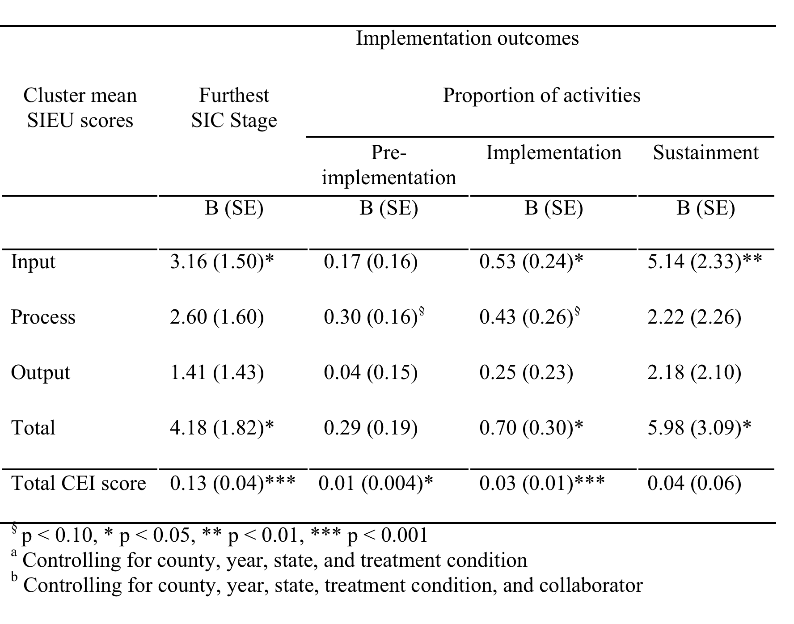
Mixed Methods Design
Qual
themes
Engagement in URE was positively associated with stage of implementation
  Especially in later phases/stages
Systems leaders use three other types of evidence when considering whether to seek and apply research evidence in making decisions:
  evidence of resources necessary and available for making use of research evidence (supply),
  evidence of the need for research evidence, usually obtained from local conditions of client and service needs (demand), and
  evidence gained from experience
Qual
interviews
QUAN
SIEU
QUAN
SIC
Collection
Analysis

Slide 85
Child STEPS Effectiveness Trial
Dissemination and Implementation Study
Background
Single disorder cases are rare; comorbidity is common
Children don’t stay put; problems shift during episode of care
Clinicians dislike rigidity & single focus; may not be sustainable
Modular mirrors what clinicians do with EBTs in practice, BUT provides structure and logic for decision-making
Aims
Compare effectiveness of 3 approaches to treating depression, anxiety, and conduct disorders in 8-13 yr olds
  Usual Clinical Care
  Standard Manualized Treatment (SMT)
  Modular Manualized Treatment (MMT)
Conduct a process and implementation evaluation of SMT and MMT

Slide 86
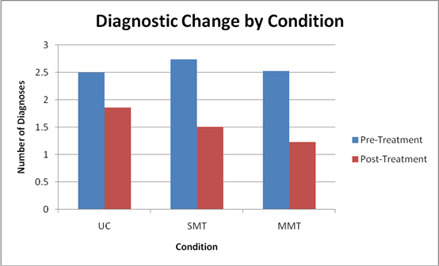
Mixed Methods Design
Qual
Interviews, observations
QUAL
themes
MMT was significantly more effective than SMT and TAU.
Short-term implementation associated with opportunity for use, clinician engagement in RCT, and clinician/intervention fit.
Clinician success and clinician/researcher interaction were key to short-term implementation.
93% of therapists continued to use EBTs 3 months after conclusion of RCT, but 93% of these therapists used them in modular fashion.
MMT allowed for more cultural exchange between therapists and researchers.
QUAN
Surveys
Qual
Interviews, focus groups
Qual
Themes
Collection
Analysis

Slide 87
An effectiveness-implementation hybrid trial targeting posttraumatic stress disorder and comorbidity
Background
Each year, 1.5–2.5 million Americans are so severely injured that they require inpatient hospitalization.
Multiple conditions including posttraumatic stress disorder (PTSD), alcohol and drug use problems, depression, and chronic medical conditions are endemic among physical trauma survivors.
Aims
Enhance the implementation of evidence-based screening and interventions for PTSD and comorbidity for 25 level Level I trauma centers nationwide.
Impact clinical effectiveness for patient outcomes while also targeting national trauma center implementation policies.

Slide 88
Mixed Methods Design
Table 2. American College of Surgeons policy and implementation process summary matrix
Implementation Process | Alcohol Screening and Intervention Requirement | PTSD Screening and Intervention/Referral Practice Guideline | Possible Patient-centered Care Informational Section Addition to Guideline | No Mandate or Guideline
Reach | Implied that screening should be available for all patients; unclear whether verification site visits check on this or if this data is available within trauma registries | Not addressed | Not addressed | Not addressed
Effectiveness | Pragmatic trial literature including DO-SBIS study supports (Cite) | Pragmatic trial literature supports | Some initial clinical trials, but insufficient for requirement or practice guideline not addressed | Insufficient literature Not addressed
Adoption Likely Adopter Groups | Early, Middle & Late Adopters required | Early Adopters likely to uptake | Early Adopters could explore uptake | No adoption likely
Adoption Centers familiar with topic (e.g., alcohol, PTSD) | Mandate enforces familiarity with issue | Guideline suggests familiarity with issue | Informational section introduces/disseminates patient-centered care | Familiarity optional
Implementation Centers required to implement procedure | Mandate requires; verification site visit confirms | Guideline only suggests appropriate practice, no implementation required | Informational section only introduces idea; no implementation required | No requirements
Implementation & Maintenance Adequate staffing and resources allocated | Not addressed; mandate does allow on-site providers to lobby institution for additional staffing and resources | Not addressed; Practice guideline does allow on-site providers to lobby institution for additional staffing and resources | Not addressed; Informational section does allow on-site providers to lobby institution for additional staffing and resources | No requirements
Implementation & Maintenance High quality procedures implemented and maintained | Not addressed unless specifically required by mandate; on-site provides may be aware of issues related to the variable quality of screening and intervention procedures delivered | Not addressed; on-site provides may be aware of issues related to the variable quality of screening and intervention procedures delivered | Not addressed; on-site provides may be aware of issues related to quality | No requirements
Qual
RAPICE
Qual
crystallization/themes
QUAN
National Trauma Center Behavioral Health Surveys
QUAN
Collection
Analysis

Slide 89
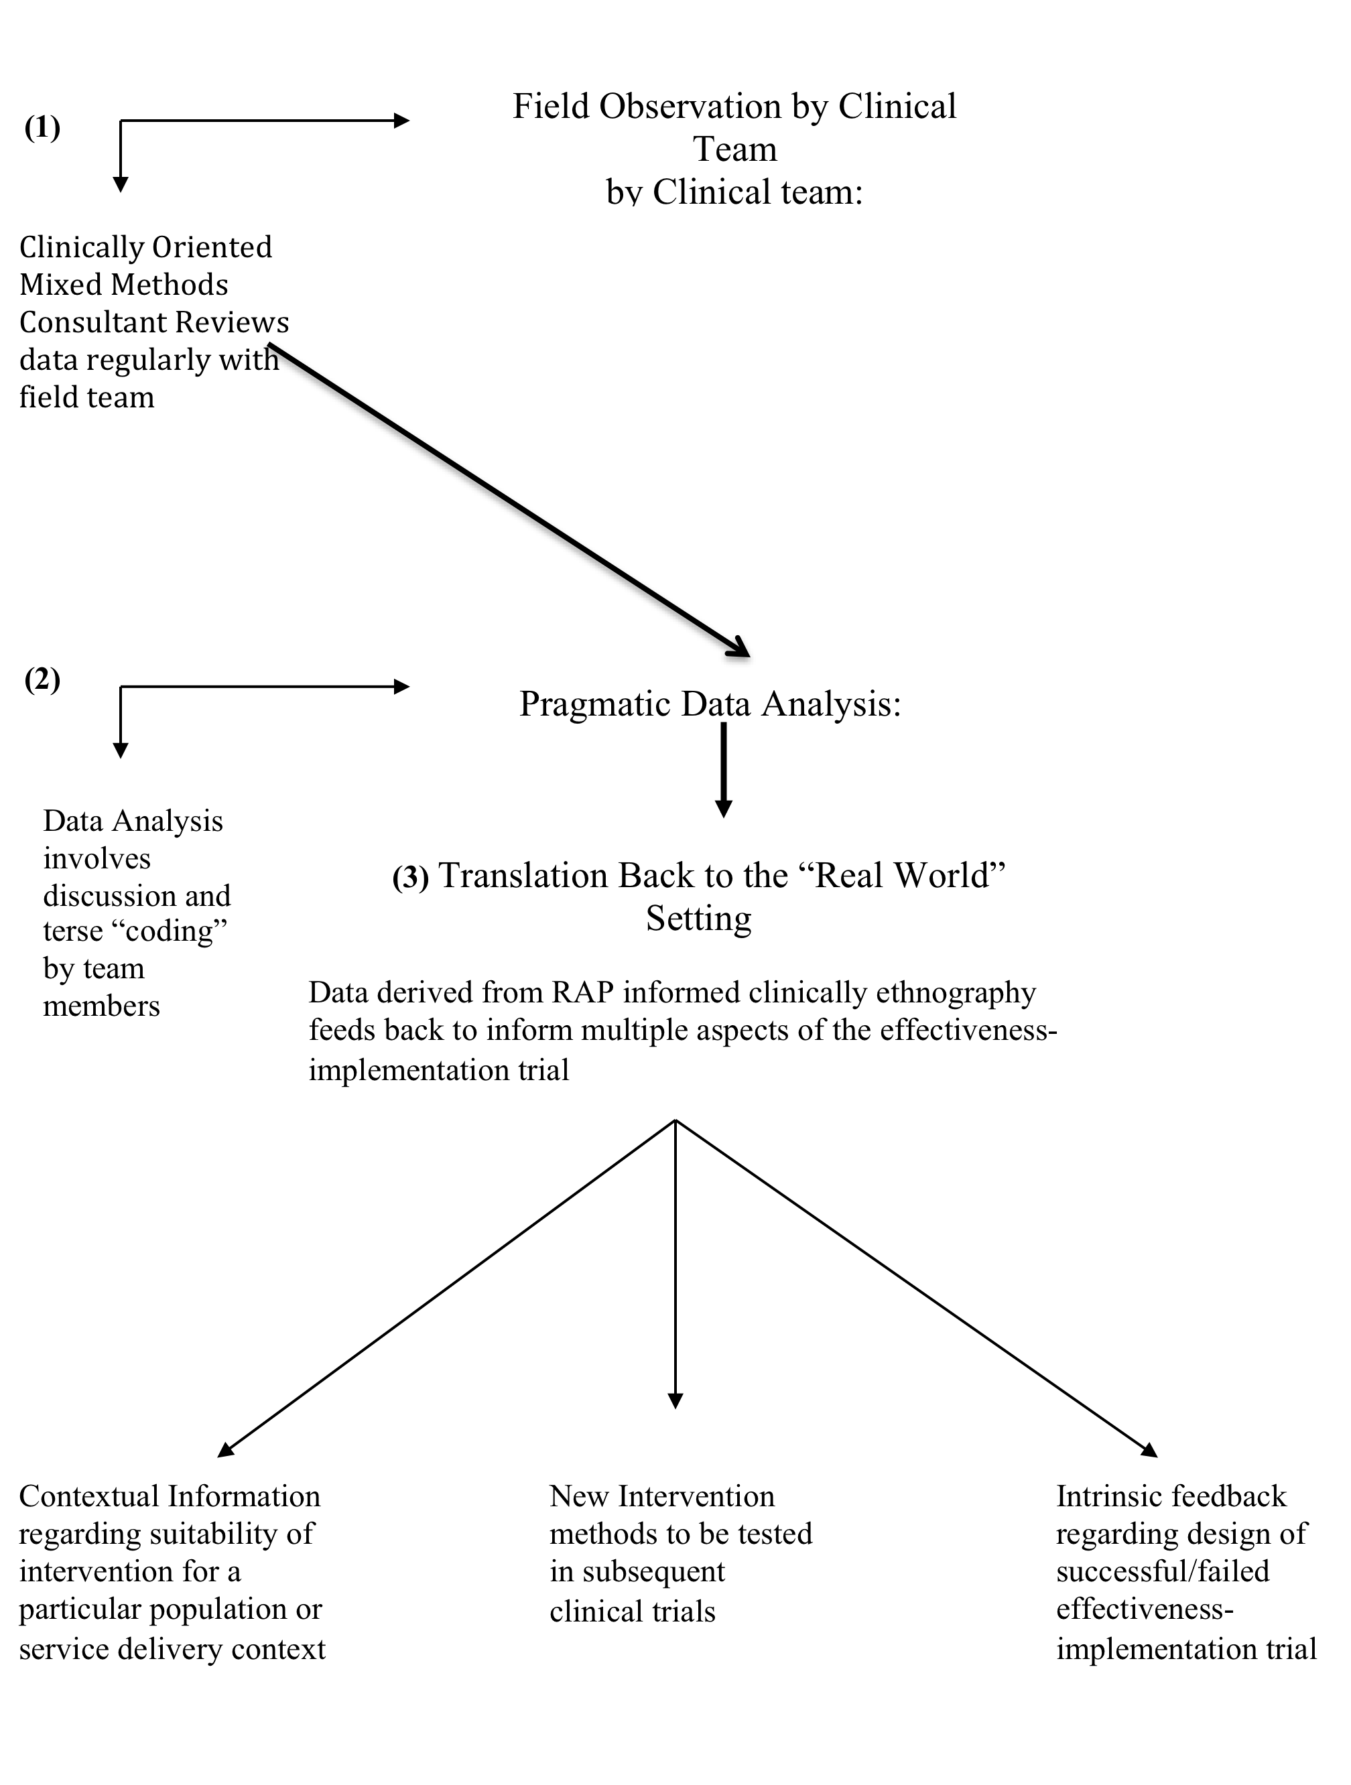
Rapid Assessment Procedure Informed Clinical Ethnography
Meets requirements for time-efficient data collection with minimal participant burden in pragmatic clinical trials
Involves interaction between ethnographically trained clinician who acts as participant observer (PO) and clinically oriented social scientist who acts as mixed methods consultant (MMC) (Palinkas & Zatzick, 2018; Zatzick et al, 2011)

Slide 90
Sustainment of Prevention Programs and Initiatives
Background
Sustaining prevention efforts directed at drug and alcohol abuse, HIV, and related mental health problems is currently one of the greatest challenges in implementation science.
A large knowledge gap exists regarding what is meant by the term “sustainment” and what factors predict or even measure sustainability of effective prevention programs and support systems, in communities, tribal nations, states, and the federal environment.
Aims
Identify core components and their interrelationships across time for sustainability of prevention programs and their support infrastructures.
Design a measurement system for monitoring and providing feedback regarding sustainment within SAMHSA.
Pilot test the predictability of the Sustainment Measurement System (SMS) and the feasibility and acceptability of this system to evaluate and improve sustainment likelihood.

Slide 91
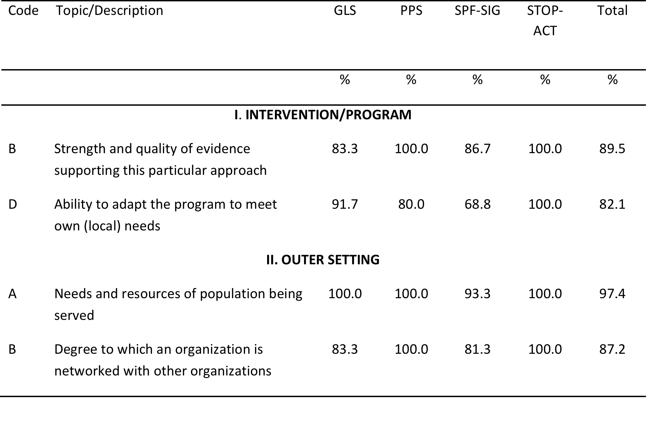
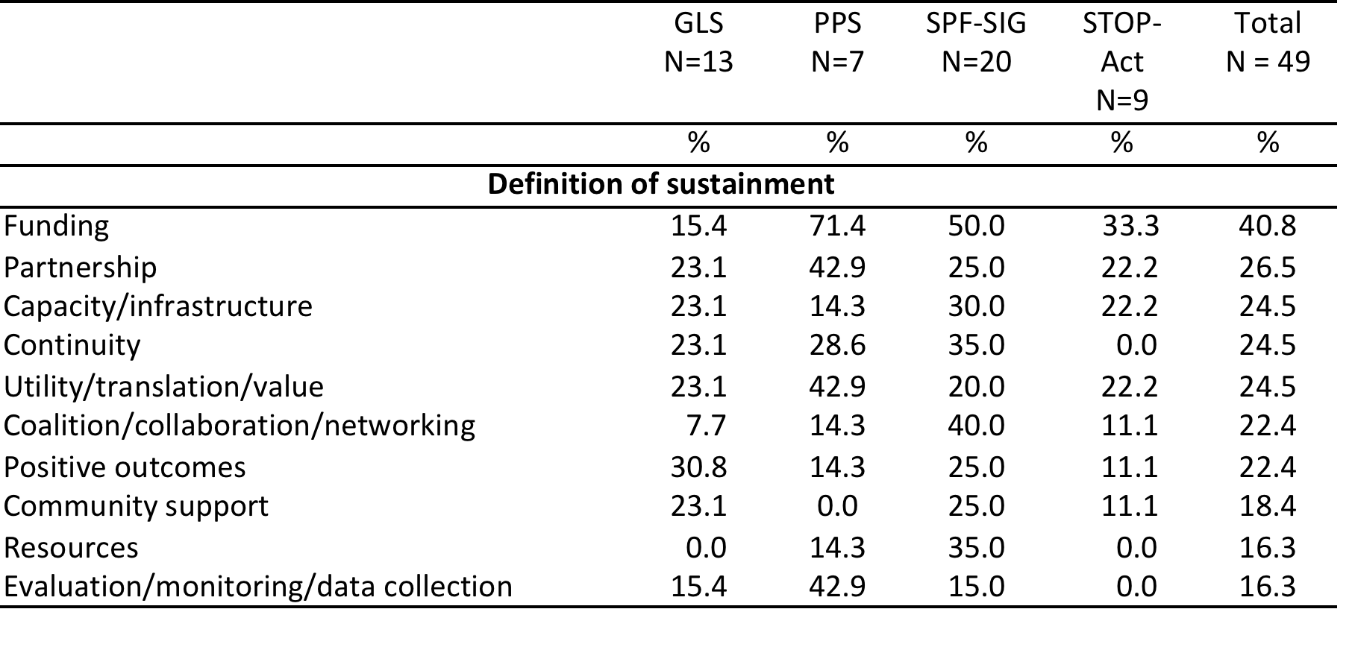
Mixed Methods Design 1
Sustainment Measurement System Scale
RESPONSIVENESS TO COMMUNITY NEEDS AND VALUES (n = 7)
The project delivered meets the needs of the intended target populations. | 1 2 3 4 5
The project addresses the behavioral health needs of the communities/populations being served. | 1 2 3 4 5
The project can be adapted to meet the needs of the communities or populations being served. | 1 2 3 4 5
The project is consistent with the norms, values and guiding principles of participating organizations. | 1 2 3 4 5
The project fits well with the values of the organization(s) responsible for sustaining it and the communities where it is being sustained. | 1 2 3 4 5
Participating organizations have a shared perception of the importance of the project. | 1 2 3 4 5
The current social or health issue addressed by the project is perceived as intolerable or unacceptable to the community. | 1 2 3 4 5
Qual
Interviews free lists
CFIR checklist
42 items
1 sustainment outcomes subscale
6 sustainability determinants subscales
Collection
Analysis

Slide 92
Mixed Methods Design 2
Subscale definition and items | Initial Model |  | Final Model
 | Item factor loading | R² | Item factor loading |  | R² | Mean | S.D.
Inter-item reliability of entire scale | .93 |  | .93
Factor 1. Financial stability | α = .75 |  | α = .81 |  |  | 2.58 | 1.04
The project is supported by federal, state or local government funding. | .090 | .008
Project is funded through non-profit, private, and/or non-governmental sources. | .579 | .335 | .582 | .339 | .339 | 1.94 | 1.32
Project has a combination of stable (i.e., earmarked) and flexible (i.e., discretionary) funding. | .745 | .555 | .748 | .559 | .559 | 2.40 | 1.34
Project has sustained funding. | .758 | .575 | .754 | .569 | .569 | 2.69 | 1.37
Diverse community organizations are financially invested in the success of the project. | .720 | .519 | .724 | .524 | .524 | 2.77 | 1.45
Project is financially solvent. | .585 | .342 | .581 | .338 | .338 | 3.15 | 1.44
QUAN
Sustainment Measurement System Scale
Construct | Continues to exist but adapted (n=55) | Continues to exist in same form (n=124)
Outcome
Continue to operate as described in original application | 4.00 (0.94) | 4.53 (0.70)***
Continue to deliver preventive services to intended population | 4.40 (0.95) | 4.81 (0.52)***
Continue to deliver evidence-based services | 4.24 (1.09) | 4.69 (0.65)***
Periodically measure fidelity of services delivered | 3.71 (1.49) | 4.29 (0.97)**
Global sustainment | 4.09 (0.99) | 4.58 (0.51)***
Determinant
Financial stability | 2.80 (1.17) | 2.49 (0.96)
Responsiveness to community needs | 4.48 (0.76) | 4.48 (0.57)
Responsiveness to community values | 4.72 (0.45) | 4.73 (0.38)
Coalitions, partnerships and networks | 4.05 (1.05) | 4.13 (0.67)
Organizational capacity | 4.19 (0.84) | 4.26 (0.68)
Organizational staff capability | 4.41 (0.87) | 4.65 (0.50)*
Implementation leadership | 4.16 (0.98) | 4.00 (0.74)
Evaluation, feedback & program outcomes | 4.01 (0.91) | 4.10 (0.65)
Collection
* p < 0.05; ** p < 0.01; *** p < 0.001
Analysis

Slide 93
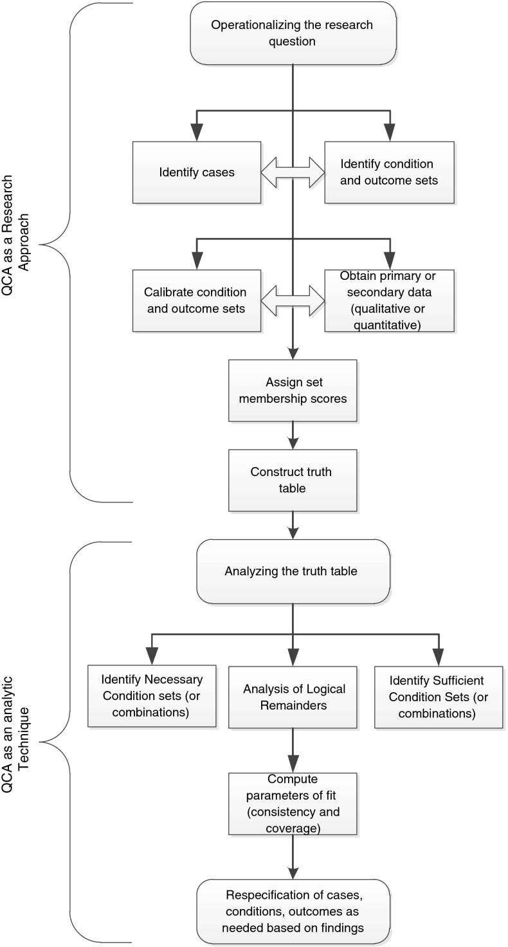
Mixed Methods Design 3
Initial minimizations based on Boolean logic found 14 configurations of a possible 32 to be relevant to sustainment.
Standard analysis found two configurational pathways with high consistency and moderate coverage, indicating that when these particular constructs combine, they are, as a unit, sufficient to produce sustainment: 1) community responsiveness and organizational capacity when combined with process, and 2) community responsiveness and organizational capacity when combined with coalitions, networks, and partnerships.
QUAN
Sustainment Measurement System Scale
QCA
Collection
Analysis

Slide 94
THAnk you
Questions??
For further information, contact palinkas@usc.edu

