Slide 1

2022 Multilevel Intervention Training Institute
February 24, 2022

Slide 2
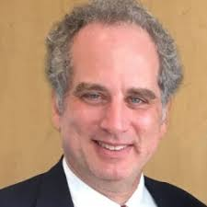

Quantitative Analytic Techniques. Part I
Thomas Belin Ph.D. University of California Los Angeles

Slide 3
Study Design and Quantitative Methods for Multi-Level Studies: Statistical Concepts and Experience from Community-Partnered Research
Thomas R. Belin
UCLA Department of Biostatistics
UCLA Department of Psychiatry and Biobehavioral Sciences

Slide 4
My background
Ph.D. in Statistics
Post-doc at UCLA beginning in 1991 (focused on cancer prevention and control research)
Faculty appointment since 1993 in Biostatistics
Joint appointment since 1995 in Psychiatry and Biobehavioral Sciences
Chair of Design Committee of Community Partners in Care (CPIC), a multi-level study on collaborative care for depression across social-service programs serving under-resourced areas of Los Angeles

Slide 5
Outline (for presentation)
Part 1 (Today):
Challenges to internal / external validity in a multi-level context illustrated through the Community Partners in Care (CPIC) study
Foundations of statistical inference and the role of randomization
Issues arising in design of multi-level studies
Part 2 (Two weeks from today):
Strategies for enhancing precision of inferences about intervention effects from experiments
Statistical issues arising from clustering / nesting of sub-units within units

Slide 6
Community Partners in Care (CPIC) background
General idea of collaborative care: Address unmet needs through health-services interventions
“Partners in Care” (Wells, et al. JAMA 2000) shows:
Screening for depression and staffing primary-care clinic with “depression care specialist” ⇒ better mental-health and better economic outcomes (fewer missed work days)
Effect sizes observed to be larger than average for African-Americans, Latinos
Successor studies show advantages of collaborative care for depression extend to other settings (elderly subjects, youth)

Slide 7
CPIC as a multi-level study
Central CPIC question: Can evidence-based depression treatments be disseminated by adapting collaborative-care framework to
Social service agencies
Substance-abuse treatment settings
Community-based primary-care clinics
Community-based mental-health treatment settings
Faith-based entities
Other community-trusted locations (e.g., parks and recreation programs, salons/barber shops, fitness centers)
Investigated by recruiting clients at risk of depression from programs serving under-resourced areas in L.A.
(> 80% of CPIC sample Hispanic or African-American)

Slide 8
CPIC design features
Enrollment of agencies (based on consent of agency decision-makers)
Randomization of sites/programs/agencies
Data collection from agency administrators
Enrollment of and data collection from agency providers
Field interviews where staff approach agency clients, administer informed-consent procedures, and perform initial eligibility screening (based on signs of depression)
Telephone surveys to collect client outcomes at baseline, 6 months, 12 months

Slide 9
Key CPIC references: Screening procedures, baseline client profile
Roughly 30% (1,322 of 4,440) of clients screened using PHQ-8 instrument exceeded pre-specified threshold making them eligible to participate in study of community-coalition intervention
(Miranda J, et al., Journal of General Internal Medicine, 2013)

Slide 10
Key CPIC references: 6-month outcomes
1,246 enrolled clients from 93 programs randomized to
Community Engagement and Planning (CEP) (active treatment), or
Resources for Services (RS) (comparison treatment)
Found significant effects favoring CEP on
one of two primary outcomes (44% vs. 51% with poor mental-health quality of life), and
multiple secondary outcomes
(Wells KB, et al., Journal of General Internal Medicine, 2013)

Slide 11
Key CPIC references: 12-month outcomes
Planned analyses (using linear / logistic mixed-models) continue to favor CEP over RS on mental-health related quality of life at both 6 and 12 months
Significance findings sensitive to analysis assumptions related to handling of time in longitudinal mixed-effect models and related to handling incomplete data
[“Conclusion: In contrast to 6-month results, no consistent effects of CEP on reducing the likelihood of poor MHRQL and behavioral health hospitalizations were found at 12 months. Still, given the needs of underresourced communities, the favorable profile of CEP, and the lack of evidence-based alternatives, CEP remains a viable strategy for policymakers and communities to consider.”]
(Chung B, et al., Annals of Internal Medicine 2014)

Slide 12
Key CPIC references: Program sampling frame
Stockdale, et al. (2016 Health Promotion Practice) reviews how:
Agency sampling frame assembled from (i) a prior study of partnering agencies serving mental-health / substance-use clients, (ii) a directory of non-profit organizations in L.A., and (iii) recommendations by lead partners (Healthy African American Families II and Queenscare Health and Faith Partnership)
Project steering committee (CPIC Council, comprised of roughly equal numbers of academic and community partners) developed work groups, including rating of agencies as prospects for participation (“A”, “B”, or “C”)
Agency administrators, after being contacted and consented, nominated programs within agencies anticipated to have eligible clients

Slide 13
Development of CPIC design
Discussion of ethics / scientific rationale for randomization (balance, equipoise, impact for evidence from study)
Discussion of possible levels for intervention (site-level: lacked resources to study many sites, individual-level: possible “contamination”) leading to CPIC Council vote for program-level randomization
Investigated statistical power with varying numbers of clients across programs (multi-level design)
Experimental design conceptualization / randomized-block design for pairs or small groups of programs
Community-partnered approach to random-number seed
[Belin TR, Jones A, Tang L, et al. Ethnicity and Disease, 2018]

Slide 14
Core elements of “Thinking like a statistician”
If intervention has effect, it will leave detectable traces on exposed units
The ability to detect smaller treatment effects depends on having a larger number of units under study
End-game perspective on how research findings will be summarized and interpreted calls for attention from the beginning to frameworks for causal inference
It is important to anticipate consequences of investigation unfolding at multiple levels (e.g., clients within programs, with corresponding potential for intracluster correlation)
Study’s overarching budget constraint induces sample-size tradeoffs (# of programs versus # of clients per program)

Slide 15
“Thinking like a statistician” (cont’d)
Uncertainty about the number of available participants at each site calls for flexibility to accommodate varying numbers of participants within clusters
Intuition about sources of variation can translate into appreciable gains in precision of inferences about intervention effects (e.g., “blocking” in design to control key sources of variation in the process of assigning treatments)
“Draw distinctions where there are important distinctions to be drawn” as an overarching scientific principle (cf. Heinz Pagels, The Dreams of Reason, 1988)

Slide 16
2. Foundations of statistical inference and the role of randomization

Slide 17
Frameworks for causal inference
Reference: P. Holland, “Statistics and Causal Inference,” 1986 Journal of the American Statistical Association
Draws extensively on “Rubin causal model” (Rubin 1978 Annals of Statistics):
each individual unit has potential outcomes under each possible treatment
potential outcomes viewed as innate characteristics of individual rather than as realizations of random process
treatment as a replicable set of actions, to be distinguished from an attribute
causal effect for an individual as a difference between potential outcomes

Slide 18
Implications of Rubin Causal Model
Effects of two different multi-component treatments will not in general be the same even if they share a salient feature (e.g., effect of action under unblinded conditions ≠ effect of same action under blinded conditions)
Assignment of treatment becomes a marker in time distinguishing
pre-treatment period (measures from which can serve as covariates)
post-treatment period (measures from which can serve as outcomes)
“The Fundamental Problem of Causal Inference”: Cannot observe outcomes for treatments not assigned
(In CPIC, ethical concerns about a “usual care” control led to choice to offer training to RS administrators, which at the same time fueled statistical concern about the ability to detect a treatment effect)

Slide 19
Statistical solution to the Fundamental Problem of Causal Inference
Statistical solution:
Work with a group of exchangeable units (i.e., units with all relevant characteristics measured, so could permute index of units with no loss of generality)
Assign one treatment to one group of units, another treatment to another group of units
Compare average outcomes
[Encompasses randomized controlled trials
Also motivates analyses of observational studies using “propensity-score” methods (Rosenbaum and Rubin 1983 Biometrika, 1984 JASA) ]

Slide 20
Statistical Solution to Fundamental Problem of Causal Inference: Comments
Cannot identify individual-level causal effect using statistical solution; can only identify average causal effects, either overall or within subgroups
Can assess whether average causal effect is different between men and women
Cannot determine whether treatment effect applicable to me is the same or different from the average causal effect for men
Inference more straightforward when it is possible to assume no interference between units (i.e., “Stable Unit Treatment Value Assumption” (SUTVA): outcome for a given unit depends on treatment assigned to that unit, not on treatments assigned to other units)

Slide 21
Statistical Solution to Fundamental Problem of Causal Inference: Comments (cont’d)
Study design aims to support ability to attribute effect to a single antecedent (“But for this, that would not have happened”)
Design also aims to collect evidence as efficiently as possible (i.e., in less time, or with fewer units studied), typically by striving for units to be as alike as possible except for intentional application of treatment
A randomized controlled trial is a desirable strategy for pursuing the statistical solution to the Fundamental Problem of Causal Inference, as unobserved characteristics are then known to be distributed randomly

Slide 22
Frequentist / Bayesian inference
Traditional “frequentist” study design based on setting “Type I error” = significance level of test, then optimizing power by minimizing risk of “Type II error”
Frequentist paradigm: influenced by “minimax” decision-analysis framework (minimize the maximum possible loss)
Robustness of inference achieved by guarding against worst-case scenarios / least-favorable distributions and developing strategies that work even in these scenarios (nonparametric methods)
Alternative “Bayesian” paradigm aims to minimize “expected loss” with respect to a prior distribution for unknown parameters
Robustness achieved by studying sensitivity to model specification / calibration to external information (“posterior predictive checks”)

Slide 23
Example of a study design decision dependent on overarching loss function
Should challenge trials (intentionally infecting individuals) be used to study prospective COVID-19 vaccines instead of waiting for people to become infected through traditional social interactions?
From J. Nathan-Kazis, “The Risks in the Race for Covid-19 Drugs,” Barron’s, May 4, 2020:
Dr. Stanley Plotkin, the 87-year-old virologist whose lab led to the development of the rubella vaccine, has a modest proposal: give test subjects Covid-19 on purpose.
The idea of exposing volunteers to Covid-19, or so-called challenge trials, was floated in late March in a paper in the Journal of Infectious Diseases by Marc Lipsitch, a leading infectious-desease epidemiologist at the Chan School of Public Health at Harvard University, and others. …
“If we do things the usual way, a lot more people will die by the time a vaccine is licensed,” says Plotkin, who consults for drugmakers, including some working on a Covid-19 vaccine.

Slide 24
The role of randomization in statistical inference (Fisher null, Neyman-Pearson framework)
Randomization induces distribution of test statistic under null hypothesis
(Fisher framework) Under null hypothesis of zero effect for all units, can calculate p-value = probability of a result as extreme or more extreme than observed test statistic assuming null hypothesis true
(Neyman-Pearson framework) Null: Zero average treatment effect
Alternative: Non-zero average treatment effect
(≠ Fisher null of zero effect for all units--led to scientific dispute)
Within Neyman-Pearson framework, randomization yields
unbiased estimate of average treatment effect / unbiased estimate of standard error internal to the data
significance tests, confidence intervals that have valid operating characteristics / statistical properties (Imbens & Rubin 2015)
Can extend to more complex designs, supporting ANOVA-based (or regression-model-based) significance tests

Slide 25
Philosophical foundations and study design
Limits of logic (e.g., inability to identify unit-level causal effects) and contextual realities (e.g., tradeoffs involving precision of information, timing of answers, resources available for research) force pragmatic choices that encode implicit priorities / ethical judgments
Practical study design calls for setting priorities (identifying primary hypotheses), enforcing evidentiary standards within an established protocol (scientific method), using insights about drawing inference from a sample to a population to pursue end-game strategy from the start (statistical science)

Slide 26
3. Issues arising in the design of multi-level studies

Slide 27
Questions relevant to study design in multi-level settings
How can investigators structure studies to make complex organizations as alike as possible?
If units self-select to participate in research, what are the implications for being able to generalize to other units? (Exchangeability / external validity)
In community-based research settings, how to address community distrust of randomization?

Slide 28
Questions relevant to study design in multi-level settings
How to approach design when inference involves intermediate endpoints (mediators) that are both outcomes of earlier interventions and predictors of subsequent outcomes? (Cochran 1957; Baron and Kenny 1986; Holland 1988; Wainer 1989; Angrist, Imbens, Rubin 1996; Rubin 2004, 2005; Valeri and VanderWeele 2013; Zhou, Elliott, Little 2019)
How to approach questions regarding sensitivity of inferences and potential for hidden bias? (Rosenbaum 1991, 1995; Gail 1996)
How to approach issues of treatment choice by study participants? (Long, Little, Lin 2004)

Slide 29
CPIC references
Belin TR, Jones A, Tang L, Chung B, Stockdale SE, Jones F, Lucas Wright A, Sherbourne CD, Perlman J, Pulido E, Ong MK, Gilmore J, Miranda J, Dixon E, Jones L, Wells KB. Maintaining internal validity in community partnered participatory research: Experience from the Community Partners in Care Study. Ethnicity and Disease, 2018; 28 (Suppl 2): 357-364.
Chung B, Ong M, Ettner SL, Jones F, Gilmore J, McCreary M, Sherbourne C, Ngo V, Koegel P, Tang L, Dixon E, Miranda J, Belin TR, Wells KB. 12-month outcomes of community engagement versus technical assistance to implement depression collaborative care. Annals of Internal Medicine, 2014; 161:10(S):S23-S34.
Miranda J, Ong MK, Jones L, Chung B, Dixon EL, Tang L, Gilmore J, Sherbourne C, Ngo VK, Ong MK, Stockdale S, Ramos E, Belin TR, Wells KB. Community-partnered evaluation of depression services for clients of community-based agencies in under-resourced communities in Los Angeles. Jrl of General Internal Med, 2013; 28: 1279-1287.
Stockdale SE, Tang L, Pulido E, Lucas-Wright A, Chung B, Horta M, Masongsong Z, Jones F, Belin TR, Sherbourne C, Wells KB. Sampling and recruiting community-based programs using community partnered participatory research. Health Promotion Practice, 2016; 17: 254-264.
Wells KB, Sherbourne C, Schoenbaum M, Duan N, Meredith L, Unützer J, Miranda J, Carney MF, Rubenstein LV. Impact of disseminating quality improvement programs for depression in managed primary care: a randomized controlled trial. JAMA, 2000, 283: 212-220.
Wells KB, Jones L, Chung B, Dixon EL, Tang L, Gilmore J, Sherbourne C, Ngo VK, Ong MK, Stockdale S, Ramos E, Belin TR, Miranda J. Community-partnered cluster-randomized comparative effectiveness trial of Community Engagement and Planning or Resources for Services to address depression disparities. Jrl of General Internal Med, 2013; 28: 1268-1278.

Slide 30
Intermediate endpoint/mediation references
Angrist, J.D., Imbens, G.W., Rubin, D.B. (1996). “Identification of Causal Effects Using Instrumental Variables” (with discussion), Jrl of the American Statistical Assoc, 91:444-472.
Baron, R.M., Kenny, D.A. (1986). “The Moderator-Mediator Variable Distinction in Social Psychological Research: Conceptual, Strategic, and Statistical Considerations,” Journal of Personality and Social Psychology, 51: 1173-1182.
Holland, P.W. (1988). “Causal Inference, Path Analysis, and Recursive Structural Equations Models,” Sociological Methodology, 18:449-484.
Rubin, D.B. (2004). “Direct and Indirect Causal Effects via Potential Outcomes,” Scandinavian Journal of Statistics, 31: 161-170.
Rubin, D.B. (2005). “Causal inference using potential outcomes: Design, modeling, decisions,” Jrl of the American Statistical Assoc, 100, 322-331.
Valeri, L., VanderWeele, T. (2013). “Mediation Analysis Allowing for Exposure-Mediator Interactions and Causal Interpretation: Theoretical Assumptions and Implementation with SAS and SPSS Macros,” Psychological Methods, 18: 137-150
Wainer, H. (1989). “Eelworms, Bullet Holes, and Geraldine Ferraro: Some Problems with Statistical Adjustment and Some Solutions” (with discussion), Journal of Educational Statistics, 14:121-140
Zhou, T., Elliott, M.R., Little, R.J.A. (2019). “Penalized Spline of Propensity Methods for Treatment Comparison” (with discussion), Jrl of the American Statistical Assoc, 114: 1-38.

Slide 31
Other references
Cochran, W.G. (1957). “Analysis of Covariance: Its Nature and Uses,” Biometrics, 13: 261-281.
Gail, M. (1996). “Statistics in Action,” Jrl of the American Statistical Association, 91: 1-13.
Holland, P. (1986). “Statistics and Causal Inference” (with discussion), Journal of the American Statistical Association, 81: 945-970.
Imbens, G.W., Rubin, D.B. (2015). Causal Inference for Statistics, Social, and Biomedical Sciences: An Introduction, New York: Cambridge University Press.
Long, Q., Little, R.J.A., Lin, X. (2004) “Causal Inference in Hybrid Intervention Trials Involving Treatment Choice,” Journal of the American Statistical Association, 103: 474-484.
Rosenbaum, P.R. (1991). “Discussing Hidden Bias in Observational Studies,” Annals of Internal Medicine, 1991; 115: 901-905.
Rosenbaum, P.R. (1995). “Discussion of ‘Causal diagrams for empirical research’ by J. Pearl,” Biometrika, 82: 698-699.
Rosenbaum, P.R., Rubin, D.B. (1983). “The Central Role of the Propensity Score in Observational Studies for Causal Effects,” Biometrika, 70: 41-55.
Rosenbaum, P.R., Rubin, D.B. (1984). “Reducing Bias in Observational Studies Using Subclassification on the Propensity Score,” Journal of the American Statistical Association, 79:516-524.
Rubin, D.B. (1978). “Bayesian Inference for Causal Effects: The Role of Randomization,” Annals of Statistics, 6: 34-58.

Slide 32

Multilevel Hierarchical Modeling
Donna Spiegelman, Ph.D.
Yale University
School of Public Health

Slide 33
The Analysis of Multilevel Interventions
Donna Spiegelman, Sc.D.
*Susan Dwight Bliss Professor of Biostatistics, Yale School of Public Health
*Director, Center for Methods in Implementation and Prevention Science (CMIPS), Yale School of Public Health
https://publichealth.yale.edu/cmips
*Professor, Department of Statistics and Data Science, Yale University
*Director, Interdisciplinary Methods Core, Center for Interdisciplinary Research on AIDS, Yale School of Public Health
*Assistant Director, Global Oncology Program, Yale Cancer Center
donna.spiegelman@yale.edu
617-835-5119/203-785-6271
Web: https://publichealth.yale.edu/people/donna_spiegelman.profile

Slide 34

Who am I?
Joint doctorate in biostat and epi
Statistician for NHS, NHS2 and HPFS
Measurement error and misclassification
HIV/AIDS treatment and care, DSM;
Cardiometabolic prevention, Nepal, India, Mexico, South Africa; cervical cancer, Nepal, Mexico
NIH Director’s Pioneer Award 2014-2020
Led to CMIPS

Slide 35

New Academic Programs in IS
New BIS Specializations in Methods for Implementation and Prevention Science
MS and PhD Biostatistics students matriculating this fall, as well as second year students, will be able to enroll in the new specializations in Methods Implementation and Prevention Science. Although other institutions offer various certificate programs, masters programs, PhD programs in implementation science, YSPH's are the very first program to provide rigorous training in implementation and prevention science methods, including training in the development methods to advance the field. Our first three Ph.D. students enrolled this past fall.
https://publichealth.yale.edu/cmips/educational-programs/

Slide 36
The Analysis of Multi-level Interventions
√ Who am I. What is the Yale School of Public Health’s new Center for Methods in Implementation and Prevention Science (CMIPS)?
Beaber et al. study of non-adherence to screening guidelines
Define notation, research questions
Basic characteristics of Beaber et al.
Multi-level models – model specification and interpretation of parameters
Link functions
Marginal vs. conditional models
Variance estimation
Quantification of variation due to random effects
Results of Beaber et al. – individual-level
Results of Beaber et al – facility-level
SAS code
Conclusions

Slide 37
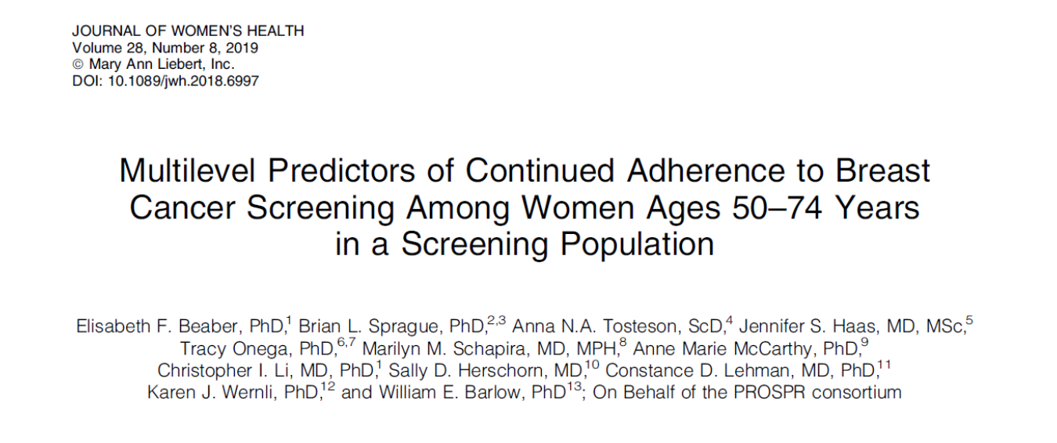
Example

Slide 39
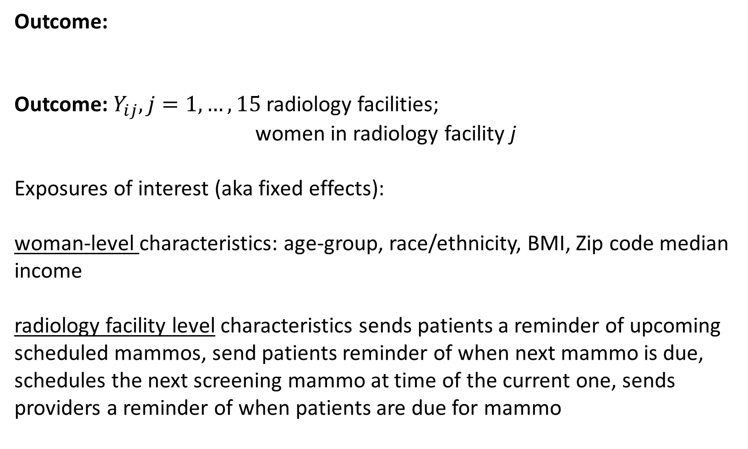
Outcome:
Outcome: $Y_{ij}, j=1,…,15$ radiology facilities;
women in radiology facility j
Exposures of interest (aka fixed effects):
woman-level characteristics: age-group, race/ethnicity, BMI, Zip code median income
radiology facility level characteristics sends patients a reminder of upcoming scheduled mammos, send patients reminder of when next mammo is due, schedules the next screening mammo at time of the current one, sends providers a reminder of when patients are due for mammo

Slide 40
Research Questions:
What women-level characteristics are associated with non-adherence to screening guidelines?
Given these, what radiology facility characteristics are associated with non-adherence to screening guidelines?
Does the impact of any radiology facility characteristics vary by women-level characteristics, e.g., race/ethnicity, education level, etc.? (epidemiologic effect modification)

Slide 43
The Multi-level model:
Good paper:
Synonyms:
Mixed regression model
Hierarchical model
Longitudinal model
Clustered data model
Best reference: ¹ Fitzmaurice GM, Laird NM, Ware JH. Applied longitudinal analysis. Vol 998: John Wiley & Sons; 2012.

Slide 44
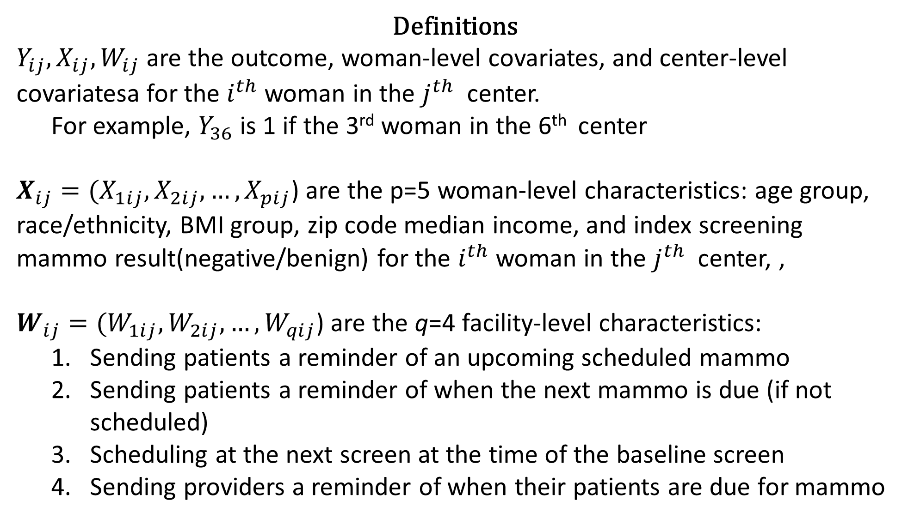
Definitions
$Y_{ij}, X_{ij}, W_{ij}$ are the outcome, woman-level covariates, and center-level covariatesa for the $i^{th}$ woman in the $j^{th}$ center.
For example, $Y_{36}$is 1 if the 3rd woman in the 6th center
$X_{ij}=(X_{1ij},X_{2ij},…,X_{pij}$) are the p=5 woman-level characteristics: age group, race/ethnicity, BMI group, zip code median income, and index screening mammo result(negative/benign) for the $i^{th}$ woman in the $j^{th}$ center, ,
$W_{ij}=(W_{1ij},W_{2ij},…,W_{qij}$) are the q=4 facility-level characteristics:
Sending patients a reminder of an upcoming scheduled mammo
Sending patients a reminder of when the next mammo is due (if not scheduled)
Scheduling at the next screen at the time of the baseline screen
Sending providers a reminder of when their patients are due for mammo

Slide 50
Variance estimation
Multi-level studies typically involve clustering by level. That is, there participants within the same facility are more likely to have similar outcomes than those in other facilities. Facilities in the same region are more likely to have similar outcomes than those in other regions, etc.
Although point estimates of effect (e.g., odds ratios, risk ratios) in GEEs can be validly estimated given sufficient data regardless of what this correlation structure is, the variance of these estimates will be wrong if the correlation structure is not correctly specified to some extent. By wrong, I mean that 95% confidence intervals will not cover the true value of the parameter, on average, 95% of the time, and p-values will not reject the null 5% of the time when the null is true, for a type I error rate of 5%.
By to some extent, I mean that the analysis needs to correctly indicate which groups of participant outcomes are independent from which other groups of participant outcomes (e.g., facilities, districts, states of Mexico). In modern GEE methods, as long as that is done, it has been shown, given sufficient data, that valid inference (Cis, p-values) will be obtained even when the correlation structure within dependent groups is mis-specified, as long as the robust or sandwich variance estimator is used.
Correct specification of the correlation structure within dependent groups provides a gain in statistical efficiency, i.e. narrower Cis, smaller p-values, all else being equal.
In multi-level studies, the most common correlation structure is ‘compound symmetry’ or ‘exchangeable’. This structure assumes that within a correlated group, the correlation is the same for all pairs. This is a realistic assumption for most multilevel data.
To avoid mis-specifying independent blocks, the highest level alone can be specified. A GEE model can be fit with the working independence correlation structure to obtain valid inference. This method may not work well if there are fewer than 50 clusters at the highest level.3 (Miglioretti DL, Heagerty PJ. Marginal modeling of nonnested multilevel data using standard software. Am J Epidemiol. 2007;165(4):453-463.)

Slide 51
Results of Bieber at al.
Using the marginal model, which will provide estimates of effects that are increasingly
smaller than those of the conditional model as the between facility variation increases,
they found that
Unadjusted non-adherence rates ranged from 4% to 29% across facilities,
with a median of 15%
After adjusting for women’s characteristics and those of research center,
facilities’ non-adherence rates ranged from 10% to 27%, with a median of 17%

Slide 52
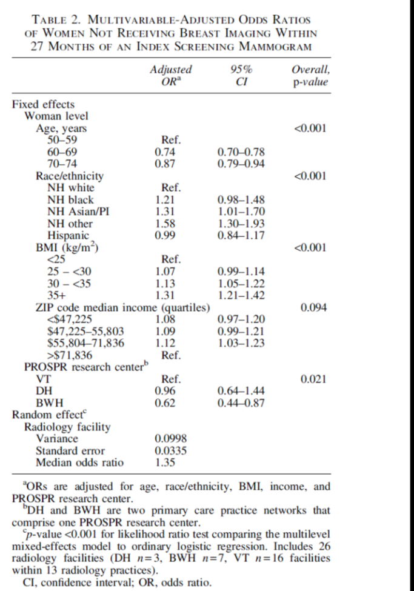

Slide 53
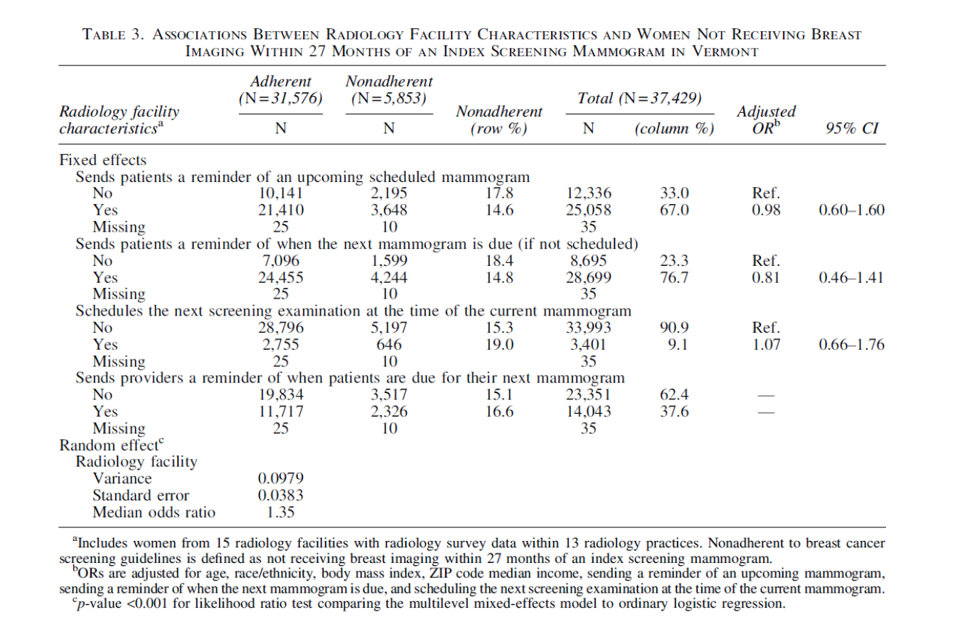


Slide 54
SAS code
Marginal model
Proc genmod;
Class facility;
Model nonadher = sex bmi income test race remind_schedule remind_date next_date md_date/link=logit var=binomial;
repeated subject=facility/type=indep;
Conditional
proc glimmix;
class facility;
model nonadher = sex bmi income test race remind_schedule remind_date next_date md_date/link=logit dist=binary/ solution;
random intercept / subject=facility;
run;
[Proc mlmixed;
Eta=beta0+betasex*sex + betabmi*bmi + betaincome*income +betatest*test + betarace*race
+betaremind*remind + betaschedule*schedule + betareminddate*remind_date
+ betanextdate* next_date + betamddate * md_date + b;
Expeta = exp(eta);
Pred_Nonadher = expeta/(1+expeta);
Model nonadher ~ binomial (1, pred_nonadher);
Random b ~ normal (0, s2b) subject=facility;]
Mlmixed syntax much more difficult – perhaps a more general procedure
Change link to log (i.e. link=log) in genmod and glimmix to get relative risks instead of odds ratios. Estimates from both models then have the same interpretation (Ritz and Spiegelman, 2004)

Slide 55
Conclusions:
The analysis of MLI studies is a special case of standard longitudinal regression methods and can be conducted using standard statistical software tools.
The variance of the random effects will decrease as the fixed effects associated with that level explain an increasing amount of the outcome variation.
When the logit link is used for assessing effects of binary outcomes, the marginal model will give smaller effect estimates than the conditional model – GLMM models are thus recommended. A causal inference perspective is consistent with the conditional modeling framework which estimates individual, rather than average, effects.
Thank you!

