Slide 1

2022 Multilevel Intervention Training Institute
March 10, 2022

Slide 2


Quantitative Analytic Techniques. Part II
Thomas Belin Ph.D.
University of California Los Angeles

Slide 3
Study Design and Quantitative Methods for Multi-Level Studies:
Statistical Concepts and Experience from Community-Partnered Research (Part 2)
Thomas R. Belin
UCLA Department of Biostatistics
UCLA Department of Psychiatry and Biobehavioral Sciences

Slide 4
Outline
Strategies for enhancing precision of inferences about intervention effects from experiments (with illustration of the role of blocking in Community Partners in Care study)
Statistical issues arising from clustering / nesting of sub-units within units
Challenges / threats to inference in multi-level studies and discussion of possible design and analysis strategies

Slide 5
1. Strategies for enhancing precision of inferences about intervention effects from experiments

Slide 6
Impact of design on precision of treatment-effect inference
Completely-randomized trial of 11 vs. 11
Outcome: QOL score
Mean SD
Treated: 12 29 16 37 28 16 44 8 22 31 10 23.00 11.73
Control : 10 28 17 35 25 16 39 6 21 26 7 20.91 10.92
______________________________________________________
Paired design, 11 subjects measured before and after intervention
Outcome: QOL score
Subject: 1 2 3 4 5 6 7 8 9 10 11 Mean SD
Treated: 12 29 16 37 28 16 44 8 22 31 10 23.00 11.73
Control : 10 28 17 35 25 16 39 6 21 26 7 20.91 10.92

Slide 7
Impact of design on precision of treatment-effect inference (cont’d)
Traditional analysis, completely-randomized: 2-sample t-test
Mean difference: 2.09 Pooled SD estimate (df =20): 11.33
T = 0.433 p = 0.670
_____________________________________________________
Traditional analysis for paired design: Paired t-test
Mean difference score: 2.09
SD of difference scores (df = 10): 1.87
T = 3.712 p = 0.004 (!!!!)
Exact same data values, but much sharper inference in paired design. Why? (Also, isn’t it true that more degrees of freedom for error-variance estimate yields more precise inference?)

Slide 8
Impact of design on precision of treatment-effect inference: Discussion
Variability can arise at multiple levels, owing to different sources
Viewing the latter study as featuring both variability between treatment arms and person-to-person variability, the QOL scores exhibited substantial person-to-person variability
Paired design, 11 subjects measured before and after intervention
Subject: 1 2 3 4 5 6 7 8 9 10 11 Mean SD
Treated: 12 29 16 37 28 16 44 8 22 31 10 23.00 11.73
Control : 10 28 17 35 25 16 39 6 21 26 7 20.91 10.92
Difference: 2 1 -1 2 3 0 5 2 1 5 3 2.09 1.87

Slide 9
Impact of design on precision of treatment-effect inference: Discussion (cont’d)
First taking differences, then calculating SD (as in paired analysis) has the effect of separating person-to-person variability from variability in treatment outcomes (effectively using each person as his/her own control)
The two-sample analysis had more degrees of freedom (20), but the variability in the individual values translated into an error-variance estimate of 11.33².
The paired analysis sacrificed 10 degrees of freedom for the error-variance estimate, but the reduction in residual variance more than compensated for the loss in degrees of freedom by yielding a much smaller error-variance estimate of 1.87², thereby yielding a much sharper inference for the same mean difference.

Slide 10
Impact of design on precision of treatment-effect inference: Discussion (cont’d)
Paired design could also be analyzed using randomized-block ANOVA, which would provide a separate estimate of person-to-person variability through the main effect of blocks (pairs) in addition to estimate of the error variance (treatment-by-block interaction, which could be used to testing the significance of the treatment effect):
Source df SS MS F p
Intervention 1 24.0455 24.0455 13.78 .004
Blocks (Pairs) 10 2551.4545 255.1455 146.17 < .0001
Error 10 17.4546 1.7455
Total 21 2592.9545
(More than 98% of variation in QOL explained by block/pair)

Slide 11
Experimental design: general comments
Other experimental-design contexts similarly take advantage of structure in data collection to improve precision for testing intervention effects
Especially relevant for precision to evaluate multi-level interventions are tradeoffs involving number of units, number of sub-units per unit as revealed through repeated-measures or mixed-model analysis
  Generally, for the same total number of ascertainments, it’s better to have more units and fewer sub-units per unit

Slide 12
Experimental design: general comments
Other decisions in the art and science of study design involve creative choices:
  Regarding factors that are anticipated to contribute to variation in outcomes in an experiment, how many such factors to include?
  What levels of each factor should be included?
Global cost constraint (or sample-size constraint) translates experimental design into constrained optimization problem
  Typically manifested in grant applications as power analysis for inferences about primary hypotheses

Slide 13
Guarding against threats to inference through blocking in randomized trials
By itself, randomization does not guarantee covariate balance
When there is a key characteristic that could confound inference, desirable to treat that characteristic as a blocking factor in study design and randomize within blocks
Example: When cultural differences are anticipated to influence study outcomes, could randomize by ethnicity
Example: When participants are enrolled individually over time, and when disruptive external events (e.g., 9/11 attacks, COVID-19 pandemic, protests surrounding George Floyd death) could affect study outcomes, could randomize within blocks of a modest fixed size of consecutive participants (e.g., within every consecutive set of 8, assign 4 to intervention, 4 to control)
  Avoids being in a position at any point in time where assignment to active treatment vs. control gets badly out of balance, in which case time could later confound estimates of treatment effects

Slide 14
Guarding against threats to inference from lack of covariate balance
When a characteristic is out of balance in randomized trial, can use analysis of covariance / regression and analogous strategies to adjust for imbalances
  Study of smoking cessation in head-and-neck cancer patients: control group has higher rate of smoking cessation than active treatment, but also revealed to have disproportionate numbers of individuals further along on “stage of change” (Gritz et al. 1993 CEBP, Belin and Normand 2009 Psychiatric Annals)
  Multi-site study of sexual functioning of breast-cancer survivors: After randomizing within blocks defined by study site, chemotherapy, and marital status, active interventions had higher baseline depression symptoms than control ⇒ use baseline depression as covariate (Stanton, et al. 2005 JCO)
Perspective: Control for what’s possible to control in design, control for the rest in the analysis

Slide 15
Threat to inference from covariate imbalance even more pressing with observational data
In observational studies, bias due to potential confounding emerges as much greater threat to causal inference than in randomized studies
Matching, covariance adjustment as strategies for mitigating bias due to potential confounding, but:
  With multivariate background characteristics, hard to find differently treated units with matching covariates
  Worry about inference from covariance adjustment being based on extrapolation across covariate distributions
Example in W.G. Cochran (1957 Biometrics)
Treatment: private vs. public school Outcome: SAT score
Covariate: family income

Slide 16
Threat to inference from covariate imbalance: illustrative example
High-profile example: Women’s Health Initiative (WHI)
(Prentice RL, et al., 2005 Biometrics, including discussion by Hernan, et al.; Hernan MA, et al., 2008 Epidemiology)
Observational data from Nurses Health Study (NHS) suggested that hormone replacement therapy would reduce cardiovascular events in post-menopausal women, motivating the investigation of HRT in the randomized WHI study, but part of WHI stopped early due to greater number of cardiovascular events in active-treatment arm
Re-analysis suggests that much of the difference could be explained by differences in time since menopause in the WHI sample and the NHS sample

Slide 17
The challenge of inference for mechanisms
High-profile example: Potential Vitamin C / cancer survival link
(Cameron E, Pauling L, 1976, 1978 PNAS; Moertel CG, et al. 1985 NEJM;
highlighted in Rosenbaum 1995 Biometrika)
Based on observational data on 100 patients taking high-dose Vitamin C and 1000 other patients matched for age, sex, and primary tumor type, Cameron and Pauling (double Nobel Prize winner in chemistry and peace) found survival benefit of ~10 months for Vitamin C takers
But subsequent double-blind randomized trial of Vitamin C versus placebo found no survival benefit
Respective design/analysis criticisms generated controversy
It remains possible that observational-study finding was attributable to lurking factor associated with taking Vitamin C

Slide 18
Application of blocking in CPIC
In an effort to achieve as much balance as possible in background covariates, pursued a blocking strategy for programs within agencies
Academic partners developed provisional blocks from information on domain of agency activity (e.g., substance use) and # of clients served (mostly pairs, sometimes triples where a large agency would be balanced by two smaller agencies)
Community partners reviewed provisional blocks based on expertise / greater familiarity with agency activity ⇒ revised blocks where one program (or set of programs) would receive CEP and another would receive RS

Slide 19
Results
CPIC collected data on 1,018 clients from 90 programs (average of 11.3 per program), yielding 6-month outcomes on 759 clients (average of 8.4 per program)
Among 17 client characteristics measured at baseline, none showed an imbalance at 0.05 significance level
  Although worth noting that p-values for imbalance as high as 0.20 (expected # out of 17 = 17 x 0.20 = 3.4, observed # = 5) can still induce meaningful confounding (Maldonado and Greenland 1993 American Journal of Epidemiology)
One of two primary outcomes (proportion below pre-specified threshold signaling poor mental-health quality of life) yielded significant findings at 6 months and 12 months
  Remained significant in adjusted analyses at 6 months

Slide 20
2. Statistical issues arising from clustering / nesting of sub-units within units

Slide 21
Intraclass correlation in nested sampling
Suppose data arise from nested sampling of sub-units within units (repeated measurements on individuals, students within classrooms, clients within programs) where it is anticipated that two sub-units within the same unit will be more similar to one another than two sub-units from separate units.
Can be conceptualized through the idea of “intraclass correlation”: sub-units from separate units are assumed independent, sub-units from the same unit are assumed to have correlation ρ.

Slide 22
Intraclass correlation arising in hierarchical representation of ANOVA model
Can arise from “random-effect” model or “components-of-variance” model where, in ANOVA model, unit-specific means assumed to vary from grand mean according to N(0,σ_{A}²) distribution and n sub-units within each unit assumed to vary around unit-specific mean according to N(0,σ²) distribution
Then variance of individual observations is σ_{A}² + σ² , covariance between two sub-units from the same unit is σ_{A}² , and correlation ρ between two sub-units from the same unit is then σ_{A}² / (σ_{A}² + σ²).
  In components-of-variance model, intraclass correlation is always non-negative; it is possible to have negative intraclass correlation, as when litter-mates in a pen are competing for insufficient food supply, with one’s gain being another’s loss, resulting in weight variation within pens being greater than variation between pens.

Slide 23
Implications of intraclass correlation in cluster randomized trials
If the intraclass correlation (ICC) is greater than zero, then the precision of estimation of the unit-specific means is less than would be expected if all sub-units were independent. In cluster sampling with n sub-units per unit and ICC = ρ, the “design effect” describing the ratio of the variance of the unit mean with correlated observations and the variance of the unit mean from the same sized simple random sample is
Deff = 1 + (n – 1) ρ
With clusters of size 10 and ICC = 0.1, then Deff = 1.9, implying that the effective sample size is only 1/1.9 = 52.6% as large as a simple random sample of the same size. With clusters of size 20, then Deff = 2.9, implying an effective sample size 34.5% as large as the nominal sample size.

Slide 24
Implications of intraclass correlation in cluster randomized trials (cont’d)
Intraclass correlation thus can have a major impact on statistical power in cluster-randomized trials. The situation is not as problematic when the ICC is close to zero, but even very modest levels of ICC can be impactful when cluster sizes are large (e.g., with ICC = 0.01 but n = 100 per cluster, the effective sample size is about half of the nominal sample size).
In practice, for a given total sample size, it is desirable for purposes of statistical power to have more units and fewer sub-units per unit.

Slide 25
3. Challenges / threats to inference in multi-level studies and discussion of possible design and analysis strategies

Slide 26
Data analysis in multi-level models
Hierarchical data structures are typically analyzed using random-effect or mixed-effect models (which accommodate both correlated sub-units within units and fixed effects to reflect systematic variation across covariate values) or “generalized estimating equation” (GEE) methods (assuming a “working” correlation structure where inference is robust to the choice)
Models assuming the same ICC for all pairs of sub-units within the same unit are described as having “compound symmetry” covariance or correlation structure.
Programs for analyzing multi-level data can also accommodate many other covariance structures, including “autoregressive” (especially applicable to repeated measures over time where correlation diminishes over time in multiplicative fashion) as well as correlation structures indexed by multiple parameters
Models can incorporate covariates at unit or sub-unit level; also can incorporate “cross-level” interactions (a.k.a. “contextual effects”)

Slide 27
Statistical power evaluations and adaptations for on-site screening in CPIC
Anticipated using multi-level models for primary analyses to account for clustering, lack of perfect balance in sample sizes
Evidence suggested that moderate departures from equality in program sample sizes would not have substantial impact on power to detect significant intervention effects
Anticipating uneven recruitment, investigated scenarios where 1/3 of clusters had average number of clients, 1/3 had 50% fewer, 1/3 had 50% more (e.g., 1/3 with 5 per site, 1/3 with 10 per site, 1/3 with 15 per site)

Slide 28
Statistical power evaluations and adaptations for on-site screening in CPIC (cont’d)
At the planning stage, anticipating attrition as well, provisional plans contemplated analyzing 4 to 12 individuals from each of 108 programs after identifying 5 to 15 eligible clients per program
Pragmatic screening considerations:
  If possible to screen all clients of a program, then do so
  If not (e.g., program clients standing in line to obtain a meal), use a randomizing device (specifically a table of random digits to determine how many clients to skip before choosing the next client), with attention to balancing broad time-of-day categories (recognizing that there might be systematic differences between breakfast clients and dinner clients)

Slide 29
Interplay of statistical-design/CPPR principles
Belin, et al. (2018 Ethnicity and Disease) emphasizes community-partnered participatory research (CPPR) principles, underscoring need for partnered research to build on a foundation of trust
Seemingly minor technical issues (e.g., choice of seed for randomization) can have broader implications:
  For the worse if partnership is ignored (e.g., leading to perceptions of cutting corners, leaving academic partners in control)
  For the better if partnership is embraced (sharing control, diffusing responsibility for intervention assignment if participants unhappy)
Innovative strategies for cultivating trust in community-partnered research need not be technically difficult
With imperative for solid inference foundation, flexibility also important
Anchoring plans to traditional experimental-design principles succeeded in imposing discipline on the process while leaving room for team-based strategies (e.g., blocking) to strengthen project’s scientific foundation
Principles of community-partnered participatory research do not inherently conflict with experimental design principles

Slide 30
Challenges: Post-treatment concomitant variables in experiments
Cochran (1957 Biometrics): In classic agricultural example:
plots of land as units,
pesticide treatments assigned at random,
crop yield from plots as the outcome of interest, and
an available measure of the number of eelworms (a pest) on the plot 6 weeks after treatment assignment,
should analyses to draw inferences about treatment effects be adjusted by the eelworm count?
With eelworm count being a post-treatment, concomitant (correlated with outcome) variable on the “causal pathway”, standard regression-model adjustment (ANCOVA adjustment) for eelworm count can be anticipated to bias estimates of treatment effect (adjusting away part of treatment effect)

Slide 31
Challenges: handling post-treatment variables
Modern approaches finesse this concern in different ways:
“Marginal structural models” (Robins, Hernan, Brumback 2000 Epidemiology): condition on post-treatment variables in analysis, as when treatment arms were not balanced on exposure to prophylaxis for an AIDS-defining opportunistic infection that was approved by FDA during randomized trial of an anti-retroviral therapy for AIDS patients
“Principal stratification” (Frangakis and Rubin 2002 Biometrics): condition on vector of potential intermediate endpoints, not just observed intermediate endpoints (e.g., for non-compliance in experiments, view observed data as latent-class mixture of potential outcomes for compliers, always-takers, never-takers)
[If compliance profile is an immutable characteristic of the unit, then it is post-treatment but no longer concomitant]

Slide 32
Causal inference via graphical modeling / path analysis of observational data?
Pearl (1995 Biometrika; 2009 text) advocates graphical-model analysis of observational data to infer causal relations
Rosenbaum (1995 Biometrika discussion) advocates for more scientifically conservative perspective:
“We do not say an inference is justified because it depends on assumptions. We distinguish warranted and unwarranted inferences. … Inference about treatment effects can sometimes be warranted by the following methods:
Care in research design, for instance, random assignment of treatments, may provide a warrant.
Insensitivity to substantial violations of assumptions may provide a warrant. For instance, the conclusion that heavy smoking causes lung cancer is highly insensitive to the assumption that smokers are comparable to nonsmokers (Cornfield, et al. 1959 JNCI, Rosenbaum 1993 JASA, 1995 text)

Slide 33
When are causal inferences warranted? (cont’d)
Rosenbaum (1995 Biometrika discussion cont’d):
(iii) Confirmation of numerous, elaborate predictions of a simple causal theory may at times provide a warrant. Here is Fisher’s advice, as discussed by Cochran (1965):
About 20 years ago, when asked in a meeting what can be done in observational studies to clarify the step from association to causation, Sir Ronald Fisher replied: ‘Make your theories elaborate.’ The reply puzzled me at first, since by Occam’s razor, the advice usually given is to make theories as simple as is consistent with known data. What Sir Ronald meant, the subsequent discussion showed, was that when constructing a causal hypothesis one should envisage as many different consequences of its truth as possible, and plan observational studies to discover whether each of these is found to hold. ”

Slide 34
Discussion
Insights from statistical inference can help in the process of adopting an end-game perspective at the start of the research process
In addition to statistical considerations that arise in settings without nested sampling structure (such as the importance of striving for balance so that units exposed to different treatments have distributions of background characteristics that are as similar as possible), studies of multi-level treatments also call for consideration of the correlation structure among sub-units within the same units
Research sponsors regularly express interest in understanding mechanisms underlying intervention effects, but inference for intervention mechanisms can be sensitive to underlying assumptions, with scientific controversy surrounding proposed methodologies
  Theoretical frameworks can motivate choices of measurements, research focus (“Better to do a 100% job on a narrowly defined problem than an 80% job on a more broadly defined problem”)
  Planning to study sensitivity of inferences to perturbations of assumptions is good practice from both a scientific perspective and a “grantsmanship” perspective

Slide 35
References
Belin TR, Jones A, Tang L, Chung B, Stockdale SE, Jones F, Lucas Wright A, Sherbourne CD, Perlman J, Pulido E, Ong MK, Gilmore J, Miranda J, Dixon E, Jones L, Wells KB. Maintaining internal validity in community partnered participatory research: Experience from the Community Partners in Care Study. Ethnicity and Disease, 2018; 28 (Suppl 2): 357-364.
Belin TR, Normand SLT. The role of ANCOVA in analyzing experimental data. Psychiatric Annals, 2009; 39:753-759.
Cochran WG. Analysis of covariance: Its nature and uses. Biometrics, 1957; 13: 261-281.
Frangakis,C, Rubin DB. Principal stratification in causal inference,” Biometrics, 2002; 58:21-29.
Gritz ER, Carr CR, Rapkin D, Abemayor E, Chang LJC, Wong WK, Belin TR, Calcaterra T, Robbins KT, Chonkich G, Beumer J, Ward PH. Predictors of long-term smoking cessation in head and neck cancer patients. Cancer Epidemiology, Biomarkers, and Prevention, 1993; 2(3):261-269.
Maldonado G, Greenland S. Simulation study of confounder-selection strategies. American Journal of Epidemiology, 1993; 138: 923-936.
Pearl J. Causal diagrams for empirical research (w/ discussion), Biometrika, 1995; 82:669-710.
Robins JM, Hernan MA, Brumback B. Marginal structural models and causal inference in epidemiology. Epidemiology, 2000; 11(5): 550-560.
Rosenbaum PR. Discussion of ‘Causal diagrams for empirical research’ by J. Pearl. Biometrika, 1995; 82: 698-699.
Stanton AL, Ganz PA, Kwan L, Meyerowitz BE, Bower JE, Krupnick JL, Rowland JH, Leedham B, Belin TR. Outcomes from the Moving Beyond Cancer psychoeducational randomized, controlled trial with breast cancer patients. Jrl of Clinical Oncology, 2005; 23: 6009-60/18.

Slide 36
References (Vitamin C / cancer survival)
Cameron E, Pauling L. Supplemental ascorbate in the supportive treatment of cancer: Prolongation of survival times in terminal human cancer. PNAS, 1976; 73: 3685=3689.
Cameron E, Pauling L. Supplemental ascorbate in the supportive treatment of cancer: Reevaluation of prolongation of survival times in terminal human cancer. PNAS, 1978; 75: 4538-4542.
Moertel CG, Fleming TR, Creagan ET, Rubin J, O’Connell MJ, Ames MM. High-dose vitamin C versus placebo in the treatment of patients with advanced cancer who have had no prior chemotherapy: A randomized double-blind comparison. NEJM, 1985; 312: 137-141.
Rosenbaum PR. Discussion of ‘Causal diagrams for empirical research’ by J. Pearl. Biometrika, 1995; 82: 698-699.

Slide 37
References (Women’s Health Initiative)
Prentice RL, Langer R, Stefanick M, et al. Combined postmenopausal hormone therapy and cardiovascular disease: toward resolving the discrepancy between Women's Health Initiative Clinical Trial and Observational Study Results. Amer Jrl of Epidemiology, 2005; 162: 404–414.
Prentice RL, Pettinger M, Anderson GL. Statistical issues arising in the Women’s Health Initiative (with discussion) Biometrics, 2005; 61: 899–941.
Hernan MA, Robins JM, Garcia Rodriguez LA. Discussion on “Statistical issues arising in the Women’s Health Initiative”, Biometrics, 2005; 61: 922-930.
Hernán MA, Alonso A, Logan R, Grodstein F, Michels KB, Willett WC, Manson JE, Robins JM. Observational studies analyzed like randomized experiments: an application to post-menopausal hormone therapy and coronary heart disease. Epidemiology, 2008; 19:766-779.
Hoover RN. The sound and the fury: Was it all worth it? Epidemiology, 2008; 19: 780-782.
Stampfer MJ. ITT for observational data: Worst of both worlds? Epidemiology, 2008; 19: 783-784.
Prentice RL. Data analysis methods and the reliability of analytic epidemiologic research. Epidemiology, 2008; 19: 785-793.
Hernán MA, Robins JM. Authors’ response, Part 1: Observational studies analyzed like randomized experiments: The best of both worlds. Epidemiology, 2008; 19: 789-792.
Willett WC, Manson JE, Grodstein F. Author’s response, Part II. Epidemiology, 2008; 19: 793.
Prentice RL, Anderson GL. The Women’s Health Initiative: Lessons learned. Annual Review of Public Health, 2008; 29: 131-150.

Slide 38
Thank you
Tom Belin
tbelin@ucla.edu

Slide 39

Configurational Comparative Methods
Edward J. Miech, Ph.D.
Regenstrief Institute
Indianapolis, IN

Slide 40
Configurational Comparative Methods
A New Mathematical Approach for Cross-Case Analysis
Edward J. Miech
edward.miech@va.gov
@edmiech

Slide 41
Presentation Basics
Conceptual introduction (no prior knowledge assumed)
Necessarily incomplete (full course takes 5 days)
Three applied examples from implementation science

Slide 42
Brief Introduction
both implementation scientist and methodologist
FTE now split roughly 50/50 across the two areas
located in Indianapolis
primary affiliation with VA HSR&D/QUERI
also: Regenstrief Institute, Indiana University School of Medicine

Slide 43
Why use configurational analysis at all?

Slide 44
Project Scenario
project with relatively small sample size (say, n=12)
but dataset has relatively large number of factors (say, 40)

Slide 45
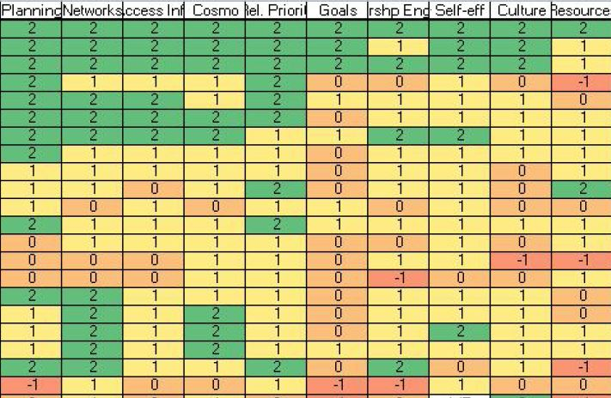
12 cases
40 factors (10 shown)

Slide 46
Project Scenario
relatively small sample size (say, n=12)
but dataset has relatively large number of factors (say, 40)
sample too small for traditional statistical modeling
data matrix too large for traditional qualitative analysis

Slide 47
  few cases, many factors problem

Slide 48
What if....?
there was another way to transform & analyze your data?
software already existed and was available at no charge?
could address the few cases, many factors problem?

Slide 49


Slide 50
Configurational analysis:
offers another way to transform & analyze your data
is distinct from qualitative or statistical approaches
opens up fundamentally different analytic possibilities

Slide 51
Applied Example

Slide 52
Technical Note: Method
All analyses in this presentation conducted with:
Coincidence Analysis (cna)

Slide 53
Technical Note: Software
All analyses in this presentation conducted with:
R
R package “cna”
R Studio

Slide 54
Applied Example
Original dataset had 8 health systems and 50 factors
Outcome had 3 levels: high, medium or low
Configurational analysis yielded two-factor model

Slide 55
Results

Slide 56
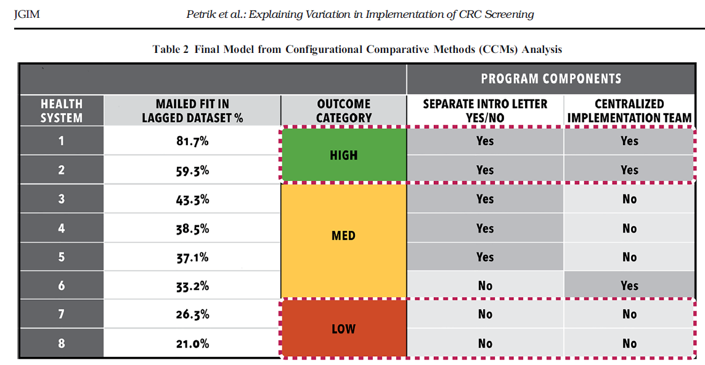

Slide 57
n=8 cases

Slide 58
Two Factors

Slide 59

─ Journal of General Internal Medicine. 2020;35:815-822

Slide 60
Configurational Analysis
Mathematical, inductive method
Causal complexity: combinations of conditions → outcome
Equifinality: multiple solution paths → outcome
Uses Boolean algebra and set theory
Operates from a regularity theory of causation

Slide 61
Configurational Analysis
Uses categorical or ordinal factors
Numbers represent membership in a “group” (i.e., set)
  e.g., Leadership Engagement= +2
Target: minimally sufficient/necessary conditions → outcome
Model output is at level of conditions, not variables

Slide 62
Configurational Analysis
umbrella term = “Configurational Comparative Methods” (CCMs)
includes:
Qualitative Comparative Analysis (QCA)
Coincidence Analysis (CNA)

Slide 63
Data Transformation
qualitative research: codes
statistical analysis: variables
configurational analysis: configurations

Slide 64
Transformation w/ Configurations
each case instantiates a configuration of specific values
configuration:
string of specific values (conditions)
each factor appears only once

Slide 65

Transformation w/ Configurations
analogy: beads on a string

Slide 66
each string is a “case”

Slide 67
each string is a “case”
each bead on the string represents a “condition”

Slide 68
each string is a “case”
each bead on the string represents a “condition”
conditions: forces that inhibit/facilitate/influence implementation

Slide 69
each string is a “case”
each bead on the string represents a “condition”
conditions: forces that inhibit/facilitate/influence implementation
each case is a string of conditions (“a string of beads”)

Slide 70

Transformation w/ Configurations
in example below: 1 case; 4 factors plus the outcome

Slide 71
Transformation w/ Configurations
in example below: 1 case; 4 factors plus the outcome
five beads (i.e., specific values)

Slide 72
Transformation w/ Configurations
in example below: 1 case; 4 factors plus the outcome
configuration for Facility 23:
S01=1 л S02=1 л S03=0 л S04=0 л OUTCOME=1

Slide 73
Transformation w/ Configurations
“configurational transformation” fundamental to CCMs
sets it apart from qualitative and statistical analysis
configurations permit systematic cross-case comparisons

Slide 74
Transformation w/ Configurations
compare cases with outcome vs. without outcome
identify conditions that uniquely distinguish Group A vs B
develop configurational models based on “minimal theory”
draws upon Boolean algebra and set theory

Slide 75
Project Scenario #2

Slide 76
Project Scenario #2
no single factor alone (“magic bullet”) explains outcome
certain conditions seem to work together in concert
“package” of conditions consistently yields outcome

Slide 77
Applied Example #2

Slide 78
Applied Example #2
Analytic dataset:
80 VA medical centers
for each case, data for 70 implementation strategies (1/0)
Outcome: higher vs lower HCV treatment starts in FY15

Slide 79
Applied Example #2
Figure that follows below shows a matrix display*
rows: individual VA medical centers
left-most column: outcome (=1 or =0)
remaining columns: individual implementation strategies
arranged “S01” to “S73”

Slide 80
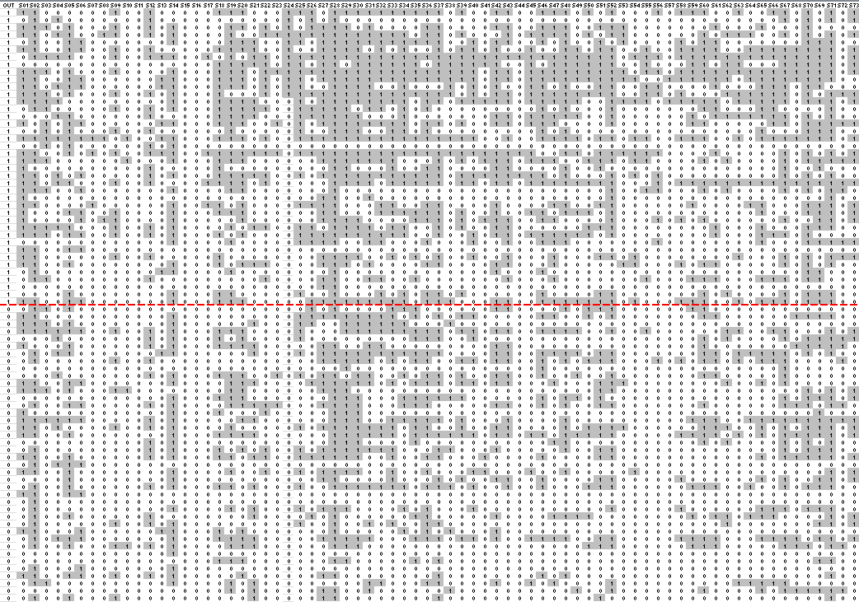

Slide 81
Applied Example #2
each configuration (“string of beads”) is 71 conditions long

Slide 83
Applied Example #2
each configuration (“string of beads”) is 71 conditions long
40 cases where Outcome = 1

Slide 85
Applied Example #2
each configuration (“string of beads”) is 71 conditions long
40 cases where Outcome = 1
another 40 cases where Outcome = 0

Slide 87
Applied Example #2
each configuration (“string of beads”) is 71 conditions long
40 cases where Outcome = 1
another 40 cases where Outcome = 0
analyze all 80 configurations to identify “minimal theory”

Slide 88
Applied Example #2
like finding a needle in a haystack
with a twist
the needle is multi-component
and only surfaces when several conditions appear together
kicker: there may be more than one needle

Slide 89
Results

Slide 90
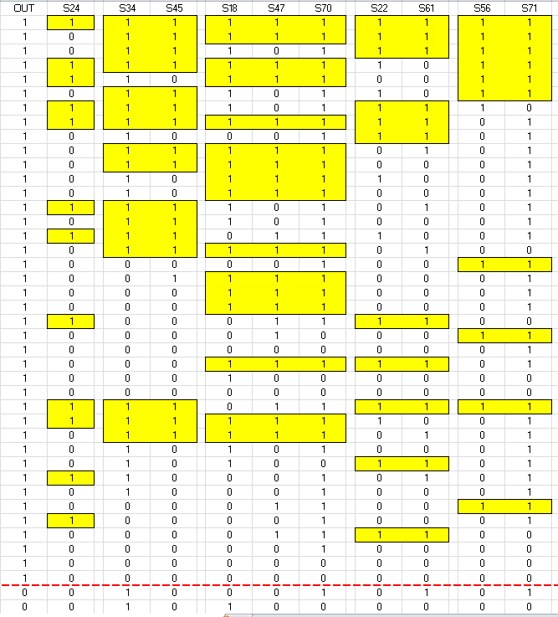

Slide 91
When S24 is present, outcome is always present

Slide 92

When outcome is absent, S24 is always absent

Slide 93
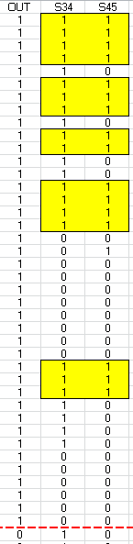
When S34=1 and S45=1, outcome is always present

Slide 94
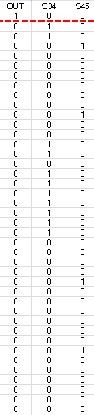
When outcome absent,
S34 and S45 never jointly present

Slide 95
Same true for :
S18=1 * S47=1 * S70=1

Slide 96
Same true for :
S18=1 * S47=1 * S70=1
S22=1 * S61=1

Slide 97
Same true for :
S18=1 * S47=1 * S70=1
S22=1 * S61=1
S56 * S71=1

Slide 98
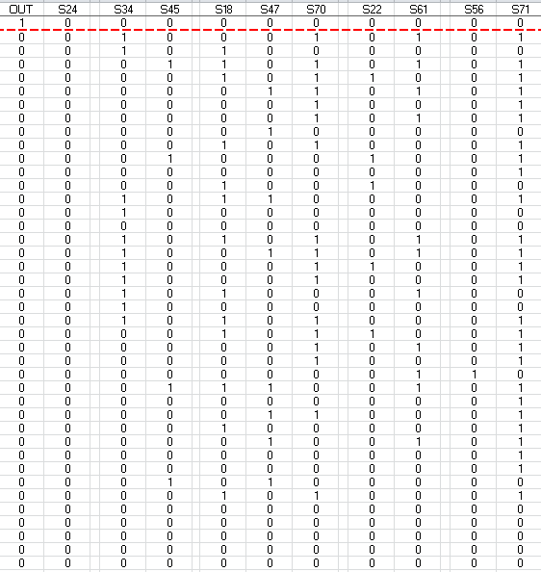
When outcome absent:
S18 and S47
never jointly present

Slide 99
When outcome absent:
S18 and S47
never jointly present
S70 and S22 and S61
never jointly present

Slide 100
When outcome absent:
S18 and S47
never jointly present
S70 and S22 and S61
never jointly present
S56 and S71
never jointly present

Slide 101
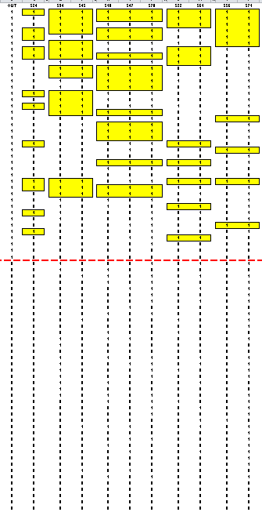
explains 80% (32/40) of cases
with 100% consistency (32/32)

Slide 102
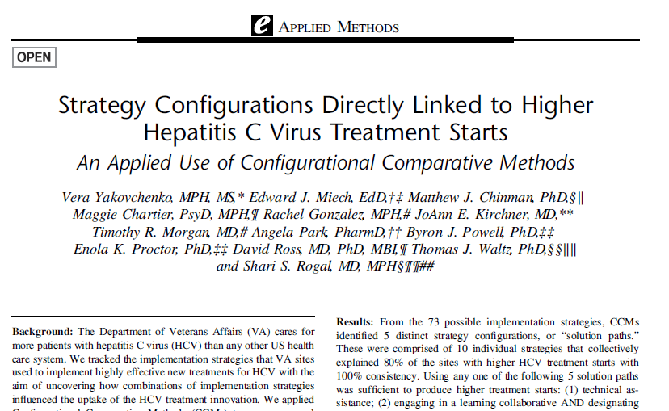
─ Medical Care. 2020;58(5):e31-38

Slide 103
Project Scenario #3
something already known to be important
less clear: how is it important?
is it necessary? is it sufficient? is it neither?

Slide 104
“Implementation Strategy 24” is sufficient
When S24 is present, outcome is always present

Slide 105
While S24 is sufficient
it is not necessary
...because other paths exist to Outcome=1 without S24

Slide 106
Project Scenario #4
local context can play pivotal role in implementation
but how to factor local context into models?

Slide 107
Applied Example #3

Slide 108


Slide 109
VA DCEP Project
Lead investigator: Laura Damschroder
Aim: Which combinations of obesity treatment options
offered by which types of VAMCs
lead to the best reach outcomes?
Reach: extent to which initiative reaches target population

Slide 110
Dataset: Cases
Cases = 100 VA Medical Centers
            50 higher-reach facilities
            50 lower-reach facilities

Slide 111
Dataset: Factors
29 facility-level categorical variables of interest
Related to three type of programming:
                MOVE!
                Pharmacotherapy
                Bariatric surgery

Slide 112
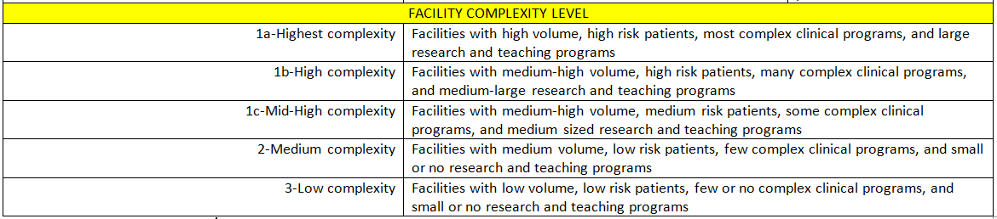
Dataset: 30th Factor

Slide 113
Results

Slide 114
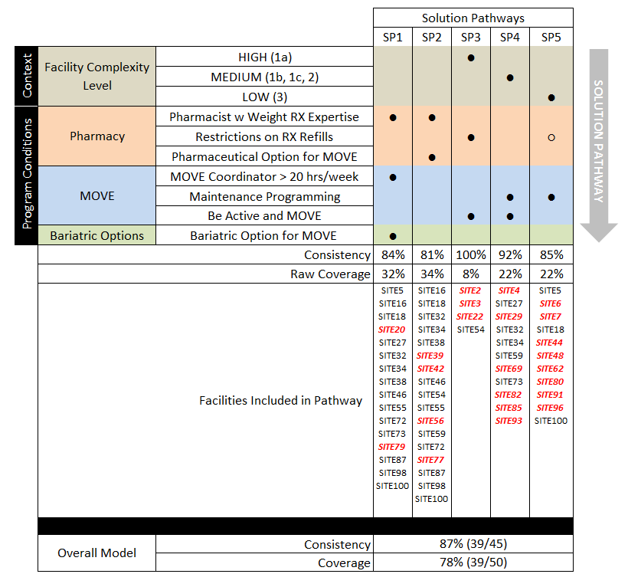

Slide 115
Equifinality
multiple paths lead to the same outcome
allows for different paths to apply in different contexts

Slide 116

https://www.researchsquare.com/article/rs-289551/v1

Slide 117
Conclusion

Slide 118

Methods Radar
Qualitative Analysis
Statistical Analysis

Slide 119
Methods Radar
Qualitative Analysis
Statistical Analysis
new “blip”: Configurational Analysis

Slide 120
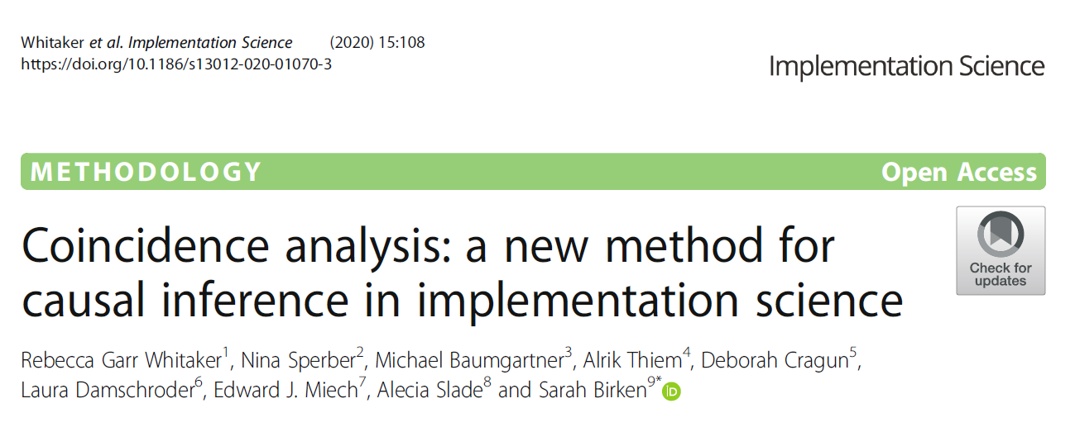
Next Steps
Read recent articles (like this one in Implementation Science)

Slide 121

Next Steps
take CCMs seminar
2017: in person
2020: virtual
2021: August 3-5

Slide 122
Next Steps
download software available at no charge:
R
R package “cna”
R Studio

Slide 123
Next Steps
Join “All Things Configured”
national community of practice devoted to CCMs
membership is voluntary with no requirements
monthly calls
> 100 members, half from outside of VA

Slide 124

Contact Information
edward.miech@va.gov
@edmiech

